Slide 1
Welcome

Slide 2
Welcome!
Topics that will be covered:
  Alcohol Law and Your Responsibility
  Recognizing and Preventing Intoxication
  Checking Identification
  Handling Difficult Situations
Notes:
Instructor Notes:
Welcome the class to training and review the content on the slide.

Slide 4
What Do You Think?
What Do You Like about Serving Alcohol?
Notes:
Instructor Notes:
Ask the class the question, “What do you like about serving alcohol?” Discuss the answers given. Point out that serving alcohol can let you show off a skill and help people have fun while you have fun, too! And you can make a nice living. But before you get to do those things, you need to understand alcohol service laws and your responsibility.

Slide 5
Objectives
After completing this topic, you will be able to identify the following:
  Costs of not serving alcohol responsibly
  Three types of liability related to alcohol service
  Laws for alcohol service
  Alabama State Laws
Notes:
Instructor Notes:
Discuss the course objectives.

Slide 6
Costs of Not Serving Alcohol Responsibly
What are the costs of not serving alcohol responsibly?
Human Costs
Legal Costs
Business Costs
Injuries and death
  Fines
  Lawsuits
  Criminal charges
  Loss of liquor license
  Loss of revenue
  Loss of insurance or increased costs
Notes:
Instructor Notes:
Ask the class, “What are the costs of not serving alcohol responsibly?” Discuss the answers given. Reveal the correct answers and present any information that was not discussed.

Slide 7
What Do You Think?
What does being liable mean?
A. Being licensed to do something
B. Being responsible for something
Why? Liability means you are legally responsible for something.
Notes:
Instructor Notes:
The answer is B.
Liability means you are legally responsible for something.

Slide 8
What Do You Think?
What are you responsible for when selling or serving alcohol?
A. Your actions
B. Your customers’ actions
Why? You are legally responsible for your actions—both the things you do and the things you don’t.
Notes:
Instructor Notes:
The answer is A.
You’re legally responsible for your actions—both the things you do and the things you don’t.

Slide 9
Types of Liability
The three types of liability that apply to you when selling or serving alcohol:
  Criminal liability
  Civil liability, including dram shop laws
  Administrative liability

Slide 10

Types of Liability
Criminal Liability
  You are responsible for making sure you don’t break alcohol laws
  If you do, you can be held responsible for committing a crime
  This is criminal liability
For what two actions will you be held criminally liable in most states?
  Serving someone who is underage
  Serving someone who is intoxicated
Notes:
Instructor Notes:
States, counties, cities, and towns write laws about how alcohol is supposed to be served. You are responsible for making sure you do not break these alcohol laws. If you do, you can be held responsible for committing a crime. This is criminal liability.
Ask the question, “For what actions will you be held criminally liable in most states?” Reveal the answers and discuss them.

Slide 11
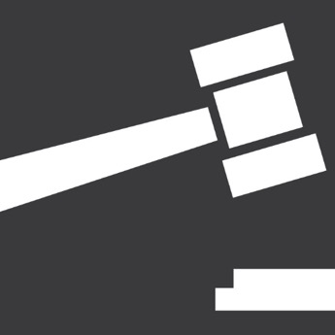
Types of Liability
What are the penalties related to criminal liability?
  Jail time
  Probation
  Fines
Notes:
Instructor Notes:
Ask the question on the slide. Reveal the answers and discuss them.

Slide 12
Types of Liability: Alabama
Complicity (Criminal liability based upon behavior of another)
Section 13A-2-23
A person is legally accountable for the behavior of another constituting a criminal offense if, with the intent to promote or assist the commission of the offense:
    (1) He procures, induces or causes such other person to commit the offense; or
    (2) He aids or abets such other person in committing the offense; or
    (3) Having a legal duty to prevent the commission of the offense, he fails to make an effort he is legally required to make
Notes:
Instructor Notes:
This is what Alabama states regarding complicity. Discuss this law with the class.

Slide 13

Types of Liability
Civil Liability
  Focuses on compensating people hurt by someone who was negligent
    Someone who does not serve responsibly is negligent
    They can be sued and forced to pay damages if they contributed to an injury

Slide 14
What Do You Think?
Can you be sued and forced to pay damages if you didn’t
cause the injury?
A. Yes
B. No
Why? Yes. You can be sued and forced to pay damages if you contributed to the injury OR if you did not prevent it.
Notes:
Instructor Notes:
The answer is A.
You can be sued and forced to pay damages if you contributed to the injury OR if you did not prevent it.

Slide 15
Types of Liability
Dram Shop Laws
  A special kind of civil liability for people who sell alcohol
  Allow a person who was not even at the business to sue for injuries caused by a guest drinking there
  Example
    A person has several drinks and leaves an establishment intoxicated
    While driving home the person kills another driver
    The business, owner, manager, and employee are sued for the death of the driver

Slide 16
Types of Liability: Alabama
Dram Shop Laws
6-5-71
  (a) Every wife, child, parent, or other person who shall be injured in person, property, or means of support by any intoxicated person or in consequence of the intoxication of any person shall have a right of action against any person who shall, by selling, giving, or otherwise disposing of to another, contrary to the provisions of law, any liquors or beverages, cause the intoxication of such person for all damages actually sustained, as well as exemplary damages.
Notes:
Instructor Notes:
This is what Alabama states regarding Dram Shop Laws. Discuss these laws with the class.

Slide 17
Types of Liability: Alabama
Dram Shop Laws cont.
6-5-71
(b) Upon the death of any party, the action or right of action will survive to or against his executor or administrator.
(c) The party injured, or his legal representative, may commence a joint or separate action against the person intoxicated or the person who furnished the liquor, and all such claims shall be by civil action in any court having jurisdiction thereof.
Notes:
Instructor Notes:
This is what Alabama states regarding Dram Shop Laws. Discuss these laws with the class.

Slide 18
Types of Liability: Alabama
Dram Shop Laws (Furnishing Liquor to Minors)
6-5-70
  Either parent of a minor, guardian, or a person standing in loco parentis to the minor having neither father nor mother shall have a right of action against any person who unlawfully sells or furnishes spirituous liquors to such minor and may recover such damages as the jury may assess, provided the person selling or furnishing liquor to the minor had knowledge of or was chargeable with notice or knowledge of such minority. Only one action may be commenced for each offense under this section.
Notes:
Instructor Notes:
This is what Alabama states regarding Dram Shop Laws (Furnishing Liquor to Minors).

Slide 19
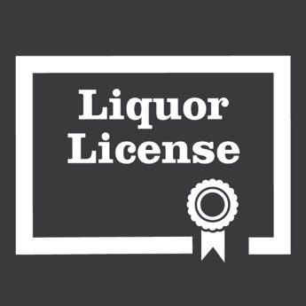
Types of Liability
Administrative Liability
  Deals with penalties for establishments and employees who do not follow alcohol laws
  Penalties are given by agencies called “liquor authorities”
  Each state and many municipalities have one

Slide 20
Types of Liability
Liquor authorities
  Grant liquor licenses
  Help enforce state and local liquor laws
  Can penalize establishments and employees who break alcohol laws

Slide 21
What Do You Think?
Which is a penalty that can be imposed by a liquor authority?
A. Suspension or loss of the liquor license
B. Fines against owners and staff
Why? Both A and B. Penalties can include, but are not limited to: suspension or loss of the establishment’s liquor license; loss of a server’s right to serve; fines against owners and staff.
Notes:
Instructor Notes:
The answer is both A and B.
Penalties can include, but are not limited to: suspension or loss of the establishment’s liquor license; Loss of a server’s right to serve; Fines against owners and staff.

Slide 22

Types of Liability: Alabama
Penalties
  Licensees are responsible for administrative penalties for violations by employees
  Employees are responsible for paying criminal fines

Slide 23
Apply Your Knowledge: Types of Liability
Complete the Types of Liability activity on page 1-5 in the ServSafe Alcohol Guide.
Notes:
Instructor Notes:
Ask the class to turn to page 1-5 in their copy of the ServSafe Alcohol Guide and complete the Types of Liability activity. Then, go over the answers as a class.
Answers: 1. C; 2. A; 3. B; 4. A

Slide 24
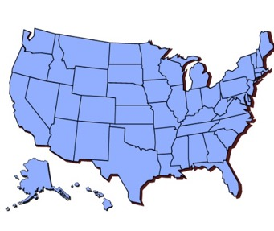
Laws Restricting Alcohol Service
State and local liquor laws:
  Each state has its own set of liquor laws.
  Many counties, cities, and towns have their own set of liquor laws.
    Their laws are usually stricter than the state laws.
  Learn the laws that apply to you and how they work.

Slide 25
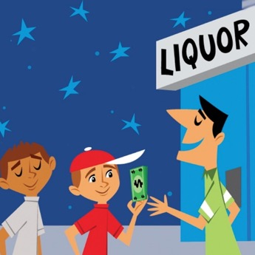
Laws Restricting Alcohol Service
Minimum age to buy, possess, or drink alcohol
  In most states, it is illegal for people under 21 to:
    Try to buy alcohol
    Possess alcohol
    Drink alcohol regardless of how they got it

Slide 26
Laws Restricting Alcohol Service: Alabama
Minimum age for purchase of alcohol
Section 28-1-5
  Notwithstanding the provisions of Section 26-1-1, it shall be unlawful for a person less than 21 years of age to purchase, consume, possess, or to transport any alcohol, liquor or malt or brewed beverages within the State of Alabama.
  Whoever violates this section shall be fined not less than $25.00 nor more than $100.00, or imprisoned in the county jail for not more than 30 days or both; provided further, that juvenile offenders shall not be held in the county jail, but shall be held, either before or after sentencing, in a juvenile detention facility pursuant to the guidelines of the Department of Youth Services, which shall be separate and apart from adult offenders.
Notes:
Instructor Notes
This is what Alabama states regarding the minimum age for the purchase of alcohol. Discuss this law with the class.

Slide 27
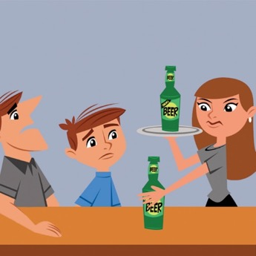
Laws Restricting Alcohol Service
Sale and supply to underage people
  In most states, it is illegal to sell or give alcohol to someone who is younger than 21
    This applies regardless of who provides the alcohol
    If people are passing drinks to underage guests, stop service and remove any alcohol
Notes:
Instructor Notes
If you see people pass drinks to an underage guest, the best practice is to stop service and remove any alcohol. There may also be other steps to take depending on the law and your company policy.

Slide 28
Laws Restricting Alcohol Service: Alabama
Selling, delivering, or furnishing alcohol to minors Section 28-3A-25 (a)(3)
  In Alabama it is illegal for any person, licensee, or the board either directly or by the servants, agents, or employees of the same, or for any servant, agent, or employee of the same, to sell, deliver, furnish, or give away alcoholic beverages to any person under the legal drinking age, as defined in Section 28-1-5, or to permit any person under the legal drinking age, as defined in Section 28-1-5, to drink, consume, or possess any alcoholic beverages on any licensee's premises.
Notes:
Instructor Notes
This is what Alabama states about selling, delivering, or furnishing alcohol to minors. Discuss this law with the class.

Slide 29
Laws Restricting Alcohol Service: Alabama
Selling, delivering, or furnishing alcohol to minors: Penalty cont. Section 28-3A-25 (b)(1)
  (b)(1) Any violation of subdivision (3) section (a) shall be a misdemeanor punishable by a fine of not less than one hundred dollars ($100) nor more than one thousand dollars ($1,000), to which, at the discretion of the court or judge trying the case, may be added imprisonment in the county jail or at hard labor for the county for not more than six months for the first conviction; and, on the second conviction of a violation of the subdivisions, the offense shall, in addition to the aforementioned fine, be punishable by imprisonment or at hard labor for the county for not less than three months nor more than six months to be imposed by the court or judge trying the case;
Notes:
Instructor Notes
This is what Alabama states about selling, delivering, or furnishing alcohol to minors. Discuss this law with the class.

Slide 30
Laws Restricting Alcohol Service: Alabama
Selling, delivering, or furnishing alcohol to minors: Penalty cont.
Section 28-3A-25 (b)(1)
  and, on the third conviction and every subsequent conviction of a violation of the subdivisions, the offense shall, in addition to a fine within the limits above named, be punishable by imprisonment or at hard labor for the county for not less than six months nor more than 12 months.
  Draft beer for off-premise consumption (Selling to a minor)
  20-X-6-.18(4)(f)
  (f) A filled or refilled container (of draft beer) shall not be sold or provided to any consumer who is under the age of 21.
Notes:
Instructor Notes
This is what Alabama states about selling, delivering, or furnishing alcohol to minors. Discuss this law with the class. The second law has to do with selling draft beer to minors for off-premise consumption. Discuss this law with the class.

Slide 31
What Do You Think?
Can parents and guardians legally serve alcohol to their
underage children?
A. Yes
B. No
C. It depends
Why? It depends on where you are.
Notes:
Instructor Notes:
The answer is C.
It depends on where you are. In some states, it’s legal for parents or guardians to serve their underage children. In others, it’s not.

Slide 32
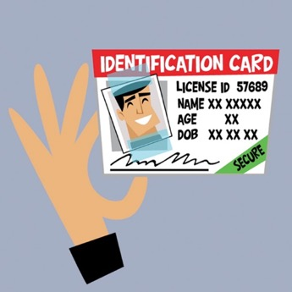
Laws Restricting Alcohol Service
Use of fake or altered IDs
  It is illegal for underage people to use fake or altered IDs to purchase alcohol
  Carefully check IDs to make sure they are genuine

Slide 33
Laws Restricting Alcohol Service: Alabama
Minors use or attempt to use non-genuine driver license Section 28-3A-25 (a)(21)
  In Alabama, it is illegal for a person under the age of 21 years to knowingly use or attempt to use a false, forged, deceptive, or otherwise non-genuine driver's license to obtain or attempt to obtain alcoholic beverages within this state.
  Penalty
  Section 28-3A-25 (b)(2)
  (2) Any violation… shall be a misdemeanor punishable by a fine of not less than fifty dollars ($50) nor more than five hundred dollars ($500), to which, at the discretion of the court or judge trying the case, may be added imprisonment in the county jail or at hard labor for the county for not more than three months.
Notes:
Instructor Notes
This is what Alabama states about minors who use or attempt to use a non-genuine driver licenses to purchase alcohol. Discuss this law with the class. Discuss the penalty that can be imposed on minors who violate this law.

Slide 34
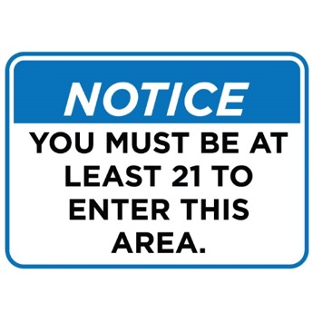
Laws Restricting Alcohol Service
Minimum age to enter a bar
  In some areas, underage people cannot enter a bar
  Some establishments require guests to be older than 21 to enter the bar area
    Some may set a minimum age of 30 (or older) to enter a bar area

Slide 35
What Do You Think?
Can someone younger than 21 legally serve alcohol?
A. Yes
B. No
C. It depends
Why? It depends on where you are. In some states, the minimum age for servers or bartenders is 21. In many other states, servers can be younger than 21.
Notes:
Instructor Notes:
The answer is C.
In some states, the minimum age for servers or bartenders is 21. In many other states, however, servers can be younger than 21.

Slide 36
Laws Restricting Alcohol Service: Alabama
Employment of underage persons by board licensee
Section 28-1-5
Persons who are 19 years of age or older and working as a waiter, waitress, or server may serve alcoholic beverages during normal dining hours in a restaurant which holds an Alcoholic Beverage Control Board restaurant retail license.
An employer who employs a person between the ages of 19 and 21 to serve alcoholic beverages as provided in the preceding sentence shall be a licensee of the board who has been annually certified as a responsible vendor under the Alabama Responsible Vendor Act as provided in Chapter 10 (commencing with Section 28-10-1) of this title.
Notes:
Instructor Notes
This is what Alabama states regarding the employment of underage people by a board licensee. Discuss this law with the class.

Slide 37
Laws Restricting Alcohol Service: Alabama
Filling and refilling (beer) requirements: Employment of minors:
Section 20-X-6-.18(3)(b)
(b) The container shall be filled or refilled only by the licensee or the licensee’s employees who are 21 years of age or older.
Notes:
Instructor Notes
This is what Alabama states regarding the age for the filling or refilling of beer containers. Discuss this law with the class.

Slide 38
Laws Restricting Alcohol Service
Read the In The News story on page 1-7 in the ServSafe Alcohol Guide.
Notes:
Instructor Notes:
Ask students to read the In The News story on page 1-7 in the ServSafe Alcohol Guide. Discuss the consequences of serving an intoxicated guest. Use a real world story of a similar event in Alabama.

Slide 39

Laws Restricting Alcohol Service
Selling and serving alcohol to intoxicated guests
  Most states have laws against selling alcohol to people who are visibly or obviously intoxicated
    Some specifically hold establishments and servers liable.
  Most laws state that any person may be held liable for serving an intoxicated person, including guests.

Slide 40
Laws Restricting Alcohol Service: Alabama
Serve alcohol to a person appearing intoxicated
Section 20-X-6-.02(4)
No ABC Board on-premises licensee, employee or agent thereof shall serve any person alcoholic beverages if such person appears, considering the totality of the circumstances, to be intoxicated.
  Draft beer for off-premise consumption
  20-X-6-.18(4)(f)
  (f) A filled or refilled container (of draft beer) shall not be sold or provided to any consumer who appears, considering the totality of the circumstances, to be intoxicated.
Notes:
Instructor Notes
This is what Alabama states regarding the service of alcohol to a person appearing intoxicated. Discuss this law with the class. The second law has to do with selling draft beer to intoxicated customers for off-premise consumption. Discuss this law with the class.

Slide 41
Laws Restricting Alcohol Service
Serving known alcoholics
  Some states hold the establishment and employees liable for serving a known alcoholic

Slide 42
Laws Restricting Alcohol Service: Alabama
Public intoxication
13A-11-10(a)(b)
(a) A person commits the crime of public intoxication if he appears in a public place under the influence of alcohol, narcotics or other drug to the degree that he endangers himself or another person or property, or by boisterous and offensive conduct annoys another person in his vicinity.
(b) Public intoxication is a violation.
Notes:
Instructor Notes
This is what Alabama states regarding public intoxication. Discuss this law with the class.

Slide 43
What Do You Think?
Can you drink alcohol on the job?
A. Yes
B. No
C. It depends
Why? It really depends on where you are. Drinking can impair judgment, making it harder to identify when guests have had enough. It can also result in bad decisions that will cost you and the establishment.
Notes:
Instructor Notes:
The answer is C.
It depends on where you are. Lots of areas have laws against drinking on the job. Even if it is not specifically illegal in your area, your company probably has a policy against it. This is because drinking can impair judgment.

Slide 44
Laws Restricting Alcohol Service: Alabama
Consuming during working hours
Section 20-X-6-.02(5)
(5) No ABC Board on-premises licensee, employee or agent thereof engaged in serving customers, may consume alcoholic beverages during working hours.
Notes:
Instructor Notes
This is what Alabama states regarding the consumption of alcohol during working hours. Discuss this law with the class.

Slide 45
What Do You Think?
Can guests bring alcohol onto the premises?
A. Yes
B. No
C. It depends
Why? It’s illegal for guests to bring their own alcoholic beverages onto the premises unless it’s permitted by law and your company policy.
Notes:
Instructor Notes:
The answer is C.
It’s illegal for guests to bring their own alcoholic beverages onto the premises unless it’s permitted by law and your company policy.

Slide 46
Laws Restricting Alcohol Service: Alabama
Allowing unauthorized alcohol (brown bagging)
Section 20-X-6-.01(12)
No ABC Board licensee shall allow on the licensed premises the consumption and/or possession of any type of alcoholic beverage which the licensee is not authorized to sell. Further, the practice of brown bagging or customers bringing on the licensed premises their own alcoholic beverages is prohibited on ABC Board licensed premises.
This brown bagging provision shall not apply to alcoholic beverages, for which the appropriate Alabama tax has been paid, which are brought on the premises of Class I Club (not operated for pecuniary gain) licensees.
Notes:
Instructor Notes:
This is what Alabama states regarding the allowance of unauthorized alcohol on the premises. Discuss this law with the class.

Slide 47
Laws Restricting Alcohol Service: Alabama
Wine, Beer, and Spirits
Notes:
Instructor Notes:
Point out that the next section covers Alabama alcohol laws specific to wine, beer and spirits.

Slide 48
Laws Restricting Alcohol Service: Alabama
Wine
Notes:
Instructor Notes:
Point out that the first section covers Alabama alcohol laws specific to wine.

Slide 49
Laws Restricting Alcohol Service: Alabama
Wine tasting
Section 20-X-7-.07
Table wine tastings may be permitted subject to the following terms and conditions:
(a) Table wine tastings are restricted to the following licensed premises:
      1. On-premises table wine.
      2. Off-premises table wine.
      3. Lounge retail liquor, Class I and Class II.
      4. Restaurant retail liquor.
      5. Club liquor, Class I and II.
      6. Wholesale table wine
      7. Special events retail
      8. Special retail
Notes:
Instructor Notes:
This is what Alabama states regarding the allowance of wine tasting on the premises. Discuss this law with the class.

Slide 50
Laws Restricting Alcohol Service: Alabama
Wine tasting cont.
Section 20-X-7-.07
(b) All wine tasting events shall be subjected to the following requirements:
      1. Notification shall be given by the licensee to the ABC Board 7 days prior to the tasting event.
      2. Only products which have been approved for sale within the state may be used in tastings.
      3. The bottles used shall be designated for tasting use only and not for resale.
      4. Those conducting the tasting shall maintain proof of purchase for the products.
Notes:
Instructor Notes:
This is what Alabama states regarding the allowance of wine tasting on the premises. Discuss this law with the class.

Slide 51
Laws Restricting Alcohol Service: Alabama
Wine tasting cont.
Section 20-X-7-.07
(b) All wine tasting events shall be subjected to the following requirements:
5. Table wine tastings shall be of a structured nature and not exceed a period of 2 ½ continuous hours.
6. All table wine shall be dispensed from original containers prepared by the manufacturer with labels visible to the consumer. Individual samples furnished to a consumer shall contain no more than two ounces of the table wine.
Notes:
Instructor Notes:
This is what Alabama states regarding the allowance of wine tasting on the premises. Discuss this law with the class.

Slide 52
Laws Restricting Alcohol Service: Alabama
Wine tasting cont.
Section 20-X-7-.07
(b) All wine tasting events shall be subjected to the following requirements:
7. Tastings shall be conducted by licensed table wine wholesalers or manufacturers on any of the licensed premises referred to in (a) above. The wholesaler or manufacturer shall be permitted to conduct wine tastings utilizing its own personnel, or representative with identification with assistance from retail personnel if desired. At all tastings, the wholesaler, the manufacturer, or the retail licensee shall provide for purposes of the promotion, a person with a sufficient knowledge of the product(s) involved to conduct said tastings.
8. Any product with a broken seal shall be removed from the licensees’ premises at the end of the tasting event.
Notes:
Instructor Notes:
This is what Alabama states regarding the allowance of wine tasting on the premises. Discuss this law with the class.

Slide 53
Laws Restricting Alcohol Service: Alabama
Wine tasting cont.
Section 20-X-7-.07
(c) All wine tasting events shall be subject to the following restrictions:
1. Tastings shall not be offered to any consumer who is under the age of 21 or who appears, considering the totality of the circumstances, to be intoxicated.
2. The tasting area shall be confined to the licensed premises, in a designated area, so as to separate the event from any point-of-sales of alcoholic beverages. Tastings shall not be conducted on a patio, or parking area that is outside the licensed premises. This restriction does not prohibit a special event licensee from conducting an out-door tasting event. A special event retail licensee shall be required to designate one area within the licensed premises to conduct tastings.
Notes:
Instructor Notes:
This is what Alabama states regarding the allowance of wine tasting on the premises. Discuss this law with the class.

Slide 54
Laws Restricting Alcohol Service: Alabama
Wine tasting cont.
Section 20-X-7-.07
(c) All wine tasting events shall be subject to the following restrictions:
3. The tasting area shall contain at a minimum one table. The wholesaler, manufacturer, or its representative shall be present at the table throughout the duration of the tasting event.
4. Only the product shall be served at the tasting event. Non-alcoholic mixers may be added. No premixed drinks or infusions shall be allowed.
Notes:
Instructor Notes:
This is what Alabama states regarding the allowance of wine tasting on the premises. Discuss this law with the class.

Slide 55
Laws Restricting Alcohol Service: Alabama
Wine tasting cont.
Section 20-X-7-.07
(c) All wine tasting events shall be subject to the following restrictions:
5. No licensee shall receive payment or any other consideration directly or otherwise from any other licensee.
6. No promotions, sweepstakes, prizes, or contests shall be held during a tasting event.
7. No signs or banners advertising the event shall be placed outside the licensed premises.
Notes:
Instructor Notes:
This is what Alabama states regarding the allowance of wine tasting on the premises. Discuss this law with the class.

Slide 56
Laws Restricting Alcohol Service: Alabama
Wine tasting cont.
Section 20-X-7-.07
(d) The licensee shall be held responsible for a tasting event held on their licensed premises.
(e) The Board may, itself initiate, investigate and, if appropriate, disapprove and prohibit the continued tastings by any licensee found to be conducting tastings in violation of the rules.
Notes:
Instructor Notes:
This is what Alabama states regarding the allowance of wine tasting on the premises. Discuss this law with the class.

Slide 57
Laws Restricting Alcohol Service: Alabama
Wine tasting cont.
Section 20-X-7-.07
(f) Additional requirements for state liquor stores and for private package stores - lounge retail liquor- Class II
1. Tastings shall commence no later than six o’clock p.m. and not exceed a period of 2 hours.
2. Individual samples furnished to a consumer shall contain no more than one ounce of the table wine and shall be limited to four products per tasting event.
3. Tastings shall be conducted at no charge to the customer.
Notes:
Instructor Notes:
This is what Alabama states regarding the allowance of wine tasting on the premises. Discuss this law with the class.

Slide 58
Laws Restricting Alcohol Service: Alabama
Resealing or recorking of wine
Section 28-3A-20.1
Notwithstanding any provision of this chapter to the contrary, a person holding a license to sell alcoholic beverages for consumption on the licensed premises may permit a customer to remove one unsealed bottle of wine for consumption off the premises if the customer has purchased and consumed a portion of the bottle of wine on the licensed premises.
The licensee or the licensee's agent shall either: (1) recork the bottle of wine with the original or similar type cork that is reinserted in the bottle and the cork can only be removed by a corkscrew or similar device; or (2) securely reseal the bottle in a bag designed so that it is visibly apparent that the resealed bottle of wine has not been tampered with and shall provide a dated receipt for the resealed bottle of wine to the customer.
Notes:
Instructor Notes:
This is what Alabama states regarding the removal of a resealed bottle of wine from the premises. Discuss this law with the class.

Slide 59
Laws Restricting Alcohol Service: Alabama
Resealing or recorking of wine cont.
Section 28-3A-20.1
A wine bottle recorked or resealed pursuant to the requirements of this section is otherwise subject to the requirements of Section 32-5A-330 as further provided herein. The recorked or resealed bottle of wine, if transported in a motor vehicle, shall be placed in a locked trunk; in a storage or luggage compartment; in a locked glove compartment; in a storage or cargo compartment in the bed of a pickup truck or in a locked case placed in an area not readily accessible behind the front seat of a pickup truck if the truck has no trunk or separate enclosed area other than the truck cab; or in the area behind the last upright seat of a motor vehicle which is not equipped with a trunk.
Notes:
Instructor Notes:
This is what Alabama states regarding the removal of a resealed bottle of wine from the premises. Discuss this law with the class.

Slide 60
Laws Restricting Alcohol Service: Alabama
Beer
Notes:
Instructor Notes:
Point out that this section covers Alabama alcohol laws specific to beer.

Slide 61
Laws Restricting Alcohol Service: Alabama
Beer Tastings
Section 20-X-7-.10
(a) Beer tastings are restricted to the following licensed premises:
1. On-premises beer.
2. Off-premises beer.
3. Lounge retail liquor, Class I.
4. Restaurant retail liquor.
5. Club liquor, Class I and II.
6. Wholesale beer.
7. Special events retail.
8. Special retail.
Notes:
Instructor Notes:
This is what Alabama states regarding the allowance of beer tastings on the premises. Discuss this law with the class

Slide 62
Laws Restricting Alcohol Service: Alabama
Beer Tastings cont.
Section 20-X-7-.10
(b) All participants in any tastings shall be of legal drinking age.
(c) Beer tastings shall be of a structured nature and not exceed a period of 2 1/2 continuous hours.
(d) All beer shall be dispensed from original containers prepared by the manufacturer with labels visible to the consumer. Individual samples furnished to a consumer shall contain no more than two ounces of the beer.
Notes:
Instructor Notes:
This is what Alabama states regarding the allowance of beer tastings on the premises. Discuss this law with the class

Slide 63
Laws Restricting Alcohol Service: Alabama
Beer Tastings cont.
Section 20-X-7-.10
(e) Beer tastings may be conducted by beer manufacturers or wholesalers on any of the licensed premises referred to in (1)(a) above. The manufacturer or wholesaler shall be permitted to conduct beer tastings utilizing its own personnel, with the assistance from retail personnel if desired. At all tastings, the manufacturer, wholesale or retail licensee shall provide for purposes of the promotion, a person with a sufficient knowledge of the product(s) involved to conduct said tastings.
Notes:
Instructor Notes:
This is what Alabama states regarding the allowance of beer tastings on the premises. Discuss this law with the class

Slide 64
Laws Restricting Alcohol Service: Alabama
Beer Tastings cont.
Section 20-X-7-.10
(f) Beer tastings shall be limited to products which have not been available, or have not been widely distributed, within the State of Alabama for a period of more than one (1) year immediately preceding the date of the beer tasting.
(g) All cost of a beer tasting, including the cost of the beer, shall be borne by the licensee on whose premises the beer tasting is held.
Notes:
Instructor Notes:
This is what Alabama states regarding the allowance of beer tastings on the premises. Discuss this law with the class

Slide 65
Laws Restricting Alcohol Service: Alabama
Beer container size
Section 28-3A-23(g)
(g) All beer, except draft or keg beer, sold by retailers must be sold or dispensed in bottles, cans, or other containers not to exceed 25.4 ounces. All wine sold by retailers for off-premise consumption must be sold or dispensed in bottles or other containers in accordance with the standards of fill specified in the then effective standards of fill for wine prescribed by the U.S. Treasury Department.
Notes:
Instructor Notes:
This is what Alabama states regarding the size of a beer container. Discuss this law with the class.

Slide 66
Laws Restricting Alcohol Service: Alabama
Draft beer for off-premises consumption: Filling/refilling requirements
Section 20-X-6-.18(3)(c)
(c) The container shall be filled or refilled only at the time the in-person sale is made and only with beer from the original container.
Notes:
Instructor Notes:
This is what Alabama states regarding the filling requirements for draft beer for off-premises consumption. Discuss this law with the class.

Slide 67
Laws Restricting Alcohol Service: Alabama
Spirits
Notes:
Instructor Notes:
Point out that this section covers Alabama alcohol laws specific to spirits.

Slide 68
Laws Restricting Alcohol Service: Alabama
Spirit tastings
Section 20-X-7-11
(1) Spirits tastings may be permitted subject to the following terms and conditions:
(a) For the purpose of this regulations, the term “spirits” applies to the same alcoholic beverages as those defined under the term “liquor” in the Glossary of Terms, Regulation 20-X-2-.01, for this publication.
Notes:
Instructor Notes:
This is what Alabama states regarding spirit tastings on the premises. Discuss this law with the class.

Slide 69
Laws Restricting Alcohol Service: Alabama
Spirit tastings cont.
Section 20-X-7-11
(b) Spirits tastings are restricted to the following licensed premises:
1. Lounge retail liquor, Class I and Class II.
2. Restaurant retailer liquor.
3. Club liquor, Class I and II.
4. Special events retail.
5. Special retails.
Notes:
Instructor Notes:
This is what Alabama states regarding spirit tastings on the premises. Discuss this law with the class.

Slide 70
Laws Restricting Alcohol Service: Alabama
Spirit tastings cont.
Section 20-X-7-11
(c) All spirit tasting events shall be subjected to the following requirements:
1. Notification shall be given by the licensee to the Board 7 days prior to the tasting event.
2. Only products which have been approved for sale within the state may be used in tastings.
3. The bottles used shall be designated for tasting use only and not for resale.
4. Those conducting the tasting shall maintain proof of purchase for the products.
Notes:
Instructor Notes:
This is what Alabama states regarding spirit tastings on the premises. Discuss this law with the class.

Slide 71
Laws Restricting Alcohol Service: Alabama
Spirit tastings cont.
Section 20-X-7-11
(c) All spirit tasting events shall be subjected to the following requirements:
5. Spirits tastings shall be of a structured nature and not exceed a period of 2 1/2 continuous hours.
6. All spirits shall be dispensed from original containers prepared by the manufacturer with labels visible to the consumer. Individual samples furnished to a consumer shall contain no more than one-half ounce of the spirits. No more than three (3) samples may be furnished to a consumer in one calendar day.
Notes:
Instructor Notes:
This is what Alabama states regarding spirit tastings on the premises. Discuss this law with the class.

Slide 72
Laws Restricting Alcohol Service: Alabama
Spirit tastings cont.
Section 20-X-7-11
(c) All spirit tasting events shall be subjected to the following requirements:
7. Spirits tastings shall be conducted by licensed manufacturers or their representative on any of the licensed premises referred to in (1)(b) above. The representative shall be permitted to conduct spirits tastings utilizing its own personnel, or industry representatives with permits and identification with assistance from retail personnel if desired. At all tastings, the manufacturer or manufacturer's representative shall provide for purposes of the promotion, a person with a sufficient knowledge of the product(s) involved to conduct said tastings.
8. Any product with a broken seal shall be removed from the licensees’ premises at the end of the tasting event.
Notes:
Instructor Notes:
This is what Alabama states regarding spirit tastings on the premises. Discuss this law with the class.

Slide 73
Laws Restricting Alcohol Service: Alabama
Spirit tastings cont.
Section 20-X-7-11
(d) All spirit tasting events shall be subject to the following restrictions:
1. Tastings shall not be offered to any consumer who is under the age of 21 or who appears, considering the totality of the circumstances, to be intoxicated.
2. The tasting area shall be confined to the licensed premises, in a designated area, so as to separate the event from any point-of-sales of alcoholic beverages. Tastings shall not be conducted on a patio, or parking area that is outside the licensed premises. This restriction does not prohibit a special event licensee from conducting an out-door tasting event. A special event retail licensee shall be required to designate one area within the licensed premises to conduct tastings.
Notes:
Instructor Notes:
This is what Alabama states regarding spirit tastings on the premises. Discuss this law with the class.

Slide 74
Laws Restricting Alcohol Service: Alabama
Spirit tastings cont.
Section 20-X-7-11
(d) All spirit tasting events shall be subject to the following restrictions:
3. The tasting area shall contain at a minimum one table. The manufacturer or its representative shall be present at the table during the duration of the tasting event.
4. Only the product shall be served at the tasting event. Non-alcoholic mixers may be added. No premixed drinks or infusions shall be allowed.
5. No licensee shall receive payment or any other consideration directly or otherwise from any other licensee.
Notes:
Instructor Notes:
This is what Alabama states regarding spirit tastings on the premises. Discuss this law with the class.

Slide 75
Laws Restricting Alcohol Service: Alabama
Spirit tastings cont.
Section 20-X-7-11
(d) All spirit tasting events shall be subject to the following restrictions:
6. No promotions, sweepstakes, prizes, or contests shall be held during a tasting event.
7. No signs or banners advertising the event shall be placed outside the licensed premises.
(e) The licensee shall be held responsible for a tasting event held on their licensed premises.
(f) The Board may, itself initiate, investigate and, if appropriate, disapprove and prohibit the continued tastings by any licensee found to be conducting tastings in violation of the rules.
Notes:
Instructor Notes:
This is what Alabama states regarding spirit tastings on the premises. Discuss this law with the class.

Slide 76
Laws Restricting Alcohol Service: Alabama
Spirit tastings cont.
Section 20-X-7-11
(g) Additional requirements for state liquor stores and for private package stores- lounge retail liquor- Class I
1. Tastings shall commence no later than six o’clock p.m. and not exceed a period of 2 hours.
2. Individual samples furnished to a consumer shall contain no more than one-quarter ounce of the spirits and shall be limited to 2 products per tasting event.
3. Tastings shall be conducted at no charge to the customer.
Notes:
Instructor Notes:
This is what Alabama states regarding spirit tastings on the premises. Discuss this law with the class.

Slide 77
Laws Restricting Alcohol Service: Alabama
Use and disposition of original liquor containers
Section 20-X-6-.03
(1) Except as hereinafter authorized, no liquor product may be kept or maintained on any ABC Board licensed premises at any time in any container, bottle, or receptacle, other than the original bottle prepared by the manufacturer with proper taxes paid thereon. Any liquor in possession or custody of the licensee found on the licensed premises and not in compliance herewith shall be seized as contraband and may subject the licensee to disciplinary action.
    (2) No ABC Board licensee shall have more than one bottle of each brand of liquor opened at each serving station at any time in the licensed establishment, provided however, such licensees may dispense liquor from a pre-mix dispenser in accordance with ABC Board Regulation 20-X-6-.05 or from an automatic dispensing system.
Notes:
Instructor Notes:
This is what Alabama states regarding the use and disposition of original liquor containers on the premises. Discuss this law with the class.

Slide 78
Laws Restricting Alcohol Service: Alabama
Use and disposition of original liquor containers cont.
Section 20-X-6-.03
(3) All ABC Board licensees authorized to sell liquor are required to destroy, as soon as reasonably possible, all empty liquor bottles. It is not permitted for any such licensee to refill any alcoholic beverage container.
    (a) "Destroy" as related to containers or bottles, means breaking, crushing, or smashing or by any means wherein the containers or bottles are rendered unsuitable for reuse.
  (b) "As soon as reasonably possible" means immediately after use, serving, or consuming the contents thereof, provided, however, that in all events empty bottles shall be immediately segregated from existing usable inventory.
Notes:
Instructor Notes:
This is what Alabama states regarding the use and disposition of original liquor containers on the premises. Discuss this law with the class.

Slide 79
Laws Restricting Alcohol Service: Alabama
Fortifying, adulterating alcohol
Section 28-3A-25(a)(9)
(a) It shall be unlawful:.
    (9) For any person to fortify, adulterate, contaminate, or in any manner change the character or purity of alcoholic beverages from that as originally marketed by the manufacturer, except that a retail licensee on order from a customer may mix a chaser or other ingredients necessary to prepare a cocktail or mixed drink for on-premises consumption.
Notes:
Instructor Notes:
This is what Alabama states regarding fortifying or adulterating alcohol on the premises. Discuss this law with the class.

Slide 80
Laws Restricting Alcohol Service: Alabama
Fortifying, adulterating alcohol: Penalties
Section 28-3A-25(b)(1)
  (b)(1) Any violation of subdivisions (1) through (17) of subsection (a) shall be a misdemeanor punishable by a fine of not less than one hundred dollars ($100) nor more than one thousand dollars ($1,000), to which, at the discretion of the court or judge trying the case, may be added imprisonment in the county jail or at hard labor for the county for not more than six months for the first conviction; and, on the second conviction of a violation of the subdivisions, the offense shall, in addition to the aforementioned fine, be punishable by imprisonment or at hard labor for the county for not less than three months nor more than six months to be imposed by the court or judge trying the case; and, on the third conviction and every subsequent conviction of a violation of the subdivisions, the offense shall, in addition to a fine within the limits abovenamed, be punishable by imprisonment or at hard labor for the county for not less than six months nor more than 12 months.
Notes:
Instructor Notes:
This is what Alabama states regarding the penalties associated with fortifying or adulterating alcohol on the premises. Discuss this law with the class.

Slide 81
Laws Restricting Alcohol Service: Alabama
Sales of untaxed alcohol
Section 28-3A-25(a)(16)
(a) It shall be unlawful:
    (16) For any person to sell, give away, or otherwise dispose of taxable alcoholic beverages within this state on which the required taxes have not been paid as required by law.
Notes:
Instructor Notes:
This is what Alabama states regarding the sale of untaxed alcohol on the premises. Discuss this law with the class.

Slide 82
Laws Restricting Alcohol Service: Alabama
Sales of untaxed alcohol: Penalties
Section 28-3A-25(b)(1)
  (b)(1) Any violation of subdivisions (1) through (17) of subsection (a) shall be a misdemeanor punishable by a fine of not less than one hundred dollars ($100) nor more than one thousand dollars ($1,000), to which, at the discretion of the court or judge trying the case, may be added imprisonment in the county jail or at hard labor for the county for not more than six months for the first conviction; and, on the second conviction of a violation of the subdivisions, the offense shall, in addition to the aforementioned fine, be punishable by imprisonment or at hard labor for the county for not less than three months nor more than six months to be imposed by the court or judge trying the case; and, on the third conviction and every subsequent conviction of a violation of the subdivisions, the offense shall, in addition to a fine within the limits abovenamed, be punishable by imprisonment or at hard labor for the county for not less than six months nor more than 12 months.
Notes:
Instructor Notes:
This is what Alabama states regarding penalties for the sale of untaxed alcohol on the premises. Discuss this law with the class.

Slide 83
Laws Restricting Alcohol Service: Alabama
Display of alcoholic beverages by retail licensees
Section 20-X-6-.08
  Retail licensees may display alcoholic beverages within their licensed premises, provided said beverages are displayed, stored or kept in such a manner so as not to be conspicuously visible to the public from outside the licensed premises.
Notes:
Instructor Notes:
This is what Alabama states regarding the display of alcoholic beverages by retail licensees on the premises. Discuss this law with the class.

Slide 84
Laws Restricting Alcohol Service: Alabama
Sale of alcoholic beverages by retail licensees: Resale
Section 20-X-6-.04(5)
  (5) An ABC Board retail licensee shall not sell to any person or other licensee for purposes of resale, nor shall such licensee purchase or attempt to purchase alcoholic beverages from another ABC Board retail licensee.
Notes:
Instructor Notes:
This is what Alabama states regarding the sale of alcoholic beverages to others for resale purposes. Discuss this law with the class.

Slide 85
Laws Restricting Alcohol Service: Alabama
Beverage locker/Storage service
Section 20-X-6-.01(11)
  (11) ABC Board licensees shall not rent, furnish, or maintain beverage locker service or storage service for the keeping of alcoholic beverages by customers, patrons, or consumers.
Notes:
Instructor Notes:
This is what Alabama states regarding beverage locker/storage service on the premises. Discuss this law with the class.

Slide 86
Laws Restricting Alcohol Service: Alabama
Sales from storage cabinets and guest rooms
Section 20-X-6-.17
  (1) Licensees of the ABC Board possessing the privilege of selling liquor at retail who regularly offer to the public, for compensation, transitory lodging or sleeping accommodations may provide alcoholic beverages to registered guests twenty-one years of age or older in storage cabinets individual private rooms of lodging.
  (2) All storage cabinets (also commonly known as mini bars) in private rooms must be locked with a secure locking device. The key or combination needed to open the cabinets may only be given by the licensee to the registered guest responsible for the room rental.
Notes:
Instructor Notes:
This is what Alabama states regarding sales from storage cabinets and guest rooms on the premises. Discuss this law with the class.

Slide 87
Laws Restricting Alcohol Service: Alabama
Sales from storage cabinets and guest rooms cont.
Section 20-X-6-.17
  (3) The sale of the registered guest of alcoholic beverages from storage cabinets is deemed to occur upon the delivery of the key or combination to the locking device. In the case of refills or restocking, the sale is deemed to occur upon delivery by room service. No sale of alcoholic beverages shall be made on Sundays after 2:00 A.M., except where the sale thereof is permitted by law.
  (4) All sales herein made shall be made in unopened containers. After the registered guest vacates the room, the licensee shall promptly inventory the storage cabinet and cause the cabinet to be locked and secure. All containers which have been opened must be removed from the private room. The contents of the opened containers must be poured out immediately and not reused.
Notes:
Instructor Notes:
This is what Alabama states regarding sales from storage cabinets and guest rooms on the premises. Discuss this law with the class.

Slide 88
Laws Restricting Alcohol Service: Alabama
Sales from storage cabinets and guest rooms cont.
Section 20-X-6-.17
  (5) If the licensee determines or has reason to believe that the registered guest having the key or combination to the storage cabinet has allowed or intends to allow minors to consume alcoholic beverages from the cabinet, then the licensee shall take such action as necessary to remove the alcoholic beverages from the cabinet and/or retrieve the key thereto or cancel the combination device.
  (6) ABC Board agents may enter any room containing a storage cabinet, for inspection thereof, at any time that the room is not let to a registered guest.
Notes:
Instructor Notes:
This is what Alabama states regarding sales from storage cabinets and guest rooms on the premises. Discuss this law with the class.

Slide 89
Laws Restricting Alcohol Service: Alabama
Service of alcoholic beverages on patios or around swimming pool areas
Section 20-X-6-.07
  Any ABC Board on-premises licensee may serve alcoholic beverages as authorized by their license on patios or around swimming pool areas adjacent to or connected with the main licensed premises. Said serving area shall be located so as not to be a nuisance nor readily visible from a church or school premises.
Notes:
Instructor Notes:
This is what Alabama states regarding the service of alcoholic beverages on patios or around swimming pool areas adjacent or connected to the premises. Discuss this law with the class.

Slide 90
What Do You Think?
Can people continue drinking past the hours of service listed on an operation’s liquor license?
A. Yes
B. No
C. It depends
Why? This is illegal. The hours listed on the liquor license must be strictly followed. They apply to both guests and employees
Notes:
Instructor Notes:
The answer is B.
This is illegal. The legal hours for the sale and service of alcohol are listed on the establishment’s liquor license. They apply to both guests and employees. The hours listed on the liquor license must be strictly followed.

Slide 91
Laws Restricting Alcohol Service: Alabama
Sunday sales
Section 28-3A-25-(a)(19)
  (a) It shall be unlawful:
  (19) For any person, except where authorized by a local act or general act of local application, to buy, give away, sell, or serve for consumption on or off the premises, or to drink or consume any alcoholic beverages in any cafe, lunchroom, restaurant, hotel dining room, or other public place on Sunday after the hour of two o’clock a.m.
Notes:
Instructor Notes:
This is what Alabama states regarding Sunday sales on the premises. Discuss this law with the class.

Slide 92
Laws Restricting Alcohol Service: Alabama
Sunday sales: Penalty for violations
Section 28-3A-25-(b)(2)
  (2) Any violation of any provision of subdivisions (18), (19), (20), and (21) of subsection (a) shall be a misdemeanor punishable by a fine of not less than fifty dollars ($50) nor more than five hundred dollars ($500), to which, at the discretion of the court or judge trying the case, may be added imprisonment in the county jail or at hard labor for the county for not more than three months.
Notes:
Instructor Notes:
This is what Alabama states regarding the penalty for Sunday sales on the premises. Discuss this law with the class.

Slide 93
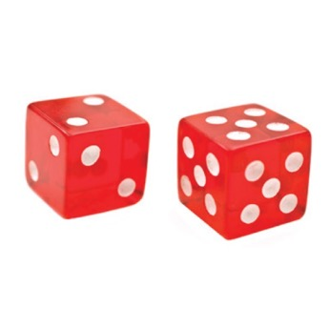
Laws Restricting Alcohol Service
Some other activities that are illegal on the premises.
  Gambling, prostitution, other lewd behavior
    In most states you can be liable if you knowingly permit these activities
  Drinking games and contests
    In many states it’s illegal to let people play games that involve drinking alcohol
    These encourage people to drink to intoxication
  Illegal drugs
    These encourage people to drink to intoxication

Slide 94
Laws Restricting Alcohol Service: Alabama
Allowing criminal conduct
Section: 20-X-6-.01(6)
ABC Board licensees shall be accountable to the ABC Board for criminal conduct which occurs or is suffered to occur on any part of the licensed premises. Where the ABC Board or Hearing Commission finds such criminal conduct to be allowed, caused, permitted, or suffered to occur by the licensee, employees or agents thereof, such licensee’s license shall be subject to disciplinary action.
Notes:
Instructor Notes:
This is what Alabama states regarding the allowance of criminal conduct on the premises. Discuss this law with the class.

Slide 95
Laws Restricting Alcohol Service: Alabama
Prohibition of obscene, lewd or indecent conduct on licensed premises
Section: 20-X-6-.11
(1) No ABC Board licensee shall permit bottomless dancing, topless dancing wherein the portion of the female breast beneath the top of the nipple is exposed, or such performing, or any other lewd or indecent conduct on the premises of such licensee.
Notes:
Instructor Notes:
This is what Alabama states regarding obscene, lewd, or indecent conduct on the premises. Discuss this law with the class.

Slide 96
Laws Restricting Alcohol Service: Alabama
Prohibition of obscene, lewd or indecent conduct on licensed premises cont.
Section: 20-X-6-.11
(2) No ABC Board licensee shall permit any person to perform acts of or acts which simulate:
      (a) Sexual intercourse, masturbation, sodomy, bestiality, oral copulation, flagellation or any sexual acts which are prohibited by law.
      (b) The touching, caressing or fondling on the breasts, buttocks, anus or genitals.
      (c) The displaying of the portion of the female breast beneath the top of the nipple, pubic hair, anus, vulva or genitals.
Notes:
Instructor Notes:
This is a continuation of the previous slide. This is what Alabama states regarding obscene, lewd, or indecent conduct on the premises. Discuss this law with the class.

Slide 97
Laws Restricting Alcohol Service: Alabama
Prohibition of obscene, lewd or indecent conduct on licensed premises cont.
Section: 20-X-6-.11
(3) No ABC Board licensee shall permit any patron, customer or member to touch, caress or fondle the breasts, buttocks, anus, genitals or any part of the body or clothing of a performer. Performers may not touch, caress or fondle the breast, buttocks, anus, genitals or any part of the body or clothing of patrons or other performers.
Notes:
Instructor Notes:
This is a continuation of the previous slide. This is what Alabama states regarding obscene, lewd, or indecent conduct on the premises. Discuss this law with the class.

Slide 98
Laws Restricting Alcohol Service: Alabama
Prohibition of obscene, lewd or indecent conduct on licensed premises cont.
Section: 20-X-6-.11
(4) No ABC Board licensee shall permit the showing of films, still pictures, electronic reproduction or other visual reproductions depicting:
      (a) Acts or simulated acts of sexual intercourse, masturbation, sodomy, bestiality, oral copulation, flagellation or any sexual acts which are prohibited by law.
      (b) Any person being touched, caressed or fondled on the breasts, buttocks, anus or genitals.
Notes:
Instructor Notes:
This is a continuation of the previous slide. This is what Alabama states regarding obscene, lewd, or indecent conduct on the premises. Discuss this law with the class.

Slide 99
Laws Restricting Alcohol Service: Alabama
Prohibition of obscene, lewd or indecent conduct on licensed premises cont.
Section: 20-X-6-.11
(4) No ABC Board licensee shall permit the showing of films, still pictures, electronic reproduction or other visual reproductions depicting:
      (c) Scenes wherein a person displays the vulva or the anus or the genitals.
      (d) Scenes wherein artificial devices or inanimate objects are employed to depict, or drawings are employed to portray, any of the prohibited activities described above.
Notes:
Instructor Notes:
This is a continuation of the previous slide. This is what Alabama states regarding obscene, lewd, or indecent conduct on the premises. Discuss this law with the class.

Slide 100
Laws Restricting Alcohol Service: Alabama
Drinking contests
Section: 20-X-6-.02(3)
An ABC Board on-premises licensee is prohibited from conducting, sponsoring or allowing any type of contest which requires participants to consume alcoholic beverages on the licensed premises.
Notes:
Instructor Notes:
This is what Alabama states regarding drinking contests on the premises. Discuss this law with the class.

Slide 101
Laws Restricting Alcohol Service: Alabama
Unlawful distribution of a controlled substance
Section 13A-12-211(a)(b)
(a) A person commits the crime of unlawful distribution of controlled substances if, except as otherwise authorized, he or she sells, furnishes, gives away, delivers, or distributes a controlled substance enumerated in Schedules I through V.
(b) Unlawful distribution of controlled substances is a Class B felony.
Notes:
Instructor Notes:
This is what Alabama states regarding the unlawful distribution of a controlled substance on the premises. Discuss this law with the class.

Slide 102
Laws Restricting Alcohol Service: Alabama
Limitations on happy hour and similar price reductions
Section 20-X-6-.13
(1) It shall be unlawful for any ABC Board licensee to:
    (a) Serve multiple drinks for a single price.
    (b) Establish a single retail price based upon the required purchase of two or more drinks.
    (c) Sell or otherwise furnish drinks before 10 a.m. or after 9 p.m. at a price which is reduced from the usual customary or established retail price charged for such drinks.
    (d) Sell or provide one person or group of persons drinks at prices less than those charged the general public for that day.
Notes:
Instructor Notes:
This is what Alabama states regarding the limitations on Happy Hours and similar reductions. Discuss this law with the class.

Slide 103
Laws Restricting Alcohol Service: Alabama
Limitations on happy hour and similar price reductions cont.
Section 20-X-6-.13
(2) Nothing herein contained shall be construed to prohibit the dispensing of drinks customarily sold in pitchers, provided such pitchers shall be available at all times the licensee is open for business. The usual, customary or established retail price thereof shall not be reduced before 10 a.m. or after 9 p.m.
Notes:
Instructor Notes:
This is a continuation of the previous slide. This is what Alabama states regarding the limitations on Happy Hours and similar reductions. Discuss this law with the class.

Slide 104
Laws Restricting Alcohol Service: Alabama
Limitations on happy hour and similar price reductions cont.
Section 20-X-6-.13
(3) The term "drink" or "drinks" is defined herein to mean any beverage containing any quantity of alcohol. "Multiple drinks" is defined to mean two or more drinks containing any quantity of alcohol or a single container which contains more than the normal quantity of alcohol for an individual drink in accordance with ABC Board Regulation 20-X-6-.04(2). The term "pitcher" is defined to mean any receptacle containing a minimum of sixty (60) fluid ounces of beverages.
(4) This regulation shall not apply to legitimate, prearranged private parties, functions, or events where guests thereof are served in a room or rooms so designated and used exclusively therefor.
Notes:
Instructor Notes:
This is a continuation of the previous slide. This is what Alabama states regarding the limitations on Happy Hours and similar reductions. Discuss this law with the class.

Slide 105
Laws Restricting Alcohol Service
Discrimination Against Guests
  States also hold the owners and operators of establishments and their employees liable if they discriminate against guests due to:
    Race
    Color
    Gender
    Sexual orientation
    Age
    Disability
    Religion or creed
Notes:
Instructor Notes:
Point out that the way to avoid problems is to treat everyone the same.

Slide 106
What Do You Think?
Can you refuse alcohol service to a pregnant woman?
A. Yes
B. No
C. It depends
Why? Refusing to serve alcohol to a woman because she’s pregnant is gender discrimination.
Notes:
Instructor Notes:
The answer is B.
Refusing to serve alcohol to a woman because she’s pregnant is gender discrimination.

Slide 107
Laws Restricting Alcohol Service: Alabama
The Premises
Notes:
Instructor Notes:
Point out that the next section covers laws regarding the premises.

Slide 108
Laws Restricting Alcohol Service: Alabama
Mechanisms to gain access to licensed premises
Section 20-X-6-.01(13)
Any ABC Board licensee which requires its members or patrons to possess keys, card keys, code numbers, membership cards or other such mechanisms as a condition to gaining access to its licensed premises, shall provide and supply to the ABC Board upon initial issuance of the license and/or renewal, as the case may be, access to and evidence of such mechanisms so as to allow entry by ABC Board personnel upon the licensed premises at any time during normal business hours for the purpose of observing the normal operation thereof. Any changes or modifications to said premise entry mechanisms during the license year shall be brought to the attention of the ABC Board immediately. Failure to provide said above information shall, at the ABC Board’s discretion, be grounds for disciplinary action against the licensee.
Notes:
Instructor Notes:
This is what Alabama states regarding ABC board access to the premises . Discuss this law with the class.

Slide 109
Laws Restricting Alcohol Service: Alabama
Sale of alcoholic beverages by retail licensees: Adequate lighting
Section 20-X-6-.04(6)
(6) All ABC Board retail licensed premises shall be adequately lighted for purposes of observing the operation thereof or patrons therein.
Notes:
Instructor Notes:
This is what Alabama states regarding appropriate lighting within the premises . Discuss this law with the class.

Slide 110
Laws Restricting Alcohol Service: Alabama
Refusing to allow inspection
Section 28-3A-25-(a)(6)
(a) It shall be unlawful:
(6) For any licensee or the servants, agents, or employees of the same to refuse the board, any of its authorized employees, or any duly commissioned law enforcement officer the right to completely inspect the entire licensed premises at any time the premises are open for business.
Notes:
Instructor Notes:
This is what Alabama states regarding a refusal to allow an inspection of the premises. Discuss this law with the class.

Slide 111
Laws Restricting Alcohol Service: Alabama
Refusing to allow inspection: Penalties
Section 28-3A-25-(b)(1)
(b)(1) Any violation of subdivision 6 of subsection (a) shall be a misdemeanor punishable by a fine of not less than one hundred dollars ($100) nor more than one thousand dollars ($1,000), to which, at the discretion of the court or judge trying the case, may be added imprisonment in the county jail or at hard labor for the county for not more than six months for the first conviction; and, on the second conviction of a violation of the subdivisions, the offense shall, in addition to the aforementioned fine, be punishable by imprisonment or at hard labor for the county for not less than three months nor more than six months to be imposed by the court or judge trying the case; and, on the third conviction and every subsequent conviction of a violation of the subdivisions, the offense shall, in addition to a fine within the limits abovenamed, be punishable by imprisonment or at hard labor for the county for not less than six months nor more than 12 months.
Notes:
Instructor Notes:
This is what Alabama states are the penalties for a refusal to allow an inspection of the premises. Discuss this law with the class.

Slide 112
Laws Restricting Alcohol Service: Alabama
Required Postings
Notes:
Instructor Notes:
Point out that the next section covers required postings in Alabama.

Slide 113
Laws Restricting Alcohol Service: Alabama
Sale of alcoholic beverages by retail licensees
Section 20-X-6-.04(2)
(2) The quantity of liquor served in an individual drink shall be posted within the licensed premises in a conspicuous place on or behind the service area and on any food or beverage menu. Said notice, except in food or beverage menus, shall be no less than 12" x 20" and shall read, "All drinks contain __ ounces of liquor, unless special ordered." Letters shall be no less than two (2) inches in height.
Notes:
Instructor Notes:
This is what Alabama states about postings regarding the quantity of liquor served in individual drinks on the premises. Discuss this law with the class.

Slide 114
Laws Restricting Alcohol Service: Alabama
Person in charge
Section 20-X-6-.06
Each licensee, except a licensed individual who is on the premises, shall have a designated person who is at least 21 years of age present and in actual charge of the business being conducted under the license at any time the licensed establishment is kept open for business, whether or not the privileges of the license are being exercised. The name of the designated person of every retail licensee shall be posted in an area of the establishment, readily available to ABC Board personnel, in letters not less than one inch in size, during the time he is in charge.
Notes:
Instructor Notes:
This is what Alabama states regarding the person in charge on the premises. Discuss this law with the class.

Slide 115
Laws Restricting Alcohol Service: Alabama
Posting of signs
Section 20-X-12-.04(1)(e)3
(3) Responsible vendors shall display signs on the licensed premises informing customers of the vendor’s policy against serving or selling alcoholic beverages to underage persons and/or intoxicated customers. These signs must measure no less than 8 inches by 13 inches with type sufficiently large to be easily read, and be placed at customer entrance(s) of the licensed premises or at cash registers and on or near the area where alcoholic beverages are displayed or dispensed. All signs shall be situated in areas easily viewed by the public.
Notes:
Instructor Notes:
This is what Alabama states regarding the posting of signs on the premises. Discuss this law with the class.

Slide 116
Laws Restricting Alcohol Service: Alabama
Displaying the beverage license
Section 20-X-6-.01(10)
(10) All ABC Board licensees shall display their current ABC licenses in public view on the licensed premises.
Notes:
Instructor Notes:
This is what Alabama states regarding the posting of the beverage license on the premises. Discuss this law with the class.

Slide 117
Laws Restricting Alcohol Service: Alabama
Training
Notes:
Instructor Notes:
Point out that the next section covers training requirements in Alabama.

Slide 118
Laws Restricting Alcohol Service: Alabama
Training within 30 days
Section 20-X-12-.06(2)(a)
(a) Responsible vendors shall require new or transferred sellers, servers, and managers to complete the course of instruction and pass the appropriate examination within 30 days of commencing employment. Responsible vendors who allow new or transferred employees to sell, serve or manage before training should strive to do so under the direct supervision of a trained seller, server, or manager.
Notes:
Instructor Notes:
This is what Alabama states regarding training for sellers, servers and managers. Discuss this law with the class.

Slide 119
Laws Restricting Alcohol Service: Alabama
Semi-annuals
Section 20-X-12-.06(2)(c)
(c) Responsible vendors shall require each server, seller and manager to attend meetings semi-annually, or more frequently as deemed appropriate. A register with names and social security numbers of all employees who attend the meeting, the date of each meeting, the person conducting the meeting, and the subjects covered shall be maintained by the responsible vendor or agent thereof.
Notes:
Instructor Notes:
This is a continuation of the previous slide. This is what Alabama states regarding training for sellers, servers and managers. Discuss this law with the class.

Slide 120
Laws Restricting Alcohol Service: Alabama
Satisfactory completion/Passing grade
Section 20-X-12-.09(5)
(5) Satisfactory completion of each course of instruction shall be demonstrated by achieving a passing grade of 80% or higher. Incorrect examination questions shall be reviewed and initiated by the employee with the correct answer(s) being provided and discussed. An examination may be repeated once in order to attain a satisfactory score of 80%, after which time retraining shall be necessary.
Notes:
Instructor Notes:
This is a continuation of the previous slide. This is what Alabama states regarding satisfactory completion of a course. Discuss this law with the class.

Slide 121
Laws Restricting Alcohol Service: Alabama
Beverage License Types
Notes:
Instructor Notes:
Point out that the next section covers beverage license types in Alabama.

Slide 122
Laws Restricting Alcohol Service: Alabama
Lounge Retail Liquor License
Notes:
Instructor Notes:
Point out that the first section covers allowances for a Lounge Retail Liquor Licensee.

Slide 123
Laws Restricting Alcohol Service: Alabama
Lounge Retail Liquor License
Section 28-3A-11
Upon applicant's compliance with the provisions of this chapter and the regulations made thereunder, the board shall, where the application is accompanied by a certificate from the clerk or proper officer setting out that the applicant has presented his application to the governing authority of the municipality, if the licensed premises is to be located therein, and has obtained its consent and approval, issue a retail liquor license…
Notes:
Instructor Notes:
This is what Alabama states are the allowances for establishments that have obtained a Lounge Retail Liquor license. Discuss this law with the class.

Slide 124
Laws Restricting Alcohol Service: Alabama
Lounge Retail Liquor License cont.
Section 28-3A-11
…which will authorize the licensee to purchase liquor and wine from the board or as authorized by the board and to purchase table wine, and beer, including draft or keg beer in any county or municipality in which the sale thereof is permitted, from any wholesaler licensee of the board and to sell at retail liquor and wine, dispensed from containers of any size, and beer, including draft or keg beer in any county or municipality in which the sale thereof is permitted, to patrons…
Notes:
Instructor Notes:
This is a continuation of the previous slide. This is what Alabama states are the allowances for establishments that have obtained a Lounge Retail Liquor license. Discuss this law with the class.

Slide 125
Laws Restricting Alcohol Service: Alabama
Lounge Retail Liquor License cont.
Section 28-3A-11
…A lounge liquor licensee may permit dancing or provide other lawful entertainment on the licensed premises. No person under 19 years of age shall be admitted on the premises of any lounge liquor licensee as a patron or employee, and it shall be unlawful for any such licensee to admit any minor to the premises as a patron or employee.
Notes:
Instructor Notes:
This is a continuation of the previous slide. This is what Alabama states are the allowances for establishments that have obtained a Lounge Retail Liquor license. Discuss this law with the class.
.

Slide 126
Laws Restricting Alcohol Service: Alabama
Lounge Retail Liquor License cont.
Section 20-X-5-.04
(1) A Lounge Retail Liquor License may be issued to any person, partnership, association, or corporation duly authorized to do business in the State of Alabama once all state and local requirements are met and approval is granted.
Notes:
Instructor Notes:
This is what Alabama states are the allowances for establishments that have obtained a Lounge Retail Liquor license. Discuss this law with the class.
.

Slide 127
Laws Restricting Alcohol Service: Alabama
Lounge Retail Liquor License cont.
Section: 20-X-5-.04
(2) There shall be two classes of Lounge Retail Liquor Licenses.
(a) Class I will permit the licensee to sell alcoholic beverages for on-premises and off-premises consumption. All sales for off-premises consumption shall be in original unopened containers.
(b) Class II will permit the licensee to sell alcoholic beverages only for off-premises consumption in the original unopened containers and shall comply with the requirements of 20-X-5-.13.
Notes:
Instructor Notes:
This is a continuation of the previous slide. This is what Alabama states are the allowances for establishments that have obtained a Lounge Retail Liquor license. Discuss this law with the class.
.

Slide 128
Laws Restricting Alcohol Service: Alabama
Restaurant Retail Liquor License
Notes:
Instructor Notes:
Point out that the next section covers allowances for a Restaurant Retail Liquor License.

Slide 129
Laws Restricting Alcohol Service: Alabama
Restaurant Retail Liquor License
Section 28-3A-13
Upon applicant's compliance with the provisions of this chapter and the regulations made thereunder, the board shall, where the application is accompanied by a certificate from the clerk or proper officer setting out that the applicant has presented his application to the governing authority of the municipality, if the licensed premises is to be located therein, and has obtained its consent and approval issue a restaurant liquor license for a hotel, restaurant, civic center authority or dinner theater…
Notes:
Instructor Notes:
This is what Alabama states are the allowances for establishments that have obtained a Restaurant Retail Liquor License. Discuss this law with the class.

Slide 130
Laws Restricting Alcohol Service: Alabama
Restaurant Retail Liquor License cont.
Section 28-3A-13
…which will authorize the licensee to purchase liquor and wine from the board or as authorized by the board and to purchase table wine and beer, including draft or keg beer in any county or municipality in which the sale thereof is permitted, from any wholesale licensee of the board and, in that part of the hotel, restaurant, club or dinner theater set out in the license, to sell liquor and wine, dispensed from containers of any size, and beer, including draft or keg beer, in any county or municipality in which the sale thereof is permitted,…
Notes:
Instructor Notes:
This is a continuation of the previous slide. This is what Alabama states are the allowances for establishments that have obtained a Restaurant Retail Liquor License. Discuss this law with the class.

Slide 131
Laws Restricting Alcohol Service: Alabama
Restaurant Retail Liquor License cont.
Section 28-3A-13
…to the patrons, guests or members for on-premises consumption in any part of the civic center or in that part of the hotel, restaurant or dinner theater habitually used for serving meals to patrons, guests or members, or other public or private rooms of the building in accordance with the provisions of this chapter and the regulations made thereunder, and where a restaurant located in a hotel, but not operated by the owner of the hotel, is licensed to sell alcoholic beverages in the restaurant, it may also sell alcoholic beverages to guests in private rooms in the hotel.
Notes:
Instructor Notes:
This is a continuation of the previous slide. This is what Alabama states are the allowances for establishments that have obtained a Restaurant Retail Liquor License. Discuss this law with the class.

Slide 132
Laws Restricting Alcohol Service: Alabama
Restaurant Retail Liquor License cont.
Section 20-X-5-.05
(1) Restaurant Retail Liquor licenses shall be issued only to reputable persons for locations which are “habitually and principally” used for the purpose of preparing and serving meals for the public to consume on the licensed premises during normal and reasonable dining hours. Only those locations whose customary and primary business is preparing and serving meals to the public will be issued a Restaurant Retail Liquor license.
Notes:
Instructor Notes:
This is what Alabama states are the allowances for establishments that have obtained a Restaurant Retail Liquor License. Discuss this law with the class.

Slide 133
Laws Restricting Alcohol Service: Alabama
Restaurant Retail Liquor License cont.
Section 20-X-5-.05
(2) Restaurant Retail Liquor license applicants shall comply with all pertinent and related requirements of state, county, and where applicable, municipal health departments prior to licensing and shall remain in compliance thereafter for as long as said license shall remain valid.
(3) All Restaurant Retail Liquor licensees shall have a fully equipped and operational kitchen on the licensed premises. The licensee shall maintain and operate said kitchen and shall, upon order of a customer, prepare and serve all food items shown on its menu during normal and reasonable dining hours. Exceptions shall be made where there is a known and provable shortage or temporary unavailable supply of a food item.
Notes:
Instructor Notes:
This is a continuation of the previous slide. This is what Alabama states are the allowances for establishments that have obtained a Restaurant Retail Liquor License. Discuss this law with the class.

Slide 134
Laws Restricting Alcohol Service: Alabama
Restaurant Retail Liquor License cont.
Section 20-X-5-.05
(4) Any applicant or licensee shall, upon request, provide to the ABC Board, any records, books, ledgers, menus, receipts, or other documentation necessary to demonstrate compliance with this regulation.
Notes:
Instructor Notes:
This is a continuation of the previous slide. This is what Alabama states are the allowances for establishments that have obtained a Restaurant Retail Liquor License. Discuss this law with the class.

Slide 135
Laws Restricting Alcohol Service: Alabama
Club Liquor Class 1
Notes:
Instructor Notes:
Point out that the next section covers allowances for a Club Liquor Class 1 license.

Slide 136
Laws Restricting Alcohol Service: Alabama
Club Liquor Class 1
Section 28-3-1(7)(a)
a. Class I. A corporation or association organized or formed in good faith by authority of law and which must have at least 150 paid-up members. It must be the owner, lessee, or occupant of an establishment operated solely for the objects of a national, social, patriotic, political, or athletic nature or the like, but not for pecuniary gain,…
Notes:
Instructor Notes:
This is what Alabama states are the allowances for establishments that have obtained a Club Liquor Class 1 license. Discuss this law with the class.

Slide 137
Laws Restricting Alcohol Service: Alabama
Club Liquor Class 1 cont.
Section 28-3-1(7)(a)
…and the property as well as the advantages of which, belong to all the members and which maintains an establishment provided with special space and accommodations where, in consideration of payment, food with or without lodging is habitually served. The club shall hold regular meetings, continue its business through officers regularly elected, admit members by written application, investigation, and ballot and charge and collect dues from elected members.
Notes:
Instructor Notes:
This is a continuation of the previous slide. This is what Alabama states are the allowances for establishments that have obtained a Club Liquor Class 1 license. Discuss this law with the class.

Slide 138
Laws Restricting Alcohol Service: Alabama
Club Liquor Class 1 cont.
Section 20-X-5-.03
(1) All membership applications shall contain at least the following:
(a) Applicant's name and date of birth.
(b) Home address and telephone number.
(c) Occupation and place of employment
Notes:
Instructor Notes:
This is what Alabama states are the allowances for establishments that have obtained a Club Liquor Class 1 license. Discuss this law with the class.

Slide 139
Laws Restricting Alcohol Service: Alabama
Club Liquor Class 1 cont.
Section 20-X-5-.03
(2) An applicant's true identity shall be verified by the club by use of any of the following:
(a) A valid driver's license of any state.
(b) A valid United States Uniformed Service Identification.
(c) A valid passport.
(d) A valid identification issued by any agency of a state for the purpose of identification, bearing a photograph and date of birth of the individual in question.
Notes:
Instructor Notes:
This is a continuation of the previous slide. This is what Alabama states are the allowances for establishments that have obtained a Club Liquor Class 1 license. Discuss this law with the class.

Slide 140
Laws Restricting Alcohol Service: Alabama
Club Liquor Class 1 cont.
Section 20-X-5-.03
(3) Upon filing by an applicant of a bona fide membership application, a club may, at its discretion, issue a temporary membership card which will allow the applicant to use the facilities of the club until the application is processed. A temporary membership card shall only be valid for a maximum of thirty calendar days from date of issue. An applicant may receive only one temporary membership card per year, per club.
Notes:
Instructor Notes:
This is a continuation of the previous slide. This is what Alabama states are the allowances for establishments that have obtained a Club Liquor Class 1 license. Discuss this law with the class.

Slide 141
Laws Restricting Alcohol Service: Alabama
Club Liquor Class 1 cont.
Section 20-X-5-.03
(4) A complete club membership record shall be maintained, showing the date of application of all proposed members, the date of admission after election, the date initiation fees and dues are paid and the amounts paid. The record shall also reflect the name of the applicant’s sponsor and other remarks deemed desirable. This record shall be either on a standard form or, preferably, a card index or a computer disk, showing the name of the member, the address of the member and the serial number of the membership card issued. Dues shall be accumulated and posted to the proper column in the income records. A separate form or card shall be prepared for each member, and when members are removed or resign, their cards shall be removed from the active file and placed in an inactive file for a period of two years.
Notes:
Instructor Notes:
This is a continuation of the previous slide. This is what Alabama states are the allowances for establishments that have obtained a Club Liquor Class 1 license. Discuss this law with the class.

Slide 142
Laws Restricting Alcohol Service: Alabama
Club Liquor Class 1 cont.
Section 20-X-5-.03
(5) Only a permanent club member may bring bona fide guests on the premises of the club at any time. The presence of a non-member (other than a club employee, a person making a sale or delivery to the club, or other individual similarly present solely in connection with the provision of services or materials to or for the club) on the premises of the club, who is not a bona fide guest of a permanent club member shall be a violation of this regulation.
(6) A bona fide guest is deemed to be a person who has a social, civic, business, or charitable relationship with their host, and shall not include persons whose primary purpose in attendance is for the pecuniary benefit of the club. The bona fide guest’s host member shall not be an employee of the club then on duty.
Notes:
Instructor Notes:
This is a continuation of the previous slide. This is what Alabama states are the allowances for establishments that have obtained a Club Liquor Class 1 license. Discuss this law with the class.

Slide 143
Laws Restricting Alcohol Service: Alabama
Club Liquor Class 1 cont.
Section 20-X-5-.03
(7) Upon initial application for a Class I Club Liquor Retail License and with each renewal thereafter, the applicant shall present to the ABC Board as part of the application process, good and sufficient evidence that the applicant is a bona fide non-profit organization and exists solely for the objects set forth in Section 28-3-1(7)(a)(b), Code of Ala. 1975.
Notes:
Instructor Notes:
This is a continuation of the previous slide. This is what Alabama states are the allowances for establishments that have obtained a Club Liquor Class 1 license. Discuss this law with the class.

Slide 144
Laws Restricting Alcohol Service: Alabama
Club Liquor Class 2
Notes:
Instructor Notes:
Point out that the next section covers allowances for a Club Liquor Class 2 license.

Slide 145
Laws Restricting Alcohol Service: Alabama
Club Liquor Class 2
Section 28-3-1(7)(b)
b. Class II. A corporation or association organized or formed in good faith by authority of law and which must have at least 100 paid-up members. It must be the owner, lessee, or occupant of an establishment operated solely for the objects of a national, social, patriotic, political, or athletic nature or the like. The club shall hold regular meetings, continue its business through officers regularly elected, admit members by written application, investigation and ballot and charge and collect dues from elected members.
Notes:
Instructor Notes:
This is what Alabama states are the allowances for establishments that have obtained a Club Liquor Class 2 license. Discuss this law with the class.

Slide 146
Laws Restricting Alcohol Service: Alabama
Club Liquor Class 2 cont.
Section 20-X-5-.03
(1) All membership applications shall contain at least the following:
(a) Applicant's name and date of birth.
(b) Home address and telephone number.
(c) Occupation and place of employment
Notes:
Instructor Notes:
This is what Alabama states are the allowances for establishments that have obtained a Club Liquor Class 2 license. Discuss this law with the class.

Slide 147
Laws Restricting Alcohol Service: Alabama
Club Liquor Class 2 cont.
Section 20-X-5-.03
(2) An applicant's true identity shall be verified by the club by use of any of the following:
(a) A valid driver's license of any state.
(b) A valid United States Uniformed Service Identification.
(c) A valid passport
(d) A valid identification issued by any agency of a state for the purpose of identification, bearing a photograph and date of birth of the individual in question.
Notes:
Instructor Notes:
This is a continuation of the previous slide. This is what Alabama states are the allowances for establishments that have obtained a Club Liquor Class 2 license. Discuss this law with the class.

Slide 148
Laws Restricting Alcohol Service: Alabama
Club Liquor Class 2 cont.
Section 20-X-5-.03
(3) Upon filing by an applicant of a bona fide membership application, a club may, at its discretion, issue a temporary membership card which will allow the applicant to use the facilities of the club until the application is processed. A temporary membership card shall only be valid for a maximum of thirty calendar days from date of issue. An applicant may receive only one temporary membership card per year, per club.
Notes:
Instructor Notes:
This is a continuation of the previous slide. This is what Alabama states are the allowances for establishments that have obtained a Club Liquor Class 2 license. Discuss this law with the class.

Slide 149
Laws Restricting Alcohol Service: Alabama
Club Liquor Class 2 cont.
Section 20-X-5-.03
(4) A complete club membership record shall be maintained, showing the date of application of all proposed members, the date of admission after election, the date initiation fees and dues are paid and the amounts paid. The record shall also reflect the name of the applicant’s sponsor and other remarks deemed desirable. This record shall be either on a standard form or, preferably, a card index or a computer disk, showing the name of the member, the address of the member and the serial number of the membership card issued. Dues shall be accumulated and posted to the proper column in the income records. A separate form or card shall be prepared for each member, and when members are removed or resign, their cards shall be removed from the active file and placed in an inactive file for a period of two years.
Notes:
Instructor Notes:
This is a continuation of the previous slide. This is what Alabama states are the allowances for establishments that have obtained a Club Liquor Class 2 license. Discuss this law with the class.

Slide 150
Laws Restricting Alcohol Service: Alabama
Club Liquor Class 2 cont.
Section 20-X-5-.03
(5) Only a permanent club member may bring bona fide guests on the premises of the club at any time. The presence of a non-member (other than a club employee, a person making a sale or delivery to the club, or other individual similarly present solely in connection with the provision of services or materials to or for the club) on the premises of the club, who is not a bona fide guest of a permanent club member shall be a violation of this regulation.
(6) A bona fide guest is deemed to be a person who has a social, civic, business, or charitable relationship with their host, and shall not include persons whose primary purpose in attendance is for the pecuniary benefit of the club. The bona fide guest’s host member shall not be an employee of the club then on duty.
Notes:
Instructor Notes:
This is a continuation of the previous slide. This is what Alabama states are the allowances for establishments that have obtained a Club Liquor Class 2 license. Discuss this law with the class.

Slide 151
Laws Restricting Alcohol Service: Alabama
Club Liquor Class 2 cont.
Section 20-X-5-.03
(7) Upon initial application for a Class I Club Liquor Retail License and with each renewal thereafter, the applicant shall present to the ABC Board as part of the application process, good and sufficient evidence that the applicant is a bona fide non-profit organization and exists solely for the objects set forth in Section 28-3-1(7)(a)(b), Code of Ala. 1975.
Notes:
Instructor Notes:
This is a continuation of the previous slide. This is what Alabama states are the allowances for establishments that have obtained a Club Liquor Class 2 license. Discuss this law with the class.

Slide 152
Laws Restricting Alcohol Service: Alabama
Retail Beer (On or Off premises)
Notes:
Instructor Notes:
Point out that the next section covers allowances for a Retail Beer license.

Slide 153
Laws Restricting Alcohol Service: Alabama
Retail Beer (On or Off premises)
Section 28-3A-16
Upon applicant's compliance with the provisions of this chapter and the regulations made thereunder, the board shall issue to applicant a retail beer license which will authorize the licensee to purchase beer, including draft beer in counties or municipalities where the sale thereof is permitted, from a licensed wholesaler and to sell at retail for on-premises consumption in a room or rooms or place on the licensed premises at all times accessible to the use and accommodation of the general public, and in original unopened containers for off-premises consumption, where such use of the proposed location is not, at the time of the original application, prohibited by a valid zoning ordinance or other ordinance in the valid exercise of police power by the governing body of the municipality or county in which the outlet is located.
Notes:
Instructor Notes:
This is what Alabama states are the allowances for establishments that have obtained a Retail Beer license. Discuss this law with the class.

Slide 154
Laws Restricting Alcohol Service: Alabama
Retail Beer (On or Off premises) cont.
Section 20-X-6-.02(6)(7)
(6) All ABC Board licensees authorized to conduct retail sales on-premises shall designate and mark an area no smaller than 500 square feet solely for service and consumption on-premises. The on-premises consumption area shall not contain sales or display items.
(a) This area shall be open and available to customers for on-premise consumption at all times that alcoholic beverages are available for sale at that premises.
(b) An employee shall be present in and maintain control of the on-premises area at all times the business is open for operation.
Notes:
Instructor Notes:
This is what Alabama states are the allowances for establishments that have obtained a Retail Beer license. Discuss this law with the class.

Slide 155
Laws Restricting Alcohol Service: Alabama
Retail Beer (On or Off premises) cont.
Section 20-X-6-.02(6)(7)
(c) No patron shall be allowed to leave the on-premises area or the licensed premises with an open container of alcoholic beverage.
(7) All ABC Board licensees authorized to conduct retail sales on-premises shall at all times provide tables and seating adequate to accommodate no less than 16 persons within the designated on-premises consumption area.
Notes:
Instructor Notes:
This is a continuation of the previous slide. This is what Alabama states are the allowances for establishments that have obtained a Retail Beer license. Discuss this law with the class.

Slide 156
Laws Restricting Alcohol Service: Alabama
Retail Table Wine (On or Off premises)
Notes:
Instructor Notes:
Point out that the next section covers allowances for a Retail Table Wine license.

Slide 157
Laws Restricting Alcohol Service: Alabama
Retail Table Wine (On or Off premises)
Section 28-3A-14
Upon applicant's compliance with the provisions of this chapter and the regulations made thereunder, the board shall issue to applicant a retail table wine license which will authorize the licensee to purchase table wine from the board or from a licensed wholesaler in counties and municipalities where authorized, and to sell at retail, in unopened original containers or dispense from containers of any size, for on-premises consumption in a room or rooms or place on the licensed premises at all times accessible to the use and accommodation of the general public, and in original unopened containers for off-premises consumption,…
Notes:
Instructor Notes:
This is what Alabama states are the allowances for establishments that have obtained a Retail Table Wine license. Discuss this law with the class.

Slide 158
Laws Restricting Alcohol Service: Alabama
Retail Table Wine (On or Off premises) cont.
Section 28-3A-14
…where such use of the proposed location is not, at the time of the original application, prohibited by a valid zoning ordinance or other ordinance in the valid exercise of police power by the governing body of the municipality or county in which the outlet is located.
Notes:
Instructor Notes:
This is a continuation of the previous slide. This is what Alabama states are the allowances for establishments that have obtained a Retail Table Wine license. Discuss this law with the class.

Slide 159
Laws Restricting Alcohol Service: Alabama
Retail Table Wine (On or Off premises) cont.
Section 20-X-6-.02(6)(7)
(6) All ABC Board licensees authorized to conduct retail sales on-premises shall designate and mark an area no smaller than 500 square feet solely for service and consumption on-premises. The on-premises consumption area shall not contain sales or display items.
(a) This area shall be open and available to customers for on-premise consumption at all times that alcoholic beverages are available for sale at that premises.
(b) An employee shall be present in and maintain control of the on-premises area at all times the business is open for operation.
Notes:
Instructor Notes:
This is a continuation of the previous slide. This is what Alabama states are the allowances for establishments that have obtained a Retail Table Wine license. Discuss this law with the class.

Slide 160
Laws Restricting Alcohol Service: Alabama
Retail Table Wine (On or Off premises) cont.
Section 20-X-6-.02(6)(7)
(c) No patron shall be allowed to leave the on-premises area or the licensed premises with an open container of alcoholic beverage.
(7) All ABC Board licensees authorized to conduct retail sales on-premises shall at all times provide tables and seating adequate to accommodate no less than 16 persons within the designated on-premises consumption area.
Notes:
Instructor Notes:
This is a continuation of the previous slide. This is what Alabama states are the allowances for establishments that have obtained a Retail Table Wine license. Discuss this law with the class.

Slide 161
Laws Restricting Alcohol Service: Alabama
Special Events Retail License
Notes:
Instructor Notes:
Point out that the next section covers allowances for a Special Events Retail License.

Slide 162
Laws Restricting Alcohol Service: Alabama
Special Events Retail License
Section 28-3A-19
Upon applicant's compliance with the provisions of this chapter and the regulations made thereunder, the board shall issue a special retail license in wet counties for a state park, racing commission, fair authority, airport authority, or civic center authority, or the franchises or concessionaire of such park, commission or authority, and may, in its discretion, issue a special retail license to any other valid responsible organization of good reputation for such period of time not to exceed one year and upon such terms and conditions as the board shall prescribe,…
Notes:
Instructor Notes:
This is what Alabama states are the allowances for establishments that have obtained a Special Events Retail License. Discuss this law with the class.

Slide 163
Laws Restricting Alcohol Service: Alabama
Special Events Retail License cont.
Section 28-3A-19
…which will authorize the licensee to purchase, where the retail sale thereof is authorized by the board, liquor and wine from the board or as authorized by the board and table wine and beer from any wholesale licensee of the board and to sell at retail and dispense such alcoholic beverages as are authorized by the board at such locations authorized by the board upon such terms and conditions as prescribed by the board. Provided, however, no sale of alcoholic beverages shall be permitted on any Sunday after the hour of 2:00 A.M.
Notes:
Instructor Notes:
This is a continuation of the previous slide. This is what Alabama states are the allowances for establishments that have obtained a Special Events Retail License. Discuss this law with the class.

Slide 164
Laws Restricting Alcohol Service: Alabama
Special Events Retail License cont.
Section 20-X-5-.12
A Special Events Retail license may be issued only after all the requirements of Section 28-3A-20, Code of Ala. 1975, have been met and only for a special event. A Special Retail license may be issued only after all the requirements of Section 28-3A-19, Code of Ala. 1975, have been met. A Special Retail license will not be issued for an occurrence that is in essence, a special event.
Notes:
Instructor Notes:
This is a continuation of the previous slide. This is what Alabama states are the allowances for establishments that have obtained a Special Events Retail License. Discuss this law with the class.

Slide 165
Apply Your Knowledge: Self-Check
Complete the Self-Check on page 1-11 in ServSafe Alcohol Guide.
Notes:
Instructor Notes:
Ask the class to turn to page 1-11 in their copy of ServSafe Alcohol Guide and complete the Self-Check. Tell them to answer each question. Then, go over the answers as a class.
Answers:
1. B; 2. C; 3. A; 4. D; 5. B; 6. C

Slide 167
Objectives
After completing this topic, you will be able to identify
the following:
  What alcohol is and how it moves through the body
  Factors that affect BAC
  How to assess guests
  How to count drinks and estimate BAC
  Signs of intoxication
  How to prevent intoxication
Notes:
Instructor Notes:
Discuss the chapter objectives.

Slide 168
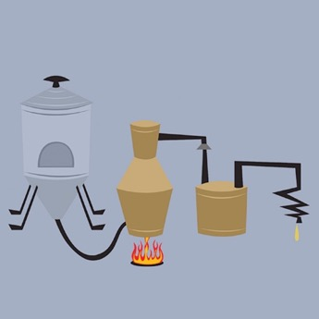
What Alcohol Is
What kind of alcohol do we drink, and how is it made?
  There are different kinds of alcohol. The kind we drink is called beverage alcohol or ethanol.
  Some alcohol, such as beer and wine, is made by fermenting plants or grains.
  Other types, such as vodka and whiskey, are made by fermenting plants and grain, then distilling the product. This removes water and makes the drink stronger.
Notes:
Instructor Notes:
Ask the class the question, “What kind of alcohol do we drink, and how is it made?” Discuss the answers given and display the text.
Beverage alcohol is typically made through two processes. Some types of alcohol are made by fermenting plants, such as berries and fruits, or grains such as barley. During fermentation, yeast breaks down these plants and grains. This is what produces ethanol.

Slide 169
What Alcohol Is
Complete the Which is stronger? activity on page 2-3 in the ServSafe Alcohol Guide.
Notes:
Instructor Notes:
Regardless of how it is made, it is important to know the strength of different types of alcohol. This is important so you can properly count drinks and assess people’s levels of intoxication.
Ask the class to turn to page 2-3 in their copy of the ServSafe Alcohol Guide and complete the Which is stronger? activity. Then, go over the answers as a class.
Answers: A.4, B.1, C.2, D.3

Slide 170
What Alcohol Is
How is alcohol strength measured?
  The term “proof” historically has been used to indicate the strength of liquor.
  By dividing the proof by two, you can determine how much alcohol a liquor contains.
  Here’s the formula: Strength of liquor = proof ÷ 2
Notes:
Instructor Notes:
Ask the class the question, “How is alcohol strength measured?” Discuss the answers given and display the text.

Slide 171
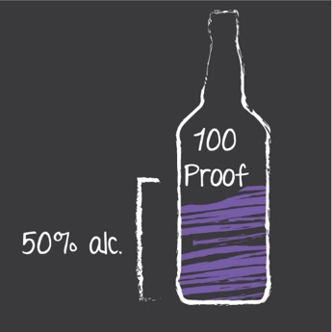
What Alcohol Is
Calculating alcohol strength
  For example, 100 proof whiskey is 50% alcohol.
  100 proof ÷2 = 50% alcohol

Slide 172
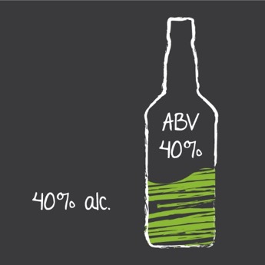
What Alcohol Is
ABV (Alcohol by Volume)
  The ABV is the percentage of a drink that is alcohol.
  For example, if a bottle of vodka has an ABV of 40%, that means that 40% of the liquid in the bottle is alcohol.
Notes:
Instructor Notes:
Most manufacturers indicate the strength of liquor by listing its Alcohol By Volume (ABV). The ABV is the percentage of a drink that is alcohol.
Alcoholic beverages vary in strength. Distilled spirits typically range from an ABV of 20% for liqueurs, like schnapps, to 40% or higher for spirits such as vodka, whiskey, and rum.

Slide 173
What Do You Think?
What’s the typical alcohol content of beer in the U.S.?
A. 4% to 6%
B. 6% to 9%
C. It depends
Why? Four to 6% is the typical ABV for beer. But craft beers can range anywhere from 2.5% to 15% ABV.
Notes:
Instructor Notes:
The answer is A.
Four to 6% is the typical ABV for beer. But craft beers can range anywhere from 2.5% to 15% ABV.

Slide 174
What Do You Think?
What’s the typical alcohol content of wine?
A. 6% to 9%
B. 12% to 14%
C. It depends
Why? This is true for wine in the U.S. But some types containing distilled spirits can have an ABV even higher.
Notes:
Instructor Notes:
The answer is B.
This is true for wine in the U.S. But some types containing distilled spirits can have an ABV even higher.

Slide 175
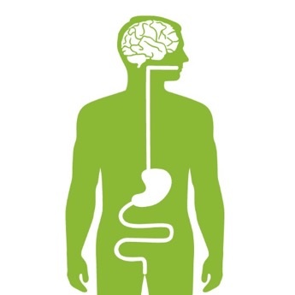
Alcohol’s Path Through the Body
How does alcohol move through the body?
  Mouth: A small amount of alcohol is immediately absorbed from the mouth into the bloodstream.
  Stomach: The rest of the alcohol moves into the stomach. Some is absorbed into the bloodstream through the stomach wall.
  Small Intestine: From the stomach, the alcohol moves into the small intestine. Most of the alcohol is absorbed into the bloodstream from here.
  Brain: Once in the bloodstream, alcohol travels quickly throughout the body. It reaches the brain in minutes.
Notes:
Instructor Notes:
Ask the class the question, “How does alcohol move through your body?” Discuss the answers given and display the text. For the most part, alcohol moves through a person’s body in a similar manner to food. But unlike food, alcohol does not need to be digested to reach the bloodstream.

Slide 176
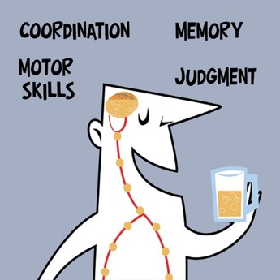
Alcohol’s Path Through the Body
Alcohol is a depressant
  It slows or reduces brain activity
  It affects areas of the brain as people drink
  These brain process are especially impacted:
    Major motor skills
    Coordination
    Memory
    Judgment
  This can make tasks dangerous, especially driving

Slide 177
Alcohol’s Path Through the Body
What is Blood Alcohol Content (BAC)?
  Also called Blood Alcohol Concentration
    The amount of alcohol in a person’s bloodstream
    The percentage of a person’s blood that is alcohol
  How much alcohol can be in the bloodstream before the brain is affected?
  Only a small amount in the bloodstream will affect the brain
  Just a teaspoonful of ethanol in the bloodstream of a 150 lb. man can raise BAC to .08
Notes:
Instructor Notes:
Ask the question, What is blood alcohol content? Reveal the answers and discuss them.
BAC is the amount of alcohol in a person’s bloodstream. You have probably heard people talk about BAC as a percentage, such as .08 or .10. This is the percentage of a person’s blood that is alcohol. It doesn’t take much alcohol in the bloodstream before the brain becomes affected.

Slide 178
What Do You Think?
In most states, what’s the legal level for intoxication when driving?
A. .08
B. .10
Why? Research has shown that a person’s motor skills can be significantly affected at .08.
Notes:
Instructor Notes:
The answer is A.
Most states have defined the legal level of intoxication for driving at .08. Why? Because research has shown that a person’s motor skills can be significantly affected at .08. Keep in mind, though, that people can be impaired at lower BAC levels.

Slide 179
Blood Alcohol Content (BAC) and Driving: Alabama
Alabama law relating to driving under the influence (alcohol, controlled substances, etc.)
  Section 32-5A-191
  (a) A person shall not drive or be in actual physical control of any vehicle while:
  (1) There is 0.08 percent or more by weight of alcohol in his or her blood;
  (2) Under the influence of alcohol;
  (3) Under the influence of a controlled substance to a degree which renders him or her incapable of safely driving;
  (4) Under the combined influence of alcohol and a controlled substance to a degree which renders him or her incapable of safely driving; or
  5) Under the influence of any substance which impairs the mental or physical faculties of such person to a degree which renders him or her incapable of safely driving.
Notes:
Instructor Note:
This is what Alabama states regarding driving under the influence. Discuss this law with the class.

Slide 180
Blood Alcohol Content (BAC) and Driving: Alabama
Alabama law relating to driving under the influence cont.
  (b) A person who is under the age of 21 years shall not drive or be in actual physical control of any vehicle if there is 0.02 percent or more by weight of alcohol in his or her blood. The Department of Public Safety shall suspend or revoke the driver's license of any person, including, but not limited to, a juvenile, child, or youthful offender, convicted or adjudicated of, or subjected to a finding of, delinquency based on this subsection. Notwithstanding the foregoing, upon the first violation of this subsection by a person whose blood alcohol level is between 0.02 and 0.08, the person's driver's license or driving privilege shall be suspended for a period of 30 days in lieu of any penalties provided in subsection (e) of this section, and there shall be no disclosure, other than to courts, law enforcement agencies, the person's attorney of record, and the person's employer, by any entity or person of any information, documents, or records relating to the person's arrest, conviction, or adjudication of or finding of delinquency based on this subsection.
Notes:
Instructor Note:
This is a continuation of the previous slide. This is what Alabama states regarding minors driving under the influence. Discuss this law with the class.

Slide 181
Blood Alcohol Content (BAC) and Driving: Alabama
Alabama law relating to driving under the influence cont.
  All persons, except as otherwise provided in this subsection for a first offense, including, but not limited to, a juvenile, child, or youthful offender, convicted or adjudicated of or subjected to a finding of delinquency based on this subsection shall be fined pursuant to this section, notwithstanding any other law to the contrary, and the person shall also be required to attend and complete a DUI or substance abuse court referral program in accordance with subsection (k).
Notes:
Instructor Note:
This is a continuation of the previous slide. This is what Alabama states regarding the penalties for driving under the influence. Discuss this law with the class.

Slide 182
Other Risk Factors for Intoxication
Risks of Excessive Consumption:
  BAC’s of .30 or higher can lead to coma or death
  That’s why binge drinking is dangerous
    Binge drinking is drinking large amounts of alcohol in a short amount of time
Notes:
.

Slide 183
Alcohol’s Path Through the Body
Read the In The News story on page 2-7 in the ServSafe Alcohol Guide.
Notes:
Instructor Notes:
Ask students to read the In The News story on page 2-7 in the ServSafe Alcohol Guide. Discuss the consequences of a high BAC. Use a real world story of a similar event in Alabama.

Slide 184
Apply Your Knowledge: Fact or Myth?
Complete the Fact or myth? activity on page 2-8 in ServSafe Alcohol Guide.
Notes:
Instructor Notes:
Ask the class to turn to page 2-8 in their copy of ServSafe Alcohol Guide and complete the Fact or myth? activity. Tell them to put a check next to each activity that they believe can help an intoxicated person become sober. Then, go over the answers as a class.
Answers: The only thing that can break down alcohol in the blood stream is the liver. And it can only do this so quickly.

Slide 185
What Do You Think?
How fast does the liver break down alcohol in the bloodstream?
A. One drink per hour
B. Two drinks per hour
Why? A healthy liver processes alcohol at a constant rate of about one drink per hour.
Notes:
Instructor Notes:
Ask the class the question, “How fast does the liver break down alcohol in the bloodstream?”
The answer is A.
The liver processes alcohol at a constant rate of about one drink per hour. This assumes that the person has a healthy liver. Diseased or damaged livers may process alcohol even more slowly.

Slide 186
What Do You Think?
What will happen to a person who drinks more than 1 drink
per hour?
A. BAC will remain steady at .08
B. BAC will continue to increase
Why? It takes the liver a whole hour to remove a single drink from the body. If a person drinks any more than that, the alcohol will build up in the bloodstream and raise the BAC.
Notes:
Instructor Notes:
Ask the class the question, “What will happen to a person who drinks more than 1 drink per hour?”
The answer is B
Explain to the class that BAC is affected by how much a person drinks and how quickly. It takes the liver a whole hour to remove a single drink from the body. If a person drinks any more than that, the alcohol will build up in the bloodstream and raise BAC.

Slide 187
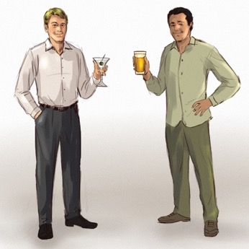
Apply Your Knowledge: Who’s BAC Is Higher?
Complete the Who’s BAC Is Higher? activity in the ServSafe Alcohol Guide on pages 2-9 and 2-10.
Notes:
Instructor Notes:
Ask the class to turn to pages 2-9 and 2-10 in their copy of ServSafe Alcohol Guide and complete the Whose BAC Is Higher activity. Tell them to circle the person in each pair who will have the higher BAC.
Then, go over the answers as a class.
Answers:
1. The answer is A.
The more alcohol a drink contains, the more that will end up in the bloodstream.
This results in a higher BAC. For example, a martini generally contains more alcohol than a
beer. So, if all other factors are the same, a martini drinker would have a higher BAC than a beer drinker.
2. The answer is B.
A small person will have a higher BAC than a large person, if all other factors are the same.
That’s because a small person’s body has less blood to dilute the alcohol than a large person’s body has.
The more blood someone has, the more diluted the alcohol becomes.
3. The answer is B.
All other factors being the same, a person with a larger amount of body fat will have a higher BAC than a lean person.
This is because body fat does not absorb alcohol. That means the alcohol has to stay in the bloodstream until the
liver can break it down. In people with less body fat, alcohol can pass through muscle and spread throughout the body,
giving them a lower BAC.
4. The answer is B.
All other factors being the same, a woman will have a higher BAC than a man. That’s because women generally have a higher percentage of body fat than men.
They also have a smaller amount of an enzyme that helps break down alcohol. They're also often smaller than men and so have less blood in their bodies.
5. The answer is A.
An older person will have a higher BAC than a younger person, all other factors being the same.
Here is why: The enzymes that break down alcohol tend to slow as a person gets older. Also, body fat typically increases with age.
6. The answer is A.
A person who is drinking a carbonated drink will have a higher BAC than a person whose drink is not carbonated, all other factors being the same.
Carbonation speeds the rate at which alcohol passes from the stomach to the small intestine.
This causes a person to reach a higher BAC at a faster rate.
7. The answer is B.
A person who has not eaten will have a higher BAC than a person who has eaten, all other factors being the same. Food keeps alcohol in the stomach for a longer period of time.
This slows the rate at which the food reaches the small intestine. So, if you know a guest is dieting, take special care.
The alcohol may pass more quickly through the stomach and into the small intestine, causing the guest to become intoxicated faster.

Slide 188
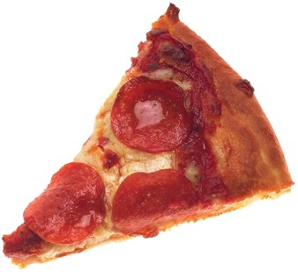
Apply Your Knowledge: Which Food?
Complete the Which Food Items Are Better for Slowing the Movement of Alcohol? activity in the ServSafe Alcohol Guide on page 2-13.
Notes:
Instructor Notes:
Ask the class to turn to page 2-13 in their copy of ServSafe Alcohol Guide and complete the Which Food Items are Better for Slowing the Movement of Alcohol? activity. Tell them to place an X next to each food item that they believe is good for slowing the movement of alcohol to the small intestine. Then, go over the answers.
Answers: 1, 4, 5, 6.
Explanation: Food that’s high in fat works well. So cheese is a good choice. And because it’s fried, it’s even better. Other examples include pizza, chicken wings, nachos, and other deep-fried items. Food that’s high in protein is a great choice. Especially things like meat, fish, and eggs. Food high in carbohydrates, like the bread and pretzels, are not good choices. These items are easily digested, so they are less effective in slowing the movement of alcohol into the small intestine. The pretzels are also not a good choice because they are salty. These items can make people thirsty and cause them to drink more.

Slide 189
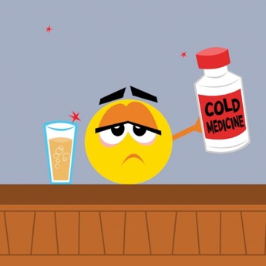
Factors That Affect Blood Alcohol Content (BAC)
Other risk factors should be considered red flags when observing guests:
  Feeling stressed, depressed, angry, or tired.
    This may cause people to be more susceptible to the effects of alcohol.
  Taking medications or illegal drugs.
    This can result in dangerous drug-alcohol interactions and/or intensified effects.
  Certain health conditions such as cirrhosis of the liver, diabetes, and transplants.
    People with these conditions are more likely to feel the effects of alcohol.
Notes:
Instructor Notes:
Explain to the class that there are other risk factors for intoxication that they should know about.
Explain to the class that it can be hard to tell if someone has a health condition just by looking at them. But sometimes they’ll tell you about it as they drink. That’s why listening to your guests is a valuable skill to develop.

Slide 190
Factors That Affect Blood Alcohol Content (BAC)
Other risk factors should be considered red flags when observing guests: cont.
  Intent on becoming intoxicated
  A person may be at a higher risk based on why they are drinking
  Certain events can trigger emotions that can cause guests to drink more:
    To forget about a sad event, such as a funeral
    To celebrate a special event, such as a wedding
    To catch up to friends who have had more drinks
    While watching a sports event

Slide 191
Factors That Affect Blood Alcohol Content (BAC)
Other risk factors should be considered red flags when observing guests: cont.
  Keep in mind that some people will be affected by a combination of risk factors
    This means they are at an even higher risk for intoxication
    These people will need more attention to prevent intoxication

Slide 192
Assessing a Guest’s Level of Intoxication
A guest’s level of intoxication can be assessed two ways:
  Count the number of drinks you serve.
  Observe the guest’s behavior.
Using a combination of the two is the best approach for preventing over-service.
Notes:
Instructor Notes:
Point out that when you know that a person is a high-risk drinker, you will need to watch that guest more closely. Doing this can help prevent over service. But the real key to preventing over service is knowing how to assess a guest’s level of intoxication.

Slide 193
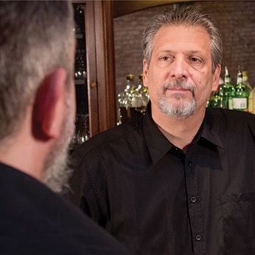
Assessing a Guest’s Level of Intoxication
When should you start assessing your guest’s level of intoxication?
  Assess people from the time they enter the establishment until they leave.
  Watching guests’ behavior from the time they arrive will serve as a reference point to spot changes in behavior.
  You are responsible from the moment guests arrive, during their time on the premises, and even after they leave.
  If a person is showing signs of intoxication or you are concerned about a guest’s alcohol consumption, tell your manager and coworkers and stop service.
Notes:
Instructor Notes:
Ask the class the question, “When should you start assessing your guest’s level of intoxication?” Discuss the answers given and display the text.

Slide 194
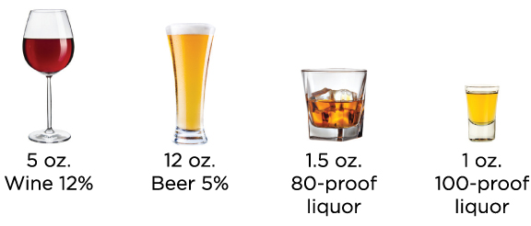
Counting Drinks
All of these drinks contain the same amount of alcohol, and are considered one “standard drink.”
Notes:
Instructor Notes:
Counting drinks can be useful for determining if a guest is intoxicated. This is especially true when the guest is not showing any signs of intoxication.
But before you can count drinks, you first need to know what a drink is. All of these drinks contain the same amount of alcohol, and are considered one “standard drink.”
BUT REMEMBER: these are just the standard. Some beer, wine, and other alcoholic beverages have a higher alcohol content, so they must be counted differently.

Slide 195
What Do You Think?
Can a beverage contain more alcohol than a “standard drink”?
A. Yes
B. No
Why? The size of a beverage and its contents also affect the way it is counted. Some beverages contain more alcohol than the standard drinks.
Notes:
Instructor Notes:
Ask the class the question, “Can one beverage can contain more alcohol than a standard drink?“
The answer is Yes, one beverage can contain more alcohol than a standard drink.
The size of a beverage and its contents also affect the way it is counted. That is because some beverages contain more alcohol than the standard drinks.
Tell the class that they will have to figure out the actual number of drinks in them. Sometimes, one beverage on a menu can equal several standard drinks!

Slide 196
Counting Drinks
To calculate the standard number of drinks in a beverage:
Amount of liquor in the beverage
Amount of liquor in 1 standard drink
Number of drinks in beverage
÷
=

Slide 197
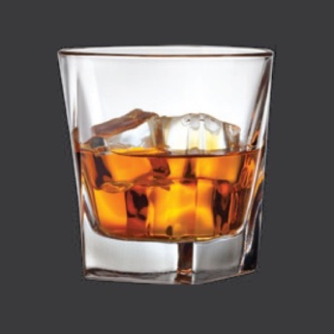
Counting Drinks
How many standard drinks are in a three ounce glass of 80-proof whiskey?
2 drinks
3
ounces of 80-proof whiskey
÷
1.5
ounces of 80-proof liquor in 1 standard drink
=
2
drinks
Notes:
Instructor Notes:
Ask the class the question, “How many standard drinks are in a three ounce glass of 80-proof whiskey?” Discuss the answers given and display the text.

Slide 198
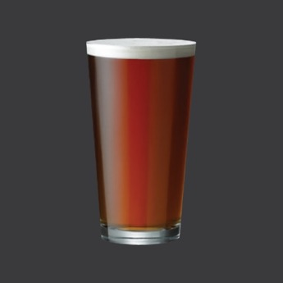
Counting Drinks
How many standard drinks are in a 16 ounce glass of 5% ABV beer?
1.33 drinks
16
ounces of
5% beer
÷
12
ounces of beer (5%) in 1 standard drink
=
1.33
drinks
Notes:
Instructor Notes:
Ask the class the question, “How many standard drinks are in a 16 ounce glass of 5% ABV beer?” Discuss the answers given and display the text.

Slide 199
Counting Drinks
Mixed Drinks
  Often contain multiple liquors.
  This makes counting them a challenge, especially if the liquors each have different amounts of alcohol.
  Always remember to round up when counting drinks.
Notes:
Instructor Notes:
Explain to the class that mixed drinks often contain multiple liquors, and counting them can be a challenge, especially if the liquors each have different amounts of alcohol. But don’t worry too much about
the math. Most establishments make these calculations for you for each drink served. Always remember, though, that it’s better to round up when counting drinks.

Slide 200
Apply Your Knowledge: Calculating Drinks
Complete the Calculating Drinks activity on page 2-18 in ServSafe Alcohol Guide.
Notes:
Instructor Notes:
Ask class to turn to page 2-18 in their copy of ServSafe Alcohol Guide and complete the Calculating Drinks activity. Tell them select the best answer for each question. Then, go over the answers as a class.
Answers:
1. C. Divide 60 ounces by 12, the amount of beer in one standard drink, to get five drinks.
2. A. Divide 15 ounces by 5 ounces, the amount of wine in one standard drink, to get three drinks.
3. B. Divide 3 ounces by 1.5 ounces, the amount of 80-proof liquor in one standard drink, to get two drinks.
4. B. One ounce of 100-proof bourbon is one standard drink. The 12-ounce beer is another standard drink. This gives a total of 2 drinks.

Slide 201
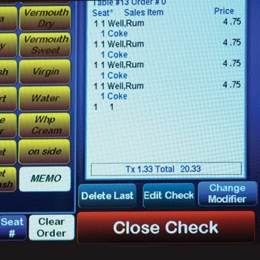
Estimating BAC
Steps when estimating BAC:
  Count the number of standard drinks the person was served.
  Estimate the person’s weight.
  Determine the person’s BAC using a BAC chart.
Notes:
Instructor Notes:
Explain to the class that while you do not have to know a person’s BAC, you do have to decide whether to continue serving alcohol. Being able to estimate BAC can help with this decision.

Slide 202
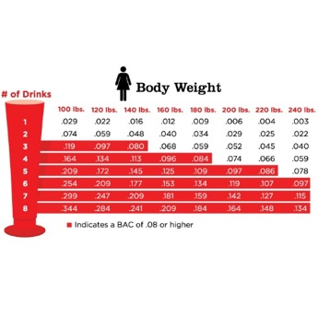
Estimating BAC
BAC Charts
  There are different BAC charts for men and women.
  The ServSafe Alcohol BAC charts are based on:
    Number of drinks consumed in one hour
    Assumption that a person’s liver breaks down one drink per hour
  The charts highlight BACs of .08 or higher by putting them in red.
Notes:
Instructor Notes:
Remember: A BAC of .08 is the legal level of intoxication while driving in most states.

Slide 203
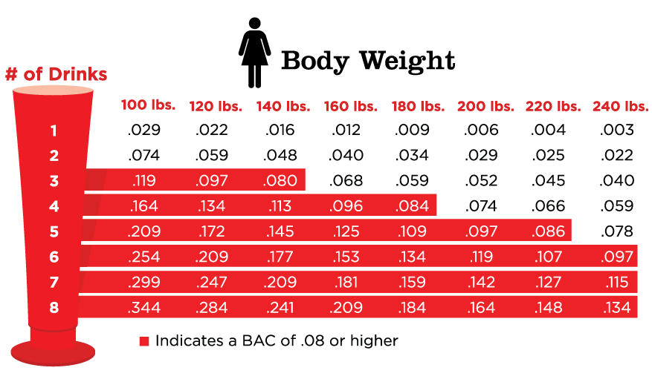
Estimating BAC
To use the BAC chart:
  Go to the row for the number of drinks.
  Follow the row across until you have reached the column with the person’s estimated weight.
  Where the row and column meet, you will find the person’s estimated BAC.
Notes:
Instructor Notes:
This screen highlights the BAC for a 120 found female who has consumed three standard drinks.

Slide 204
Estimating BAC
When estimating BAC, keep in mind:
  A person's actual BAC may be higher or lower than the chart.
  BAC charts cannot account for other factors:
    Prior drinking
    Physical condition
    Emotional state
    Prior eating
    Medication that has been taken
  BAC charts should only be used as a reference.
Notes:
Instructor Notes:
Review things to keep in mind when estimating a person’s BAC.

Slide 205
Apply Your Knowledge: Using a BAC chart
Complete the Using a BAC Chart activity on page 2-21 in ServSafe Alcohol Guide.
Notes:
Instructor Notes:
Ask the class to turn to page 2-21 in their copy of ServSafe Alcohol Guide and complete the Using a BAC Chart. Tell them to answer each question. Then, go over the answers as a class.
Answers:
1. The man’s estimated BAC is .046. No, he is not at the legal limit for driving.
2. The woman’s estimated BAC is .080. Yes, she is at the legal limit for driving.

Slide 206
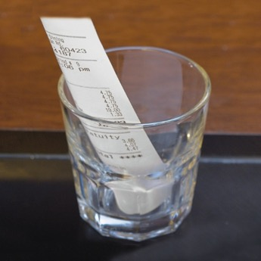
Tracking Drink Counts
How do you track drink counts in your operation?
  Use a physical tally sheet.
  Mark drinks on a coaster or napkin.
  Place a printed receipt in front of the guest,
  and update it each time the guest is served another drink.
  Use the point-of-sale system.
  Keep a drink tally on the back of the guest check.
Notes:
Instructor Notes:
Point out that there are many ways to track the number of drinks served to a guest. It really just depends on the type of establishment you work in and how busy you are.
Ask the class the question, “How do you track drink counts in your operation?“ Discuss the answers given and display the text.
After reviewing the bullet points, remind the class that in some establishments, the guest check moves with the guest, which makes counting easier. Regardless of the method, you should share drink counts with other staff members and serving stations. Remember, tracking drinks is a shared responsibility.

Slide 207
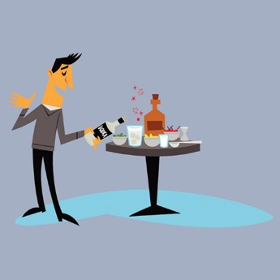
Tracking Drink Counts
Some situations can make it difficult to track drink counts.
  Bottle Service: Bottles of liquor are sold to the table and guests can mix their own drinks.
  Tableside Dispensers: Beer and wine tableside dispensers allow guests to serve themselves.
  Establishments with self-service options must create and follow policies to monitor guests.
Notes:
Instructor Notes:
Review the content on the screen, and then explain to the class that establishments that offer self-service opportunities must create policies to monitor guests—and then stick to the policies. For example, some bottle service establishments will assign a host to the table to make drinks using the guest’s liquor bottles and mixers. This allows the host to count each guest’s drinks.

Slide 208
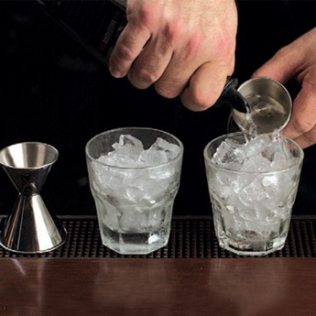
Tracking Drink Counts
Over-pouring makes it difficult to track drink counts.
  For example, three ½ ounce over-pours of 80-proof liquor will equal one additional standard drink.
  Bartenders must know and follow recipes.
  Bartenders should be tested on this knowledge.
  Always use the right-size glass. This is especially true for wine, as it can be easy to over-pour.
Notes:
Instructor Notes:
Let’s say that a recipe for a gin and tonic calls for one and a half ounces of 80-proof gin. During a guest’s visit, you mix three gin and tonics for the guest. But you pour an extra half ounce of gin in each drink. This means that you have actually served that guest four drinks instead of three.

Slide 209

Observing Guests for Signs of Intoxication
What you should look for:
  Physical and behavioral changes
    A change in behavior is more revealing than the actual behavior
  Why the guest is there
    Talk to the guest
    Keep talking throughout their stay
    Lets you know intent and if the guest is becoming intoxicated
Notes:
Instructor Notes:
A change in behavior is more revealing than the actual behavior itself. There’s a big difference between a normally loud guest and one who is quiet at first but becomes loud after a few drinks. Communication is also important. By talking to your guests, you can get a better idea of why they’re there and whether or not they’re becoming intoxicated. That’s why it’s important to keep talking to each person throughout his or her stay.

Slide 210

Observing Guests for Signs of Intoxication
Signs of intoxication:
  Relaxed inhibitions
  Impaired judgment
  Slowed reaction time
  Impaired motor coordination
Notes:
Instructor Notes:
When large amounts of alcohol reach the brain, it stops functioning normally. This results in the physical and behavioral changes identified in the slide.
Point out that most people know when they see someone with impaired motor coordination that the person is intoxicated. But some of the other signs of intoxication are harder to spot, especially if there hasn’t been enough time to see a change in the person’s behavior. Not surprisingly, it is the subtle signs that you really have to watch for.

Slide 211
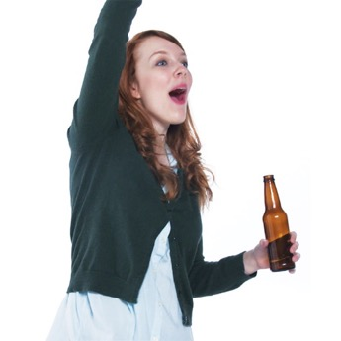
Observing Guests for Signs of Intoxication
Relaxed Inhibitions:
  Inhibitions prevent people from saying or doing things that may be unacceptable
  As people drink, their inhibitions become relaxed

Slide 212
Observing Guests for Signs of Intoxication
What are some signs of relaxed inhibitions?
  Guests with relaxed inhibitions may show these behaviors
    Be overly friendly
    Be unfriendly, depressed, or quiet
    Become loud
    Make rude comments
    Use foul language
Notes:
Instructor Notes:
Ask the class: What are some signs of relaxed inhibitions?. Discuss responses and reveal the answers.

Slide 213
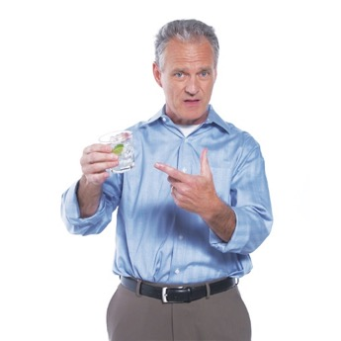
Observing Guests for Signs of Intoxication
Impaired Judgment:
  As people drink, the alcohol starts to impair their judgment
  They lose the ability to make sensible decisions

Slide 214
Observing Guests for Signs of Intoxication
  What are some signs of impaired judgment?
  Guests with impaired judgment may show these behaviors:
    Complain about the strength of a drink after drinking others of the same strength
    Begin drinking faster or switch to larger or stronger drinks
    Make irrational or argumentative statements
    Become careless with money, such as buying drinks for strangers
Notes:
Instructor Notes:
Ask the class: What are some signs of impaired judgment? Discuss responses and reveal the answers.

Slide 215
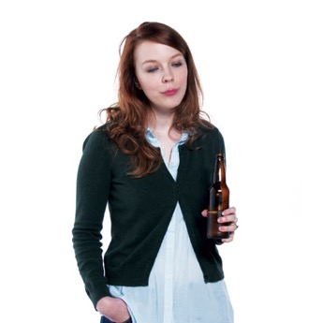
Observing Guests for Signs of Intoxication
Slowed Reaction Time:
  Guests’ reaction time and responses will become slower as they drink
  What are some signs of slowed reaction time?
  Guests with slowed reaction time may show these behaviors:
    Talk or move slowly
    Be unable to concentrate, lose their train of thought, or become forgetful
    Become drowsy
    Become glassy eyed, lose eye contact, or become unable to focus
Notes:
Instructor Notes:
Ask the class: What are some signs of slowed reaction time? Discuss responses and reveal the answers.

Slide 216
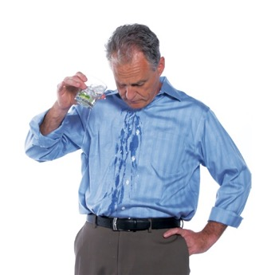
Observing Guests for Signs of Intoxication
Impaired Motor Coordination:
  Guests’ motor skills will be affected as they drink
  These people are easy to spot as they will exhibit the classic signs

Slide 217
Observing Guests for Signs of Intoxication
  What are some signs of impaired motor skills?
  Guests with impaired motor coordination may show these behaviors:
    Stagger, stumble, fall down, bump objects, or sway when sitting or standing
    Be unable to pick up objects or may drop them
    Spill drinks or miss their mouths when drinking
    Slur their speech
Notes:
Instructor Notes:
Ask the class: What are some signs of impaired motor coordination? Discuss responses and reveal the answers.

Slide 218

Observing Guests for Signs of Intoxication
Some people can handle the effects of alcohol without showing signs:
  This is called tolerance
  Tolerance does not affect BAC
  The only way to tell if an experienced drinker is intoxicated is by counting drinks
Inexperienced drinkers:
  Show signs of intoxication after drinking small amounts of alcohol
  Their bodies are not used to it
Notes:
Instructor Notes:
Some people can handle the effects of alcohol without showing the usual signs. In fact, many experienced drinkers can drink quite a bit of alcohol without showing any signs. This ability, or tolerance to alcohol, does not affect a person’s BAC at all. How can you tell if an experienced drinker is intoxicated?
You have to count their drinks. In contrast, people who are not experienced drinkers often show signs of intoxication after drinking only a small amount of alcohol. Their bodies are not used to it, so they are sensitive to smaller amounts.

Slide 219
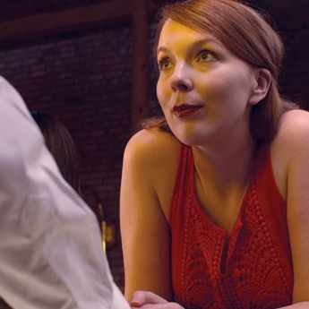
Is This Person Intoxicated? Scenario 1
Tiffany:
  Tiffany is unhappy. She accuses the bartender of scamming her by watering down her drinks, and calls him a cheat.
  She says that her first drink was fine, but the last two just tasted like water, ice, and lime.
  When the bartender explains that he measures all of his drinks the same way, Tiffany cuts him off and demands “a real drink.”
  She says that she’ll pay more for extra vodka if she has to.
Notes:
Instructor Notes:
Ask the class to read the story and decide if the person is intoxicated.
When everyone is ready, advance to the next slide.

Slide 220
Is This Person Intoxicated? Scenario 1
Is the guest intoxicated?
A. Yes
B. No
Why? She is complaining about the strength of her drinks and being argumentative—both signs of impaired judgment. She also made several rude comments, which may be a sign of relaxed inhibitions.
Notes:
Instructor Notes:
Ask the class the question, “Is the guest intoxicated?“
The answer is A. Yes, she is intoxicated.
She is complaining about the strength of her drink after drinking others of the same strength. She is also argumentative. These are signs of impaired judgement. She also made several rude comments, which may be a sign of relaxed inhibitions.

Slide 221
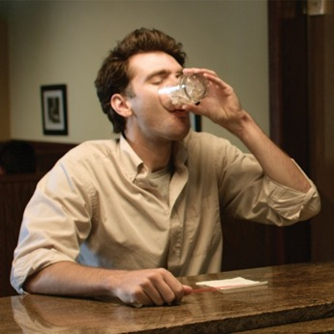
Is This Person Intoxicated? Scenario 2
Steve:
  Steve is having a great night, and his current tab shows that he’s had four rum and cokes.
  He compliments the bartender and says “I don’t know what you’re putting in these, but they’re really hitting the spot!”
  Steve chugs his current drink, and orders another. He adds “Hey, make it a double!”
Notes:
Instructor Notes:
Ask the class to read the story and decide if the person is intoxicated.
When everyone is ready, advance to the next slide.

Slide 222
Is This Person Intoxicated? Scenario 2
Is the guest intoxicated?
A. Yes
B. No
Why? He is drinking fast, and he wants to switch to a double—a much stronger drink. These are classic signs of impaired judgment.
Notes:
Instructor Notes:
Ask the class the question, “Is the guest intoxicated?”
The answer is A. Yes, the guest is intoxicated.
He is drinking fast, and he wants to switch to a double—a much stronger drink. These are classic signs of impaired judgment.

Slide 223
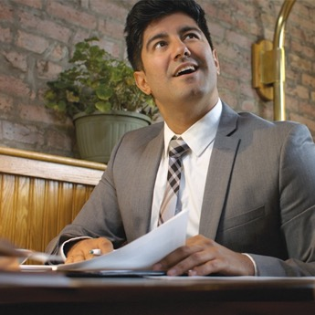
Is This Person Intoxicated? Scenario 3
Jerry and Donna:
  Jerry and Donna are coworkers. They are having a working dinner while reviewing papers.
  As they finish up a round of sliders, they discuss whether or not to order more.
  They call the server over and order more sliders. Donna orders another beer, and Jerry decides to join her in a round, adding “One more is my limit!”
Notes:
Instructor Notes:
Ask the class to read the story and decide if the people are intoxicated.
When everyone is ready, advance to the next slide.

Slide 224
Is This Person Intoxicated? Scenario 3
Are the guests intoxicated?
A. Yes
B. No
Why? There are no outward signs of intoxication because they are eating and have been at the establishment a while.
Notes:
Instructor Notes:
Ask the class the question, “Are the guests intoxicated?”
The answer is B. No, they do not seem to be intoxicated.
Even though it looks like they have each had a few drinks, there are no outward signs of intoxication. They are eating, which slows down the rate at which the alcohol gets into their bloodstream. They are also working, which makes it likely that they have been there for a while, giving their bodies more time to process the drinks.

Slide 225
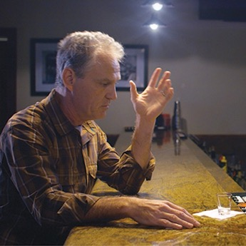
Is This Person Intoxicated? Scenario 4
Pete:
  Pete downs his first shot and asks for a second. He grabs his next drink and starts talking.
  He explains that his wife of 15 years is leaving him, which he just found out about 15 minutes ago.
  Pete empties his shot glass and says “I’m going to need a few more of these. Nothing this stuff can’t fix, am I right?”
Notes:
Instructor Notes:
Ask the class to read the story and decide if the person is intoxicated.
When everyone is ready, advance to the next slide.

Slide 226
Is This Person Intoxicated? Scenario 4
Is the guest intoxicated?
A. Yes
B. No
Why? He is not intoxicated, at least not at this point.
Notes:
Instructor Notes:
Ask the class the question, “Is the guest intoxicated?”
The answer is B. No, he is not intoxicated, at least not at this point.
He is a big man, and he has only had two shots so far. But his rate of drinking and his emotional state are a concern. He needs to be watched closely.

Slide 227
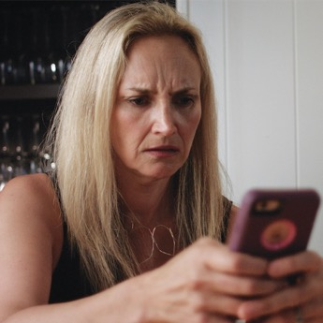
Is This Person Intoxicated? Scenario 5
Marla:
  Marla sets her wine glass down on the table very slowly and carefully.
  She receives a text on her phone, but has trouble picking it up and hitting the right keys. Marla also has trouble reading the text.
  She gives up on the phone, then asks her server for another glass of wine. She slurs her words a bit.
  When her wine arrives, Marla nearly knocks it over. She grabs the glass, drinking half of it in one gulp.
Notes:
Instructor Notes:
Ask the class to read the story and decide if the person is intoxicated.
When everyone is ready, advance to the next slide.

Slide 228
Is This Person Intoxicated? Scenario 5
Is the guest intoxicated?
A. Yes
B. No
Why? Her reaction time was affected by alcohol and she showed signs of impaired motor coordination.
Notes:
Instructor Notes:
Ask the class the question, “Is the guest intoxicated?”
The answer is A. Yes, she is definitely intoxicated.
She showed classic signs that her reaction time was being affected by the alcohol. She was moving slowly when she set the glass down and she had trouble focusing to read the text. She also showed signs of impaired motor coordination: almost knocking over the glass, having difficulty picking up the phone and texting, and slurring her speech.

Slide 229
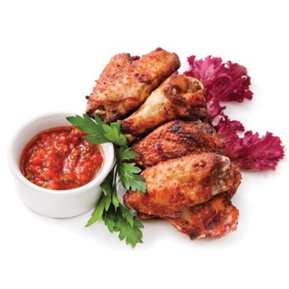
Preventing Guests From Becoming Intoxicated
How can you prevent guests from becoming intoxicated?
  Offer Water: Alcohol can cause dehydration, leading to more drinking. Offering water reduces dehydration and may reduce alcohol consumption.
  Offer Food: Food keeps alcohol in the stomach for a longer period of time, slowing its movement into the small intestine and bloodstream.
  Offer Nonalcoholic Drinks: Offer nonalcoholic drinks as an alternative to alcohol. Allows guests to still feel part of the group.
Notes:
Instructor Notes:
Ask the class the question, “How can you prevent guests from becoming intoxicated?” Discuss the answers given and display the text.
Explain to the class that, when offering food to guests, avoid suggesting carbohydrates and salty food. Offering nonalcoholic drinks can allow people who have had service stopped feel like they are still part of the group.

Slide 230
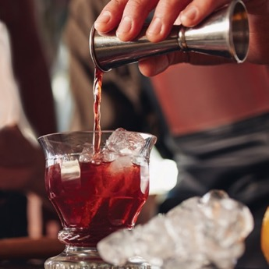
Preventing Guests From Becoming Intoxicated
How can you prevent guests from becoming intoxicated? cont.
  Measure Liquor: It can be measured using jiggers, mechanical pour spouts, or technology-equipped pour spouts.
  Free-pour accurately:
    If free-pouring is allowed, train bartenders to free-pour accurately.
    Regularly test the bartenders’ accuracy.

Slide 231
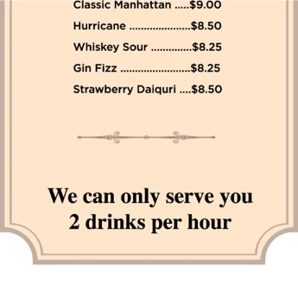
Preventing Guests From Becoming Intoxicated
How can you prevent guests from becoming intoxicated? cont.
  Set Drink Limits: Some operations limit the number of drinks that will be served to a guest.
    Setting a maximum number of drinks served to a guest per hour is one example.
    These limits slow drinking, which can help prevent intoxication.

Slide 232
Apply Your Knowledge: Self-Check
Complete the Self-Check on page 2-28 in ServSafe Alcohol Guide.
Notes:
Instructor Notes:
Ask the class to turn to page 2-28 in their copy of ServSafe Alcohol Guide and complete the Self-Check. Tell them to answer each question. Then, go over the answers as a class.
Answers:
1. D; 2. A; 3. B; 4. D; 5. D; 6. A; 7. C; 8. B; 9. A; 10. A

Slide 234
What Do You Think?
How Do You Feel about Checking IDs?
Notes:
Instructor Notes:
Ask the class the question, “How do you feel about checking IDs?” Discuss the answers given.
As you can see, a lot of people are uncomfortable when it comes to carding. Try not to worry about it.

Slide 235
Objectives
After completing this chapter, you will be able to identify the following:
  When to check IDs
  Which types of ID are acceptable
  What makes an ID valid
  The signs of a fake or altered ID
  How to determine if a person is 21 or older
  How to determine if an ID belongs to the person who gave it
Notes:
Instructor Notes:
Review the objectives with the class.

Slide 236
Apply Your Knowledge: Who is 21 or Older?
Complete the Who’s 21 or Older? activity on page 3-2 in
ServSafe Alcohol Guide.
Notes:
Instructor Notes:
Ask the class to turn to page 3-2 in their copy of ServSafe Alcohol Guide and identify which person is 21 or older.
The correct answer is A.
Both women appear 21 or older, but only one is old enough to drink. Even if you correctly guessed which woman is old enough to be served, hopefully this exercise made you think. Serving alcohol based on a hunch about someone’s age is dangerous and irresponsible. The penalties can be severe, and you could put people in danger, too. Are you willing to do that based on how old you think someone looks?

Slide 237
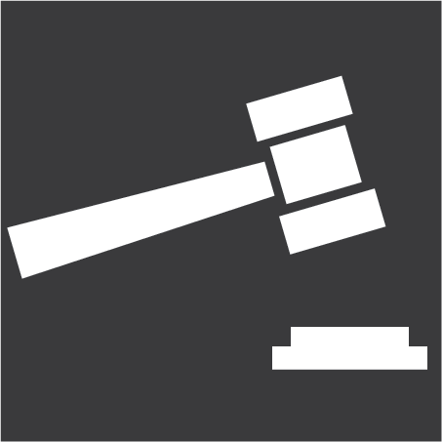
Consequences for Not Checking IDs
  Serving alcohol to an underage guest can result in:
  Severe legal penalties
  Job loss
  Risk to business
  People in danger
Notes:
Instructor Notes:
Review the legal consequences for not checking IDs with the class.

Slide 238
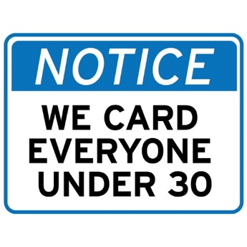
When to Check IDs
Always remember the following when checking IDs:
  Follow company policies and local laws:
    Some states provide specific guidelines for checking IDs
    For example, if someone looks older than 21 but younger than 30, you might be required to check ID
  Card guests if they leave and then return

Slide 239
What Do You Think?
You are unsure about the age of a guest who was previously carded by a coworker. Should you recheck their ID?
A. Yes
B. No
Why? It’s your responsibility to check the ID of any guest you’re unsure about–even if that guest was previously carded by a coworker. Don’t assume guests are old enough even if they have drink tickets, are wearing a wrist band, or were stamped to indicate they were carded.
Notes:
Instructor Notes:
The answer is A. It’s your responsibility to check the ID of any guest you’re unsure about–even if that guest was previously carded by a coworker.

Slide 240
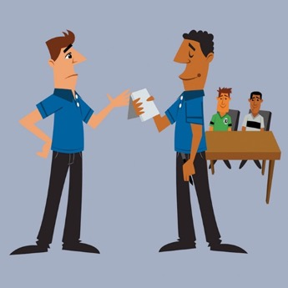
When to Check IDs
Always remember the following when checking IDs:
  Do not allow underage guests to be served
    If you do, you could be held liable
    This is true even if the guest presented what appeared to be a genuine ID
  Communicate with your team
    Discuss underage attempts with other staff
    It’s everyone’s responsibility to ensure underage guests are not served alcohol

Slide 241
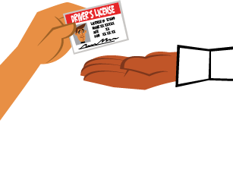
How to Check IDs
  Before accepting an ID make sure:
  The ID is acceptable
  The ID is valid
  The ID has not been falsified or altered
  The guest is old enough to be served alcohol
  The ID belongs to the guest
Notes:
Instructor Notes:
Review the items that should be looked at on an ID before accepting it. Once you have determined the ID is an acceptable type, you can check the other items in any order. More details on the following slides on each of these.

Slide 242
What Do You Think?
Can you accept an ID that’s shown to you in a wallet?
A. Yes
B. No
Why? You need to hold the ID to make sure it’s genuine.
Notes:
Instructor Notes:
The answer is B.
Never let a guest just show you an ID or leave it in their wallet. Politely ask the guest to remove the ID and hand it to you. If the guest asks why, apologize and explain that it’s company policy.

Slide 243
How to Check IDs
Hold the ID and check both sides:
  Never let a guest simply show you an ID or leave it in their wallet.
  You need to hold an ID so you can feel it and see both sides
    This helps ensure it’s real and not altered
  If a guest shows you an ID in a wallet
    Politely ask the guest to remove it
    Apologize and cite company policy if the guest asks why
Notes:
Instructor Notes:
Getting an ID in your hands is just the first step in checking an ID. You also have to know whether you can accept it for proof of age. This depends on the laws in your area. For example, some areas do not allow out-of-state drivers’ licenses or state ID cards to be used for alcohol service. Others do.
If you’re not sure which types of IDs are acceptable where you work, check with your manager. Most states accept the same types of IDs. You probably already know some of them, but see if you can identify all of them.

Slide 244
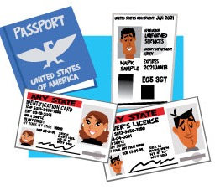
How to Check IDs
What types of IDs are acceptable:
  Acceptability depends on the laws in the area.
  Most states accept the same types of IDs.
  Check with your manager.
Notes:
Instructor Notes:
Getting an ID in your hands is just the first step in checking an ID. You also have to know whether you can accept it for proof of age. This depends on the laws in your area. For example, some areas do not allow out-of-state drivers’ licenses or state ID cards to be used for alcohol service. Others do.
If you’re not sure which types of IDs are acceptable where you work, check with your manager. Most states accept the same types of IDs. You probably already know some of them, but see if you can identify all of them.

Slide 245
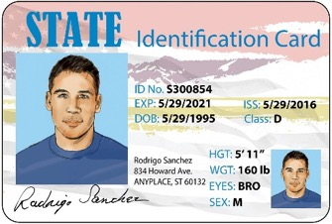
Apply Your Knowledge: Which IDs are Acceptable?
Complete the Which IDs are Acceptable? activity on page 3-5 in ServSafe Alcohol Guide.
Notes:
Instructor Notes:
Ask the class to turn to page 3-5 in their ServSafe Alcohol Guide and complete the Which IDs are Acceptable? activity. Tell them to put a check next to each ID that is acceptable as proof of age in most states. Then, go over the answers as a class.
Answers 1, 3. 5 and 6 are accepted in most states, but 7 depends on the area. Ask your manager if a permanent resident card is acceptable in your area.
Point out to the class that if they are not familiar with some of these Ids they should use an ID checking guide to validate them. This guide is covered later.

Slide 246
Types of Acceptable IDs: Alabama
Minors
Section 20-X-.09(1)(d)
It shall be unlawful:
(d) For a licensee, employee or agent thereof to accept any proof of age from a person purchasing or attempting to purchase alcoholic beverages, except for the following:
1. A valid driver's license of any state.
2. A valid United States Uniformed Service Identification.
3. A valid passport.
4. A valid identification issued by any agency of a state for the purpose of identification, bearing a photograph and date of birth of the individual in question.
Notes:
Instructor Notes:

Slide 247
What Do You Think?
Is an ID valid if it is damaged?
A. Yes
B. No
Why? In most states, a damaged ID is not valid and cannot be accepted. Damage could have been caused by someone altering the ID.
Notes:
Instructor Notes:
The answer is B.
In most states, a damaged ID is not valid and cannot be accepted. Damage could have been caused by someone altering the ID. Point out that this is only one condition for determining if an ID is valid. There are others.

Slide 248
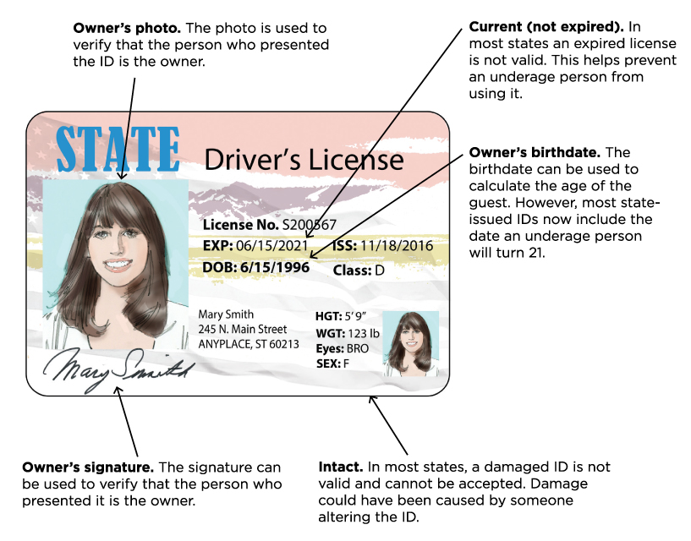
How to Check IDs
A valid ID has the following features:
Notes:
Instructor Notes:
An ID must be valid before you can accept it. That means, it has all the parts that it should. Discuss the features of a valid ID.

Slide 249
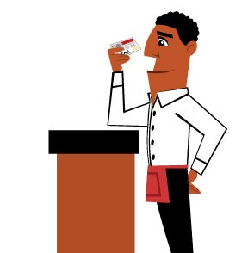
How to Check IDs
To ensure an ID is real and not altered:
  Use ID checking guides
  Check security features
  Check for signs of tampering
  Use tools designed for checking IDs
Notes:
Instructor Notes:
Part of checking an ID is determining whether it appears to be real. Unfortunately, fake IDs are becoming more common and many of them are pretty convincing.
How do you know if an ID is real or not? The key is knowing what a real ID is supposed to look like.

Slide 250
How to Check IDs
  ID Checking Guide
  Provide samples and descriptions of current driver’s licenses and state ID cards.
  Include detailed descriptions of security features on IDs.
Managers should:
  Have ID checking guides available for staff. Make sure they know where these guides are located.
  Make sure these guides are current. ID checking guides are issued annually.
  Make sure appropriate staff are trained on how to use these guides.
Notes:
Instructor Notes:
One of the most important tools for checking IDs is an ID checking guide. Consider placing a guide at each POS terminal.

Slide 251
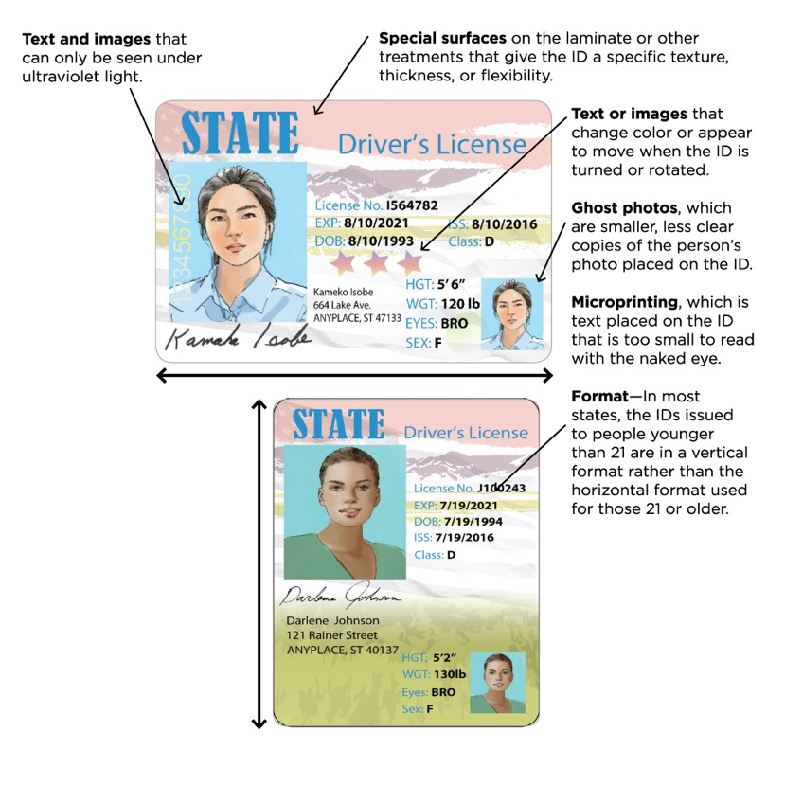
How to Check IDs
Security Features
Notes:
Instructor Notes:
Other tools used in recognizing fake or altered IDs are security features. Government agencies use them on IDs to make them harder to alter or fake. Let’s take a look at this example together.

Slide 252
What Do You Think?
Can a person with a vertical ID be 21 or older?
A. Yes
B. No
Why? IDs do not always expire on a person’s birthday. If the guest has turned 21 and the ID is not expired, it may be OK to serve the person, assuming everything else checks out.
Notes:
Instructor Notes:
The answer is A.
A person who gives you a vertical ID may have actually turned 21. Check the ID carefully. If the guest has turned 21 and the ID is not expired, it may be okay to serve that person assuming everything else checks out okay.

Slide 253
What Do You Think?
Is it okay to accept an ID that is blank on the back?
A. Yes
B. No
Why? All government-issued ID cards have information on the back.
Notes:
Instructor Notes:
The answer is B.
All government-issued ID cards have information on the back such as bar codes, magnetic strips, or both.
These contain specific data about the person, which can be accessed using an ID reader. The back of fake IDs are sometimes blank.

Slide 254
When to Check IDs
Signs of Tampering:
  Surface issues: The surface is NOT how it should be for the type of ID, such as smooth, embossed, or textured.
  Lamination flaws: The lamination has flaws, such as holes, cuts, tears, or bubbles.
  Rough edges: The edges are rough rather than smooth.
  Blurry or raised photos: The photo is blurry or has raised edges. Either can mean someone added a new photo.
  Thickness: The ID is too thick or too thin. If it is too thick, it could mean someone added layers to hide something.
Notes:
Instructor Notes:
Once you have an ID in your hands, look at it closely. Remember, in most states, a damaged ID is not valid. If you find any damage or signs of tampering, do NOT accept the ID.

Slide 255
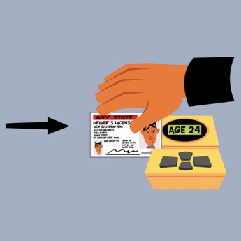
How to Check IDs
Tools for checking IDs:
  Flashlight
  ID reader
  Magnifying glass
  Ultraviolet light
  These tools should only be used to help with the ID checking process. They should never replace a good thorough inspection.
Notes:
Instructor Notes:
Introduce the tools to the learners, but don't talk about specifics. The specific information on each tool will be covered in the next several slides.
Tell learners that the activity on the following slides will help them to determine the correct tool for the intended purpose.

Slide 256
Apply Your Knowledge: Which Tool Should You Use?
Complete the Which Tool Should You Use? activity on page 3-10 in ServSafe Alcohol Guide.
Notes:
Instructor Notes:
Ask the class to turn to page 3-10 in ServSafe Alcohol Guide and complete the Which Tool Should You Use? activity. Tell them to place the correct letter in the blank space next to its corresponding number. Then go over the answers as a class.
The answers are:
1. D - Ultraviolet lights show security features that do not appear under regular light.
A - Magnifying glasses can be used to see microprinting on an ID.
C - Flashlights can be used to backlight IDs. This reveals pin holes, cut marks, and other signs of tampering.
B - ID readers show the card holder’s age and other information from the ID’s magnetic stripes or bar codes.

Slide 257
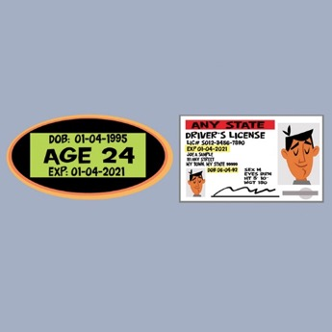
How to Check IDs
When using ID readers:
  Compare the readout with the information on the ID.
  If it doesn’t match, the ID is fake or was altered.
  If the ID reader gives an error code, check the magnetic stripe or bar codes:
    People can intentionally scratch them to stump the ID reader.
    If there are scratches, politely ask for another valid form of ID.

Slide 258
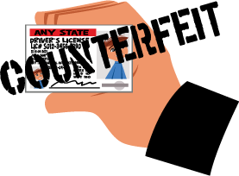
How to Check IDs
When dealing with a fake or altered ID, you may be required to:
  Refuse entry to the establishment
  Confiscate the ID, if required
  Call the police, if required
Notes:
Instructor Notes:
When someone uses a fake or altered ID, you cannot serve them alcohol. You may also be required to take the actions identified in the slide. Always follow your company policy and the law in your area.

Slide 259

How to Check IDs
How to calculate if someone is 21 or older:
1. Add 21 to the person’s birth year
    To make this easier, add 20 to the birth year and then add 1 to the total.
    The calculated year plus the person’s birthday tell you when the person turns 21.
  2. Determine if the person’s birthday has passed
    Compare the current date to the calculated date when the person will turn 21: the month, day, and year. If the person’s birthday has passed, the person is 21 or older. If not, the person is underage.
    Example:
Notes:
Instructor Notes:
There is still one more thing to check on an ID: whether the guest is 21 or older.
While most state-issued IDs show when someone underage will turn 21, you still need to know how to calculate a person’s age to see if they're 21 or older.

Slide 260

How to Check IDs
Signs
  Some establishments post signs or calendars stating that a guest must have been born on or before a certain date to be served alcohol
  These can be helpful in determining if a guest is old enough to drink.

Slide 261
Apply Your Knowledge: Old Enough to Drink?
Complete the Old Enough to Drink? activity on page 3-13 in the ServSafe Alcohol Guide.
Notes:
Instructor Notes:
Ask the class to turn to page 3-13 in the ServSafe Alcohol Guide and complete the Old Enough to Drink? activity. Then go over the answers as a class.
The answers are:
Yes. The guest turned 21 on November 30, 2018.
No. The guest will not turn 21 until May 17, 2019
Yes. The guest turned 21 on March 6, 2019.

Slide 262

How to Check IDs
To make sure an ID belongs to the person:
  Compare the person to the ID photo: Look at the features that usually do not change over time:
      Shape of the chin
      Shape of the head
      Distance between the eyes
      Location and shape of the ears
      Distance between the eyebrows and hairline
      Visible scars
Notes:
Instructor Notes:
What if an underage guest uses the valid ID of an older family member or friend? Or what if they use the expired ID of an older person who has been issued a new one? This is a pretty common practice. The way to combat it is to make sure the ID actually does belong to the person who gave it to you.

Slide 263

How to Check IDs
To make sure an ID belongs to the person:
  Compare the person to the physical traits on the ID. Look at the following traits on the ID to see if they match the person:
Notes:
Instructor Notes:
Although physical traits can change over time, many of them can still be used to help determine if the ID belongs to the person who presented it.

Slide 264
What Do You Think?
What should you do if you’re still not sure an ID belongs to someone?
A. Take your best guess
B. Ask for another ID
Why? You are liable for serving an underage guest. Ask for another acceptable type of ID. Some establishments may accept something of value with a person’s name on it as a second form of identification. Ask your manager.
Notes:
Instructor Notes:
The answer is B.
If you still have doubts about whether an ID belongs to someone, ask the person for another ID. You are liable for serving an underage guest.
Any of the acceptable ID types will work. However, some establishments will accept something of value with a person’s name on it, like a credit or debit card. Check with you manager to see if this is okay.

Slide 265

How to Check IDs
If you are still having doubts about the person:
  Ask questions that the ID owner should know:
    What is your address?
    What is your birthdate or age?
    How tall are you?
    What is your middle name?
  If the person hesitates, they may not be the ID owner.
  You can also ask guests to sign their name on a piece of paper and compare it to the signature on the ID.

Slide 266

Did They Handle It Correctly? Scenario 1
Caleb:
  Caleb is busy bartending when a young, nervous-looking female customer arrives.
  Caleb wants to be helpful. He manages to ask the customer what she’d like. After hesitating, she says “How about that light beer?”
  Caleb asks for ID and the woman hands him her wallet. He checks the birthdate without removing the ID. Everything looks okay, and he gets the woman her drink.
Notes:
Instructor Notes:
Ask the class to read the story and decide if the bartender handled the situation correctly.
When everyone is ready, advance to the next slide.

Slide 267
Did They Handle It Correctly? Scenario 1
Did the bartender handle the situation correctly?
A. Yes
B. No
Why? The bartender should have asked the person to take her ID out of the wallet and hand it to him. Then he should have spent more time checking the front and back of the ID and comparing it to the person.
Notes:
Instructor Notes:
The answer is B.
The bartender should have asked the person to take her ID out of the wallet and hand it to him. Then he should have spent more time checking the front and back of the ID and comparing it to the person.

Slide 268

Did They Handle It Correctly? Scenario 2
Jeff:
  A young-looking couple arrive at the club and offer Jeff, the doorman, their IDs. Jeff examines them front and back. He makes sure that the photos match.
  Jeff asks the male guest his age and birthday, which the guest volunteers.
  Jeff asks the male guest his height, and the guest replies “Five nine…I meant five-eleven.”
  Finally, Jeff asks the guest to provide a sample of his signature. After comparing the sample to the ID, Jeff refuses entry to the male.
Notes:
Instructor Notes:
Ask the class to read the story and decide “Did they handle it correctly?”
When everyone is ready, advance to the next slide.

Slide 269
Did They Handle It Correctly? Scenario 2
Did the door person handle the situation correctly?
A. Yes
B. No
Why? The door person thoroughly checked the ID—front and back—then compared it to the person to make sure it belonged to him. When he was unsure about that, he asked questions the ID owner should know and had the person write his signature.
Notes:
Instructor Notes:
The answer is A.
The door person thoroughly checked the ID—front and back—then compared it to the person to make sure it belonged to him. When he was unsure about that, he asked questions the ID owner should know and had the person write his signature.

Slide 270

Did They Handle It Correctly? Scenario 3
Mark:
  Mark arrives at a table with a couple already seated. When they order a round of margaritas, Mark asks for IDs.
  Mark examines the IDs, front and back, comparing the pictures and information with the guests.
  The male guest checks out. However, the female guest has an expired ID. Mark asks the female guest for an alternate form of ID, and she offers her passport.
  Mark carefully examines the passport, thanks the guests, and gets them their drinks.
Notes:
Instructor Notes:
Ask the class to read the story and decide “Did they handle it correctly?”
When everyone is ready, advance to the next slide.

Slide 271
Did They Handle It Correctly? Scenario 3
Did the server handle the situation correctly?
A. Yes
B. No
Why? The server checked the IDs thoroughly, making sure they belonged to the people and were acceptable and genuine. When he saw that one person’s license had expired, which made it invalid, he correctly asked for another valid form of ID.
Notes:
Instructor Notes:
The answer is A.
The server checked the IDs thoroughly making sure they belonged to the people and were acceptable and genuine. When he saw that one person’s license had expired, which made it invalid, he correctly asked for another valid form of ID.

Slide 272

Did They Handle It Correctly? Scenario 4
Nicole
  Nicole is serving a table of two middle-aged parents and their daughter. When they order a bottle of wine and three glasses, Nicole asks the daughter for her ID.
  The young woman offers Nicole a college ID. Nicole explains that a college ID is not acceptable and that she’d require another form of identification.
  The parents offer to “vouch” for their daughter, but Nicole explains that the establishment requires a valid ID.
  When the woman cannot provide a valid ID, Nicole politely tells her that she won’t be able to serve her. She then offers non-alcoholic alternatives.
Notes:
Instructor Notes:
Ask the class to read the story and decide “Did they handle it correctly?”
When everyone is ready, advance to the next slide.

Slide 273
Did They Handle It Correctly? Scenario 4
Did the server handle the situation correctly?
A. Yes
B. No
Why? The server did the right thing by rejecting the college ID and asking for another acceptable form of ID.
Notes:
Instructor Notes:
The answer is A.
The server did the right thing by rejecting the college ID and asking for another acceptable form of ID.

Slide 274

Did They Handle It Correctly? Scenario 5
Jasen:
  Jasen is working the door at a busy nightclub. There is a line of guests waiting to get in.
  As the guests arrive, Jasen quickly scans their IDs with an ID reader.
  After confirming that the scanner reads 21 or over, he allows the guests inside.
Notes:
Instructor Notes:
Ask the class to read the story and decide “Did they handle it correctly?”
When everyone is ready, advance to the next slide.

Slide 275
Did They Handle It Correctly? Scenario 5
Did the door person handle the situation correctly?
A. Yes
B. No
Why? While the door person did scan the licenses with an ID reader, he did not make sure that the readout matched the information on the licenses. He also failed to do a good, thorough inspection of the IDs.
Notes:
Instructor Notes:
The answer is B.
While the door person did scan the licenses with an ID reader, he did not make sure that the readout matched the information on the licenses.
He also failed to do a good, thorough inspection of the ID.

Slide 276
Apply Your Knowledge: Self-Check
Complete the Self-Check on page 3-17 in the ServSafe Alcohol Guide.
Notes:
Instructor Notes:
Ask the class to turn to page 3-17 in their copy of ServSafe Alcohol Guide and complete the Self-Check. Tell them to answer each question. Then, go over the answers as a class.
Answers:
1. A; 2. A; 3. C; 4. C; 5. C

Slide 278
What Do You Think?
How Do You Feel about Stopping Service?
Notes:
Instructor Notes:
Ask the class the question, “How do you feel about stopping service?” Discuss the answers given.

Slide 279
Objectives
After completing this chapter, you will be able to identify
the following:
  How to deal with intoxicated guests
  Ways to communicate in difficult situations
  How to handle potentially violent situations and violence
  How to handle illegal activities
  What to do when people present fake or altered IDs
  What to do when law enforcement or liquor authorities visit your establishment
Notes:
Instructor Notes:
Some of the difficult situations that you encounter on the job may feel uncomfortable. Some may even be scary. Fortunately, there are some simple steps and techniques you can learn to resolve these situations as painlessly as possible. These will be addressed in this chapter.

Slide 280

Fundamentals For Safety
Personal safety first:
  Call the police if you or others are at risk.
  Never assume an unsafe situation will resolve itself. It usually won’t.
Follow the requirements for your establishment:
  Always follow company policy.
  Follow local law.
Notes:
Instructor Notes:
When learning and applying the steps and techniques in this chapter, always keep safety and the requirements of your establishment in mind.
Different establishments may have their own rules. Also, sometimes what you need to do will depend on local laws. Whatever you do, always follow your company policy and the laws in your area.

Slide 281

Dealing with Intoxicated Guests
Stop alcohol service when:
  The person is showing signs of intoxication
  There is concern about the number of drinks the person has had

Slide 282

Dealing with Intoxicated Guests
Are you allowed to stop service in your establishment?
  Some establishments allow employees to stop service after notifying management
  Others require managers to stop service
  Follow your company policy
Notes:
Instructor Notes:
Ask the class if they are allowed to stop service in their establishments. Point out that some establishments allow employees to stop service but require them to notify a manager. Other places require managers to stop service. Make sure you know and follow your company policy.

Slide 283
What Do You Think?
When is the best time to tell a guest you’re stopping alcohol service?
A. While serving the person’s last drink
B. When the person orders the next drink
Why? This is the best time to tell someone because stopping service can upset people. If you tell your guests as you serve their final drink, there is more time for their resentment to build while they continue to drink.
Notes:
Instructor Notes:
The answer is B.
The best time to tell someone that you have to stop service is when the person wants to order the next drink. This is the better time to tell someone because stopping service can upset people.
If you tell your guests as you serve their final drink, there is more time for their resentment to build while they continue to drink.

Slide 284
Dealing with Intoxicated Guests
When stopping service
  If you see that a person is becoming intoxicated, you must stop service immediately.
  In some areas, this might mean stopping service while the person is still finishing their drink.
  Follow your company policy and state and local laws.

Slide 285

Dealing with Intoxicated Guests
How to Stop Service
1. Alert a Backup. Ask your manager or another coworker to back you up.
The backup person must be:
    Available to help, if needed
    Close enough to see and hear what’s happening
    Not so close that the guest feels threatened

Slide 286

Dealing with Intoxicated Guests
How to Stop Service
2. Ask for Help if Possible. If there’s an opportunity, ask the intoxicated guest’s friends or relatives for help.
    They may be able to convince the person not to order another drink.
    They can also help smooth things over.
Notes:
Instructor Notes:
If you plan to ask for this type of support, wait until the intoxicated person steps away.

Slide 287

Dealing with Intoxicated Guests
How to Stop Service
3. Tell the Person. When telling someone that you cannot serve them anymore:
    Always be professional and polite.
    Be aware of your body language. Do NOT frown or stare. This can be interpreted as shaming or aggression, and it may escalate things.
    Remain calm, even if the person does not.
    Do NOT get personal or take anything personally.

Slide 288

Dealing with Intoxicated Guests
How to Stop Service
4. Offer Food and Nonalcoholic Alternatives. They are helpful for a few reasons:
    If the person is there with others, having a nonalcoholic drink or food may let the person still feel like part of the group.
    Food slows the movement of alcohol into the bloodstream by keeping it in the stomach.
    The longer a guest sits there not drinking alcohol, the more time the body has to process the alcohol already consumed.

Slide 289

Dealing with Intoxicated Guests
How to Stop Service
5. Tell Your Coworkers.
    Make sure all coworkers in the front of the house know.
    They can keep the guest from drinking or driving while intoxicated.

Slide 290
What Do You Think?
Which is the best statement when stopping service?
  A. "Sorry, but you’ve had enough.”
B. “Sorry, but it’s against the law for me to serve you any more alcohol.”
Why? The first statement is judgmental because it sounds like you personally think the guest has had too much to drink. The second is stated as a fact: the law requires you to stop serving alcohol.
Notes:
Instructor Notes:
Let’s try another one.
The correct answer is B.
The first statement is judgmental because it sounds like you personally think the guest has had too much to drink. The second is stated as a fact: the law requires you to stop serving alcohol.

Slide 291

Dealing with Intoxicated Guests
Communication Techniques for Difficult Situations
  Avoid Judgmental Language
    Avoid “you” statements like, “You’ve had enough.”
    This can offend people and invite argument.
Notes:
Instructor Notes:
The hardest part of stopping service is telling the guest. But there are some communication techniques that you can use to help make this and other difficult situations easier.
No one wants to feel judged. If you use judgmental language when you stop service, it is more likely to upset your guest.

Slide 292
Dealing with Intoxicated Guests
Communication Techniques for Difficult Situations
  Explain with Facts
    Cite the law or company policy.
    Deflects blame and keeps things from becoming personal.
  Examples:
  “Our company policy doesn’t allow me to serve you any more alcohol.”
  It’s against the law for me to serve you any more alcohol.
Notes:
Instructor Notes:
Pick one or two statements like these that work for you. Practice them until you feel comfortable saying them.

Slide 293
What Do You Think?
Which is the best statement when stopping service?
  A. “I just want to make sure you get home okay.”
  B. “Sorry, but I’m just trying to do my job.”
Why? The first statement tells the person that you care about him or her. The second does not express any concern for the person.
Notes:
Instructor Notes:
The answer is A.
The first statement tells the person that you care about him or her. In this example, you are showing concern for the person’s safety.
The second statement does not express any concern for the person. It is not bad on its own; it just does not show concern.

Slide 294
Dealing with Intoxicated Guests
Communication Techniques for Difficult Situations
  Express Concern
    People are more likely to respond positively when they think you are stopping service out of concern for them.
    But, it needs to be genuine.
Notes:
Instructor Notes:
Pick one or two statements like these that work for you. Practice them until you feel comfortable saying them.

Slide 295
What Do You Think?
Which is the best statement when stopping service?
A. “I’m sorry if this is upsetting.”
B. “I’m sorry, but I just can’t serve you another one.”
Why? The first statement lets the person know that you understand how they feel. The second is not bad to say, it just lacks empathy.
Notes:
Instructor Notes:
The answer is A.
The first statement lets the person know that you understand how they feel. While the second statement is not bad to say, it does not express empathy.

Slide 296
Dealing with Intoxicated Guests
Communication Techniques for Difficult Situations
  Express Empathy
    Empathy means putting yourself in someone else’s shoes.
    This lets the person know you understand how they feel.
    Everyone appreciates a little understanding. This makes the use of empathy effective.
Notes:
Instructor Notes:
Pick one or two statements like these that work for you. Practice them until you feel comfortable saying them.

Slide 297
What Do You Think?
Which is the best statement when stopping service?
A. “Okay, I’ll serve you one more. But it’s the last one.”
B. “Sorry, but I could lose my job if I serve you one more.”
Why? The first statement is an agreement to do something illegal. The second statement tells the person that you are being firm; you will not change your mind about stopping service.
Notes:
Instructor Notes:
The answer is B.
Hopefully it is clear that there is a right and wrong way to handle the situation.
The first statement is an agreement to do something illegal. The second statement tells the person that you are being firm; you will not change your mind about stopping service.

Slide 298
Dealing with Intoxicated Guests
Communication Techniques for Difficult Situations
  Be Firm: Do not back down after attempting to stop service:
    It’s against the law
    It will make it harder to stop service next time
Notes:
Instructor Notes:
You have to be firm when stopping service. Backing down after attempting to stop service does not do anyone any favors. In fact, it is against the law. Plus, you will train your guests to disregard you. Then next time it will be even harder to stop service.

Slide 299

Did They Handle It Correctly? Scenario 1
Marc:
  Marc is visibly intoxicated, and he’s been pestering a woman sitting near him. This causes the woman to get up and leave.
  Seeing this, the bartender decides that it is time to stop service to Marc. She alerts her backup. Shoulder to shoulder they approach Marc, who is gesturing for another drink.
  In a clear voice the bartender leans in and says “I’m cutting you off. You’re bothering the other guests, and you’ve had enough.”
Notes:
Instructor Notes:
Ask the class to read the story and decide if the bartender(s) handled the situation correctly.
When everyone is ready, advance to the next slide.

Slide 300
Did They Handle It Correctly? Scenario 1
Was the situation handled correctly?
A. Yes
B. No
Why: While the first bartender got a backup, the backup stood too close to the guest. This can be threatening. And while she waited until the guest ordered the next drink to stop service, the way she told him was judgmental. Moreover, neither of the bartenders offered the guest food or nonalcoholic beverages as an alternative.
Notes:
Instructor Notes:
The answer is B.
While the first bartender got a backup, the backup stood too close to the guest. This can be threatening. And while she waited until the guest ordered the next drink to stop service, the way she told him
was judgmental. Moreover, neither of the bartenders offered the guest food or nonalcoholic beverages as an alternative.

Slide 301

Did They Handle It Correctly? Scenario 2
Tiffany:
  Tiffany demands another drink, and she’s not being nice about it. The bartender politely says that company policy won’t allow him to serve her more alcohol, and offers her a soda or coffee.
  Tiffany lets the bartender know that she came to the bar for a drink, not a lecture, and demands another vodka tonic.
  By this point, the bartender is fed up. He states that she’s had four drinks in 45 minutes, and for a woman her size, that’s over her limit. He adds “You’ve had enough.”
  Tiffany is not happy, and says “What do you mean ‘my size’ and what do YOU know about my limits?”
Notes:
Instructor Notes:
Ask the class to read the story and decide if the bartender handled the situation correctly.
When everyone is ready, advance to the next slide.

Slide 302
Did They Handle It Correctly? Scenario 2
Was the situation handled correctly?
A. Yes
B. No
Why? The bartender was initially polite when stopping service and offered nonalcoholic beverages. But the situation went downhill quickly. He ended up losing his temper and using judgmental language.
Notes:
Instructor Notes:
The answer is B.
The bartender did not handle the situation correctly. He was initially polite when stopping service and offered nonalcoholic beverages. But he ended up losing his temper and using judgmental language.

Slide 303

Did They Handle It Correctly? Scenario 3
Steve and Paula:
  Steve is a regular at the bar, and he’s having a great time. But he’s visibly intoxicated, and his regular bartender Paula decides to stop service. She asks her backup to tell the staff.
  When Steve orders another double bourbon, Paula explains that she can’t serve him any more. It’s against policy and she could get in trouble.
  Steve says “I won’t tell if you won’t! Besides, Mary’s driving me home tonight.”
  Paula explains that she really can’t, and offers him coffee or soda. She also recommends an order of his favorite chicken wings.
Notes:
Instructor Notes:
Ask the class to read the story and decide if the bartender handled the situation correctly.
When everyone is ready, advance to the next slide.

Slide 304
Did They Handle It Correctly? Scenario 3
Was the situation handled correctly?
A. Yes
B. No
Why? First, she alerted a backup before stopping service. She also asked her coworker to let everyone know what she was doing. Then she waited until the guest ordered his next round before speaking up. When the guest kept trying to get a drink, the bartender held her ground. And she offered him food and other nonalcoholic alternatives.
Notes:
Instructor Notes:
The answer is A.
She alerted a backup and asked her coworker to alert the rest of the staff. Then she waited until the guest ordered before stopping service and remained firm. Finally she offered food and other nonalcoholic alternatives.

Slide 305

Did They Handle It Correctly? Scenario 4
Pete:
  Pete has been drowning his sorrows, and he looks miserable. Paula decides it’s time to stop serving him.
  After alerting her manager, Paula approaches Pete. He asks for another, but Paula gently explains that she can’t serve him. She offers him a soda.
  Pete’s not interested. He says “Worst day of my life and you think I want a soda? No way, get me another drink.”
  Paula is firm but gentle. She explains that she cannot serve him any more, and asks if there is anyone who can drive him home. Pete relents and gives her his brother’s phone number.
Notes:
Instructor Notes:
Ask the class to read the story and decide if the bartender handled the situation correctly.
When everyone is ready, advance to the next slide.

Slide 306
Did They Handle It Correctly? Scenario 4
Was the situation handled correctly?
A. Yes
B. No
Why? She told another server to alert the manager for backup and to tell their coworkers about the situation. Then she defused the situation by not being judgmental and by being empathetic. She also offered food and nonalcoholic beverages. And most importantly, she called a relative to come and pick up the man.
Notes:
Instructor Notes:
The answer is A.
The bartender handled the situation correctly. She told another server to alert the manager for backup and to tell their coworkers about the situation. Then she diffused the situation by not being
judgmental and by being empathetic. She also offered food and nonalcoholic beverages. And most importantly, she called a relative to come and pick up the man.

Slide 307

Dealing with Intoxicated Guests
If drinks are being passed to a guest whose service has been stopped:
  Tell your manager and coworkers.
  Stop alcohol service to the group.
    Quote the law.
    Use good communication techniques.
  Take away the alcohol.
  Follow company policy and the law.
Notes:
Instructor Notes:
You may stop service to a guest only to find that the person is still getting drinks from companions. If this happens do the following…
Keep in mind that before you do anything, make sure you are following company policy as well as state and local laws.

Slide 308

Did They Handle It Correctly? Scenario 5
Joan:
  Joan is cashing out two guests when she sees one of them pull out his car keys. Joan asks if they are driving, and they say “Yup, sure are.”
  Because both of them appear to be intoxicated, Joan offers to call a ride for the couple. They say “No thanks, we’ve got this covered.”
  Apologetically, Joan explains that if they drive away, she’s legally required to call the police. It’s just policy. She offers again to call a ride.
  Unhappily, the guest tosses his keys to Joan, who calls for a ride.
Notes:
Instructor Notes:
Ask the class to read the story and decide if the server handled the situation correctly.
When everyone is ready, advance to the next slide.

Slide 309
Did They Handle It Correctly? Scenario 5
Was the situation handled correctly?
A. Yes
B. No
Why? The server did a good job handling the situation. When an intoxicated guest intends to drive, try to convince them not to. If the guest offers their car keys, accept them. Finally, arrange for alternate transportation. This could include asking a sober companion to drive, calling a guest’s friend or relative, calling a cab, or arranging for another mode of transportation.
Notes:
Instructor Notes:
The answer is A.
The server did a good job handling the situation. When an intoxicated guest intends to drive, try to convince them not to. If the guest offers their car keys, accept them. Finally, arrange for alternate transportation. This could include asking a sober companion to drive, calling a guest’s friend or relative, calling a cab, or arranging for another mode of transportation.

Slide 310

Dealing with Intoxicated Guests
If intoxicated guests are attempting to leave, do the following:
  Try to talk the person out of driving.
  If the guest still plans to drive:
    Warn the guest that you will call the police.
Notes:
Instructor Notes:
Stopping service to a person is only half the battle. You also need to do your best to make sure the person gets home safely. This can be challenging, especially if the person drove there alone.
One thing you CANNOT do is use physical force to stop a person from driving. So what should you do instead?

Slide 311
What Do You Think?
What should you do if an intoxicated person still insists on driving after you’ve tried to talk them out of it?
A. Ask the person to leave immediately.
B. Prevent the person from leaving.
C. Call the police.
Why? If an intoxicated person plans on driving, warn the person that you will call the police. If the person still insists on driving, call the police. Give them the make and model of the vehicle, license plate number, and the person’s direction of travel.
Notes:
Instructor Notes:
The answer is C.
If an intoxicated person plans on driving, warn the person that you will call the police. If the person still insists on driving, call the police. Give them the make and model of the vehicle, license plate number, and the person’s direction of travel.

Slide 312

Dealing with Intoxicated Guests
If the guest agrees not to drive, follow these steps to help the guest get home safely:
  Accept the guest’s car keys if they are offered.
  Arrange for alternative transportation. This might include any of the following:
    Asking a sober companion to drive.
    Calling the guest’s friend or relative.
    Calling a cab or arranging for another mode of transportation.

Slide 313
What Do You Think?
Can you serve guests to the point of intoxication if they have a designated driver?
A. Yes
B. No
Why? You’re never allowed to serve someone to the point of intoxication. And you shouldn’t, because you’re still liable.
Notes:
Instructor Notes:
The answer is B.
You’re never allowed to serve someone to the point of intoxication. And you shouldn’t, because you’re still liable.
Sometimes your guests may tell you that they have a ride home with a designated driver. This is someone in a group who agrees to not drink alcohol so they can safely drive the
others home. (Some establishments even have designated driver programs that provide special incentives, such as free soft drinks. Check to see if your place has a program
Like this.)

Slide 314
What Do You Think?
What should you do if a person arrives intoxicated?
A. Refuse entry
B. Call the police
Why? If a guest arrives intoxicated, try to keep the person from entering the establishment. Remember, you always have the right to refuse service. Follow your company policy, and state and local law.
Notes:
Instructor Notes:
The answer is A.
Sometimes, a guest might arrive at your establishment intoxicated. If this happens, try to keep the guest from entering the establishment. Remember, you always have the right to refuse service. Follow your company policy and state and local law.

Slide 315

Dealing with Intoxicated Guests
If it’s not possible to keep an intoxicated person from entering:
  Do NOT serve them alcohol.
  Offer food and nonalcoholic beverages.
  Make sure the guest gets home safely.
  Make sure coworkers know about the situation.
Notes:
Instructor Notes:
If it’s impossible to keep an intoxicated person from entering, treat the guest like anyone else who has had to much.

Slide 316

Handling Potentially Violent Situations
Watch your guests.
Look for behaviors which can quickly escalate into violence:
  Being unruly or loud, or overly animated or emotional.
  Making inappropriate sexual or physical contact.
  Arguing or making threats.
  Throwing things, such as glasses and chairs.
Notes:
Instructor Notes:
What do you do when you think there’s a potential for violence—or when things actually do become violent? The key is to anticipate problems.

Slide 317
Handling Potentially Violent Situations
Be prepared.
If it looks like the situation can become violent:
  Tell your manager and coworkers right away. They should be prepared and ready to help.
  Continue to watch the situation.

Slide 318

Handling Potentially Violent Situations
Put safety first.
If anyone’s safety is at immediate risk:
  Call the police. Do NOT wait for the situation to resolve itself. It usually won’t.
  Try to keep bystanders out of harm’s way.

Slide 319
Handling Potentially Violent Situations
Manage the situation.
When it looks like a person will become violent:
  Stay calm.
  Ask the person to stop the behavior.
  Warn the person that you have called, or will call, the police.
  Do NOT get confrontational.
  NEVER touch or try to restrain someone you believe may become violent.
Notes:
Instructor Notes:
Trying to touch or restrain someone puts your safety at risk. And it could have legal consequences.

Slide 320

Handling Illegal Activities
Illegal activities include:
  Gambling
  Prostitution and other lewd behavior
  Weapons
  Drugs

Slide 321
What Do You Think?
What should you do if illegal activities are happening on
the premises?
A. Tell your manager.
B. Call the police.
Why? First, consider your safety and the safety of your guests. Tell your manager. Call the police if required.
Notes:
Instructor Notes:
The answer is that it depends on the situation.
Do NOT take any action until you first consider your safety and the safety of your guests. Tell your manager. It’s the manager’s job to decide what to do. Call the police if required. Your manager may make this decision.

Slide 322

Illegal Weapons
Some situations require extreme caution.
Example:
Say a guest is carrying an illegal weapon.
  Unfortunately, you can’t ignore this.
  In some states, an establishment can lose its liquor license if an employee knowingly allows a person to have an illegal firearm on the premises.

Slide 323
What Do You Think?
What should you do if you see someone carrying an illegal weapon?
A. Ignore the situation.
B. Ask the guest for a permit.
C. Call the police.
Why? Never ignore the situation. Do not confront the guest. Tell a manager and follow company policy, and state and local law. That may include calling the police.
Notes:
Instructor Notes:
The answer is C.
Never ignore the situation. In some states, an establishment can lose its liquor license if employees knowingly allow a person to have an illegal firearm on the premises. Do not confront the guest. Tell a manager. Follow company policy, and state and local law. That may include calling the police.

Slide 324

Requests for Illegal Activities
Request from Management
If you think your manager is asking you to do something illegal:
  Express your concern.
  Respectfully decline.
  Contact the next level of management or your human resources department.
Notes:
Instructor Notes:
You should always involve a manager when handling the situations discussed in this chapter so far. But what if someone asks you to do something illegal?
For example, your manager might ask you to continue serving a guest who you think is intoxicated. If this happens, remember that you are liable for your actions while serving alcohol. Beyond this, you must always follow the law.

Slide 325

Requests for Illegal Activities
Request from Coworkers
If a coworker asks you to do something illegal, like serving underage guests:
  Say NO!
  Then, tell your manager.

Slide 326

Requests for Illegal Activities
Request from Guests
If a guest has made an illegal request or offered a bribe to continue service:
  Respectfully decline.
  Tell your manager.
  Communicate the situation to coworkers.
  Follow state and local laws, and company policies.

Slide 327

Documenting Incidents
Incident reports:
  Written record of an event (e.g., stopping service)
  Help owners/operators prepare for possible legal action
  Help determine if alcohol service policies are effective
  Not usually required by law
  Seek legal advice if deciding whether or not to use them
  Follow company policy for when and how to use them
Notes:
Instructor Notes:
Ask the class if their establishments use incident reports and how they are used.
When certain incidents occur, such as stopping alcohol service, your establishment may require you to complete an incident report.
Incident reports are not usually required by law. If you own or manage an establishment and you are trying to decide whether to use incident reports, seek legal advice.
If you work at a place that uses incident reports, follow your company policy on when and how to record an incident.

Slide 328
Handling Fake or Altered IDs
When dealing with situations involving fake or altered IDs:
  Be polite
  Use good communication techniques
  Avoid being judgmental or rude
  Tell management and coworkers

Slide 329
Apply Your Knowledge: From the Trenches
Complete the From the Trenches activity in the ServSafe Alcohol Guide on pages 4-15 and 4-16.
Notes:
Instructor Notes:
Ask the class to turn to pages 4-15 and 4-16 in the ServSafe Alcohol Guide and complete the From the Trenches activity.
Discuss the answers with the class.
1. Yes, the server handled the situation correctly. She expressed empathy and explained why she could not accept the IDs by citing the law. She also made sure her manager and coworkers knew the
situation.
2. No, she did not handle the situation correctly. A problem does not go away because a guest leaves or it looks like they are leaving. Instead of just ignoring it, she should have told her manager and
followed her company’s policy and state and local laws.
3. Yes, she handled the situation correctly. It is okay that she called the police before telling her manager because her guests were in immediate danger. Then she and the manager tried to keep things calm, and they moved other guests out of the way.
4. Yes, he handled the situation correctly. When he saw the illegal gambling, he told his manager, and they followed company policy and state and local law.
5. No, she didn’t handle the situation correctly. She was judgmental and rude.
6. Yes, the door person handled the situation correctly. Not only did he use good communication techniques to tell her, but he was also polite and remembered to tell his manager and coworkers about the situation.

Slide 330
What Do You Think?
What should you do when law enforcement or the liquor authority show up?
A. Ask for a search warrant.
B. Ask for identification.
C. Ask them to come back at an appointed time.
Why? Politely ask for identification, tell your manager and coworkers, and follow any related company policies.
Notes:
Instructor Notes:
Ask the class the question, “What should you do when law enforcement or the liquor authority show up?”
The answer is B.
To make sure your establishment is following liquor laws, liquor authority agents and law enforcement officials can show up at any time. They do not have to tell you when they
are coming. While these visits may be routine, they can still feel stressful.
You have the right to ask officials why they are there. You also have the right to ask them questions if you need to clarify what they are saying to you. Taking notes is also a
good idea.

Slide 331
Laws Restricting Alcohol Service: Alabama
Refusing to allow inspection
Section 28-3A-25(a)(6)
(a) It shall be unlawful:
(6) For any licensee or the servants, agents, or employees of the same to refuse the board, any of its authorized employees, or any duly commissioned law enforcement officer the right to completely inspect the entire licensed premises at any time the premises are open for business.
Notes:
Instructor Notes:
This is what Alabama states reagrding the consequences for refusing to allow an inspection of the premises. Review the law with the class.

Slide 332
Apply Your Knowledge: Self-Check
Complete the Self-Check on page 4-18 in the ServSafe Alcohol Guide.
Notes:
Instructor Notes:
Ask the class to turn to page 4-18 in their copy of ServSafe Alcohol Guide and complete the Self-Check. Tell them to answer each question. Then, go over the answers as a class.
Answers:
1. A; 2. C; 3. D; 4. A; 5. C; 6.C; 7. B; 8. A

Slide 333

GREAT WORK!
Next, let’s talk
about the exam.

