Slide 2
The Flow of Food
To keep food safe throughout the flow of food:
Prevent cross-contamination
Prevent time-temperature abuse
4-2
Notes:
Instructor Notes
You are responsible for the safety of the food at every point in this flow. For example, a frozen food might be safe when it leaves the processor’s plant. However, on the way to the supplier’s warehouse, the food might thaw. Once in your operation, the food might not be stored correctly, or it might not be cooked to the correct internal temperature. These mistakes can add up and cause a foodborne illness.

Slide 3
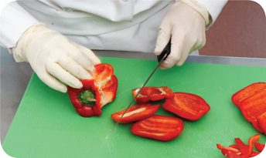
Preventing Cross-Contamination
Separate equipment:
Use separate equipment for each type of food
Clean and sanitize:
Clean and sanitize all work surfaces, equipment, and utensils after each task
4-3
Notes:
Instructor Notes
Each type of food should have separate equipment. For example, use one set of cutting boards, utensils, and containers for raw poultry. Use another set for raw meat. Use a third set for produce. Colored cutting boards and utensil handles can help keep equipment separate. The color tells food handlers which equipment to use with each food item. You might use yellow for raw chicken, red for raw meat, and green for produce, as the prep chef is doing in the photo.
Clean and sanitize all work surfaces, equipment, and utensils after each task. When you cut up raw chicken, for example, you cannot get by with just rinsing the equipment. Pathogens such as nontyphoidal Salmonella can contaminate food through cross-contamination. To prevent this, you must wash, rinse, and sanitize equipment.

Slide 4
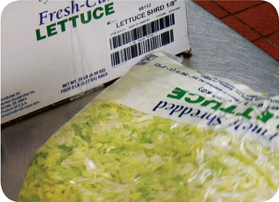
Preventing Cross-Contamination
Prep food at different times:
Prepare raw meat, fish, and poultry at different times than ready-to-eat food (when using the same prep table)
Buy prepared food:
Buy food items that do not require much prepping or handling
4-4
Notes:
Instructor Notes
If you need to use the same table to prep different types of food, prep raw meat, fish, and poultry; and ready-to-eat food at different times. You must clean and sanitize work surfaces and utensils between each type of food. For example, by prepping ready-to-eat food before raw food, you can minimize the chance for cross-contamination.
Buy food that doesn’t require much prepping or handling. For example, you could buy precooked chicken breasts or chopped lettuce, as shown in the photo.

Slide 5
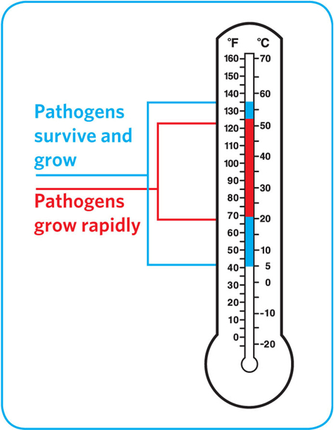
Preventing Time-Temperature Abuse
Time-temperature control:
Food held in the range of 41˚F and 135˚F (5˚C and 57˚C) has been time-temperature abused
Food has been time-temperature abused whenever it is handled in the following ways
Cooked to the wrong internal temperature
Held at the wrong temperature
Cooked or reheated incorrectly
4-5
Notes:
Instructor Notes
Most foodborne illnesses happen because TCS food has been time-temperature abused. Remember, TCS food has been time-temperature abused any time it remains between 41°F and 135°F (5°C and 57°C). This is called the temperature danger zone because pathogens grow in this range. But most pathogens grow much faster between 70°F and 125°F (21°C and 52°C).
Food is being temperature abused whenever it is handled in the following ways: cooked to the wrong internal temperature, held at the wrong temperature, or cooled or reheated incorrectly.
The longer food stays in the temperature danger zone, the more time pathogens have to grow. To keep food safe, you must reduce the time it spends in this temperature range. If food is held in this range for four or more hours, you must throw it out.

Slide 6
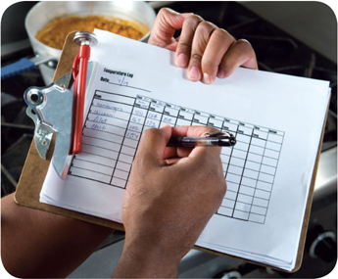
Preventing Time-Temperature Abuse
Avoid time-temperature abuse:
Monitor time and temperature
Make sure the correct kinds of thermometers are available
Regularly record temperatures and the times they are taken
Minimize the time that food spends in the temperature danger zone
Take corrective actions if time-temperature standards are not met
4-6
Notes:
Instructor Notes
Learn which food items should be checked, how often, and by whom.
Use timers in prep areas to check how long food is in the temperature danger zone.
A policy limiting the amount of food that can be removed from a cooler when prepping it can limit the time food spends in the temperature danger zone.
Reheating soup that was being held below 135°F (57°C) is an example of a corrective action.

Slide 7
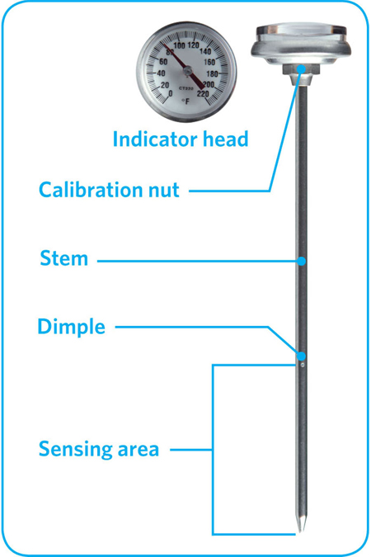
Monitoring Time and Temperature
Bimetallic stemmed thermometer
4-7
Notes:
Instructor Notes
A bimetallic stemmed thermometer can check temperatures from 0˚F to 220˚F (–18˚C to 104˚C).
This thermometer measures temperature through its metal stem. When checking temperatures, insert the stem into the food up to the dimple. You must do this because the sensing area of the thermometer goes from the tip of the stem to the dimple. This trait makes this thermometer useful for checking the temperature of large or thick food. It is usually not practical for thin food, such as hamburger patties.
The calibration nut is used to adjust the thermometer to make it accurate.

Slide 8
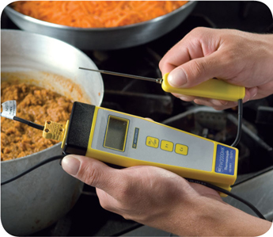
Monitoring Time and Temperature
Thermocouples and thermistors:
Measure temperature through a metal probe
Display temperatures digitally
Come with interchangeable probes
Immersion probe
Surface probe
Penetration probe
Air probe
Have a sensing area on the tip of their probe
4-8
Notes:
Instructor Notes
The sensing area on thermocouples and thermistors is on the tip of their probe. This means you don’t have to insert them into the food as far as bimetallic stemmed thermometers to get a correct reading. Thermocouples and thermistors are good for checking the temperature of both thick and thin food.
Thermocouples and thermistors come in several styles and sizes. Many come with different types of probes.
Immersion probes are used to check the temperature of liquids such as soups, sauces, and frying oil.
Surface probes are used to check the temperature of flat cooking equipment such as griddles.
Penetration probes are used to check the internal temperature of food. Small-diameter probes should be used to check the internal temperature of thin food such as meat patties and fish fillets.
Air probes are used to check the temperature inside coolers and ovens.
.

Slide 9
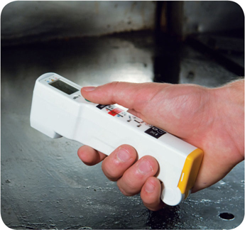
Monitoring Time and Temperature
Infrared (laser) thermometers:
Used to measure the surface temperature of food and equipment
Hold as close to the food or equipment as possible
Remove anything between the thermometer and the food, food package, or equipment
Follow manufacturers’ guidelines
4-9
Notes:
Instructor Notes
These thermometers cannot measure air temperature or the internal temperature of food.
Hold the thermometer as close as possible to the food, food package, or equipment without touching it. Do NOT take readings through glass or metal, such as stainless steel or aluminum.
Always follow the manufacturers’ guidelines. This should give you the most accurate readings.

Slide 10
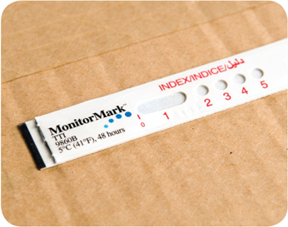
Monitoring Time and Temperature
Time-temperature indicators (TTI):
Monitor both time and temperature
Are attached to packages by the supplier
A color change appears on the device when time-temperature abuse has occurred
Maximum registering thermometer:
Indicates the highest temperature reached during use
Used where temperature readings cannot be continuously observed
4-10
Notes:
Instructor Notes
Some devices monitor both time and temperature. The time-temperature indicator (TTI) is an example. These tags are attached to packaging by the supplier. A color change appears in the window if the food has been time-temperature abused during shipment or storage. This color change is not reversible, so you know if the food has been abused.
Some suppliers place temperature-recording devices inside their delivery trucks. These devices constantly check and record temperatures. You can check the device during receiving to make sure food was at safe temperatures while it was being shipped.
Other tools are available that can help you monitor temperature. A maximum registering thermometer is one type. This thermometer indicates the highest temperature reached during use and is used where temperature readings cannot be continuously observed. It works well for checking final rinse temperatures of dishwashing machines.

Slide 11
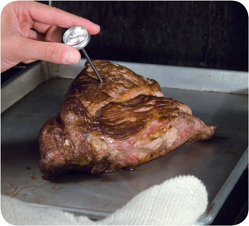
General Thermometer Guidelines
When using thermometers:
Wash, rinse, sanitize, and air-dry thermometers before and after using them
Calibrate them before each shift to ensure accuracy
Make sure thermometers used to measure the temperature of food are accurate to +/- 2˚F or +/- 1˚C
Only use glass thermometers if they are enclosed in a shatterproof casing
4-11
Notes:
Instructor Notes
Thermometers should be washed, rinsed, sanitized, and air-dried before and after each use to prevent cross-contamination. Be sure the sanitizing solution you use is for food-contact surfaces.
Thermometers can lose their accuracy when they are bumped or dropped. It can also happen when they go through severe temperature change. When this happens, the thermometer must be calibrated, or adjusted, to give a correct reading. Make sure your thermometers are accurate by calibrating them regularly. You should do this before each shift. You should also do this before the first delivery arrives. Some thermometers cannot be calibrated and must be replaced. Others will need to be sent back to the manufacturer for calibration. Follow the manufacturer’s directions regarding calibration.
Glass thermometers, such as candy thermometers, can be a physical contaminant if they break. They can only be used when enclosed in a shatterproof casing.

Slide 12
General Thermometer Guidelines
When using thermometers:
Insert the thermometer stem or probe into thickest part of the product (usually the center)
Take more than one reading in different spots
Wait for the thermometer reading to steady before recording the temperature
4-12
Notes:
Instructor Notes
When checking the temperature of food, insert the probe into the thickest part of the food, as shown in the photo. This is usually in the center. Also take another reading in a different spot. The temperature may vary in different areas. Before recording a temperature, wait for the thermometer reading to steady. Wait at least 15 seconds after you insert the stem or the probe into the food.

