Slide 2
Purchasing
and
Receiving
5-2

Slide 3
General Purchasing and Receiving Principles
Purchase food from approved, reputable suppliers:
  Have been inspected
  Meet all applicable local, state, and federal laws
Arrange deliveries so they arrive:
  When staff has enough time to do inspections
  When they can be correctly received
5-3
Notes:
Instructor Notes
Food must be purchased from approved, reputable suppliers. These suppliers have been inspected and can show you an inspection report. They also meet all applicable local, state, and federal laws. This applies to all suppliers in the supply chain. Your operation’s chain can include growers, shippers, packers, manufacturers, distributors (trucking fleets and warehouses), and local markets.
Develop a relationship with your suppliers, and get to know their food safety practices. Consider reviewing their most recent inspection reports. These reports can be from the U.S. Department of Agriculture (USDA), the Food and Drug Administration (FDA), or a third-party inspector. They should be based on Good Manufacturing Practices (GMP) or Good Agricultural Practices (GAP).

Slide 4
Receiving and Inspecting
Key drop deliveries:
  Supplier is given after-hour access to the operation
  to make deliveries
  Deliveries must meet the following criteria:
    Be inspected upon arrival at the operation
    Be from an approved source
    Have been placed in the correct storage location to
    maintain the required temperature
    Have been protected from contamination in storage
    Are NOT contaminated
    Are honestly presented
5-4
Notes:
Instructor Notes
Some foodservice operations receive food after hours when they are closed for business. This is often referred to as a key drop delivery.
The supplier is given a key or other access to the operation to make the delivery. Products are then placed in coolers, freezers, and dry-storage areas. The delivery must be inspected once you arrive at the operation and meet the criteria identified in the slide.

Slide 5
Receiving and Inspecting
Recalls:
  Identify the recalled food items
  Remove the item from inventory, and place it in a secure and appropriate location
  Store the item separately from food, utensils, equipment, linens, and single-use items
  Label the item in a way that will prevent it from being placed back in inventory
  Inform staff not to use the product
  Refer to the vendor’s notification or recall notice to determine what to do with the item
5-5
Notes:
Instructor Notes
Food items you have received may sometimes be recalled by the manufacturer. This may happen when food contamination is confirmed or suspected. It can also occur when items have been mislabeled or misbranded. Often food is recalled when food allergens have not been identified on the label. Most vendors will notify you of the recall. However, you should also monitor recall notifications made by the FDA and the USDA. Follow the guidelines in the slide when notified of a recall.
Identify the recalled food items by matching information from the recall notice to the item. This may include the manufacturer’s ID, the time the item was manufactured, and the item’s use-by date.
Remove the item from inventory, and place it in a secure and appropriate location. That may be a cooler or dry-storage area.
The recalled item must be stored separately from food, utensils, equipment, linens, and single-use items.
Label the item in a way that will prevent it from being placed back in inventory. Some operations do this by including a Do Not Use and Do Not Discard label on recalled food items. Inform staff not to use the product.
Refer to the vendor’s notification or recall notice for what to do with the item. For example, you might be instructed to throw it out or return it to the vendor.

Slide 6
Would you accept it
or reject It?
5-6
Notes:
Instructor Notes
Use the next several slides to discuss accept/reject criteria for receiving food and foodservice supplies. Ask your students to look at the product and description and decide whether to accept or reject it. Use the talking points for each slide to ensure that the necessary principles are discussed afterwards.
To ensure that everyone in class participates, pass out index cards with the letters A and B on them. Have each student answer each question by holding up the letter A or B.

Slide 7
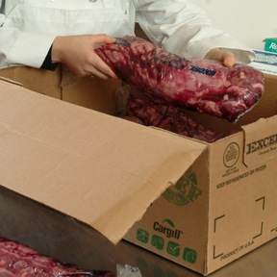
Accept / Reject Criteria
  Would you accept or reject it?
A. Accept
B. Reject
  Meat received at
  40ºF (4ºC)
5-7
Notes:
Instructor Notes
The answer is A. Cold TCS food, such as meat, must be received at 41ºF (5ºC) or lower, unless otherwise specified.

Slide 8
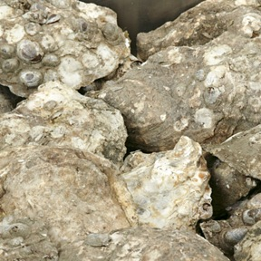
Accept / Reject Criteria
  Would you accept or reject it?
A. Accept
B. Reject
  Live oysters received at an internal temperature of
  50ºF (10ºC)
5-8
Notes:
Instructor Notes
The answer is A. Live oysters, mussels, clams, and scallops must be received at an air temperature of 45ºF (7ºC) and an internal temperature no greater than 50ºF (10ºC). Once received, the shellfish must be cooled to 41ºF (5ºC) or lower in four hours.
Shucked shellfish must be received at 45ºF (7ºC) or lower. The shellfish must then be cooled to 41ºF (5ºC) or lower in four hours.

Slide 9
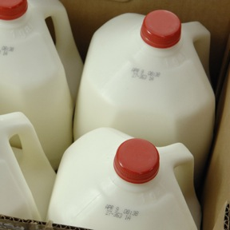
Accept / Reject Criteria
  Would you accept or reject it?
A. Accept
B. Reject
  Milk received at
  45ºF (7ºC)
5-9
Notes:
Instructor Notes
The answer is A. Milk must be received at 45ºF (7ºC) or lower. Cool the milk to 41ºF (5ºC) or lower in four hours.

Slide 10
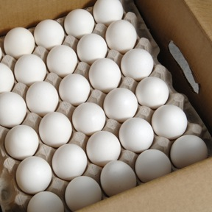
Accept / Reject Criteria
  Would you accept or reject it?
A. Accept
B. Reject
  Eggs received at an air temperature of 50ºF (10ºC)
5-10
Notes:
Instructor Notes
The answer is B. Shell eggs must be received at an air temperature of 45ºF (7ºC) or lower.

Slide 11
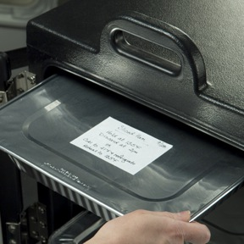
Accept / Reject Criteria
  Would you accept or reject it?
A. Accept
B. Reject
  Hot TCS food received at
  120ºF (49ºC)
5-11
Notes:
Instructor Notes
The answer is B. Hot TCS food must be received at 135ºF (57ºC) or higher.

Slide 12
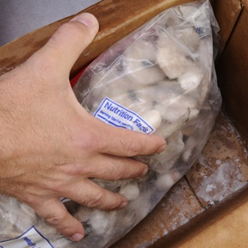
Accept / Reject Criteria
  Would you accept or reject it?
A. Accept
B. Reject
  Frozen shrimp
5-12
Notes:
Instructor Notes
The answer is B. The shrimp shows evidence of thawing and refreezing. There are ice crystals and frozen liquids on the food and the packaging. This may be evidence of thawing and refreezing, which shows the food has been time-temperature abused.

Slide 13
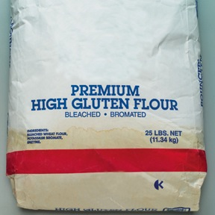
Accept / Reject Criteria
  Would you accept or reject it?
A. Accept
B. Reject
  Flour
5-13
Notes:
Instructor Notes
The answer is B. The water stain on the flour bag shows that the flour had become wet at some point.
Reject items with leaks, dampness, or water stains (which means the item was wet at some point).

Slide 14
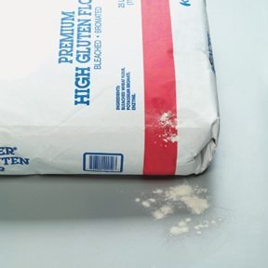
Accept / Reject Criteria
  Would you accept or reject it?
A. Accept
B. Reject
  Flour
5-14
Notes:
Instructor Notes
The answer is B. The flour bag has a tear or puncture, which may have been made by pests. These pests may have contaminated the product.
Reject items with tears, holes, or punctures in their packaging.
Likewise, reject cans with labels that are not intact or have bulging or swollen ends, rust, or dents.

Slide 15
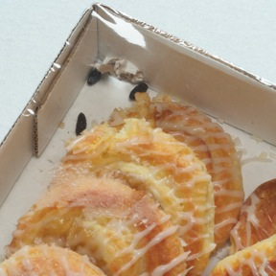
Accept / Reject Criteria
  Would you accept or reject it?
A. Accept
B. Reject
  Danish
5-15
Notes:
Instructor Notes
The answer is B. The box of Danish has been damaged by rodents, and droppings can be seen inside the box.
Reject items with signs of pests or pest damage.

Slide 16
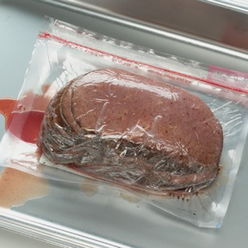
Accept / Reject Criteria
  Would you accept or reject it?
A. Accept
B. Reject
  ROP meat
5-16
Notes:
Instructor Notes
The answer is B. All food packaged in a reduced-oxygen environment, such as vacuum-packed meat, must be rejected if the packaging is bloated or leaking.
Items with broken cartons or seals, or items with dirty and discolored packaging should also be rejected.
Do not accept cases or packages that appear to have been tampered with.

Slide 17
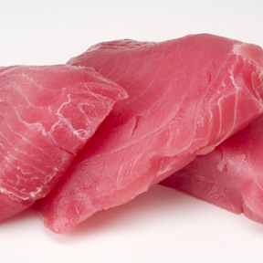
Accept / Reject Criteria
  Would you accept or reject it?
A. Accept
B. Reject
  Fresh tuna with a seaweed smell
5-17
Notes:
Instructor Notes
The answer is A. Fish often has a fresh ocean or seaweed smell.
Reject food with an abnormal or unpleasant odor.

Slide 18
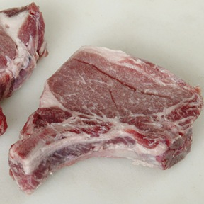
Accept / Reject Criteria
  Would you accept or reject it?
A. Accept
B. Reject
  Fresh pork chops that are sticky
5-18
Notes:
Instructor Notes
The answer is B. Reject meat, fish, or poultry that is slimy, sticky, or dry. Also reject it if it has soft flesh that leaves an imprint when you touch it.

Slide 19
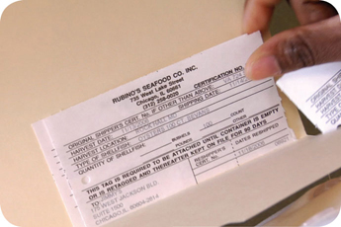
Receiving and Inspecting
Required documents:
  Shellfish must be received with shellstock identification tags
    Tags indicate when and where the shellfish were harvested
    Must be kept on file for 90 days from the date the last shellfish was used from its delivery container
5-19

Slide 20
Receiving and Inspecting
Required documents:
  Fish that will be eaten raw or partially cooked:
    Documentation must show the fish was correctly frozen before being received
    Keep documents for 90 days from the sale of the fish
  Farm-raised fish:
    Must have documentation stating the fish was raised to FDA standards
    Keep documents for 90 days from the sale of the fish
5-20

Slide 21
Storage
5-21

Slide 22
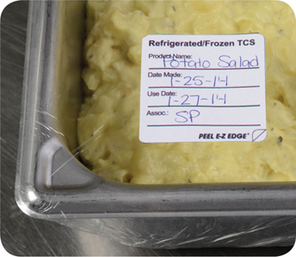
Storage
Labeling food for use on-site:
  All items not in their original containers must be labeled
  Food labels should include the common name of the food or a statement that clearly and accurately identifies it
  It is not necessary to label food if it clearly will not be mistaken for another item
5-22
Notes:
Instructor Notes
Labeling food is important for many reasons. Illnesses have occurred when unlabeled chemicals were mistaken for food such as flour, sugar, and baking powder. Customers have also suffered allergic reactions when food was unknowingly prepped with a food allergen that was not labeled.
It is not necessary to label food if it will clearly not be mistaken for another item. The food must be easily identified by sight.

Slide 23
Storage
Labeling food packaged on-site for retail sale:
  Common name of the food or a statement clearly identifying it
  Quantity of the food
  If the item contains two or more ingredients, list the ingredients
  and sub ingredients in descending order by weight
  List of artificial colors and flavors in the food, including
  chemical preservatives
  Name and place of business of the manufacturer, packer,
  or distributor
  Source of each major food allergen contained in the food
5-23
Notes:
Instructor Notes
Food packaged in the operation that is being sold to customers for use at home must be labeled. The label must include the information on the slide.
Naming the source of each major food allergen contained in the food is not necessary if the source is already part of the common name of the ingredient.
These labeling requirements do not apply to customers’ leftover food items placed in carry-out containers.

Slide 24
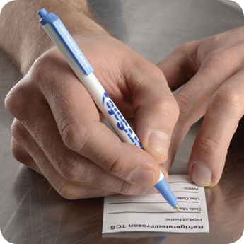
Storage
Date marking:
  Ready-to-eat TCS food can be stored for only seven days if it is held at 41ºF (5ºC)
  or lower
    The count begins on the day that the food was prepared or a commercial container
    was opened
    For example, potato salad prepared and stored on October 1 would have a discard date of October 7 on the label
    Some operations write the day or date the food was prepared on the label; others write the use-by day or date on the label
5-24
Notes:
Instructor Notes
Ready-to-eat TCS food must be date marked if held for longer than 24 hours. It must indicate when the food must be sold, eaten, or thrown out.

Slide 25
Storage
Date marking:
  If:
  A commercially processed food has a use-by date that is less
  than seven days from the date the container was opened
  Then:
  The container should be marked with this use-by date
  as long as the date is based on food safety
5-25
Notes:
Instructor Notes
Operations have a variety of systems for date marking. Some write the day or date the food was prepped on the label. Others write the use-by day or date on the label.

Slide 26
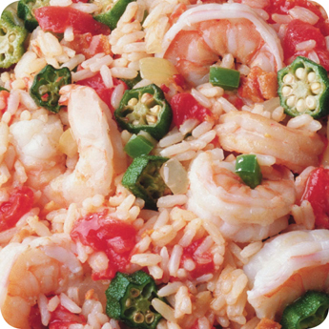
Storage
Date marking:
  When combining food in a dish with different
  use-by dates, the discard date of the dish should be based on the earliest prepared food
  Consider a shrimp and sausage jambalaya prepared on December 4
    The shrimp has a use-by date of December 8
    The sausage has a use-by date of December 10
    The use-by date of the jambalaya is December 8
5-26

Slide 27
Correct or Incorrect?
5-27
Notes:
Instructor Notes
Use the next several slides to discuss correct storage practices for food and foodservice supplies. Ask your students to look at the situation and determine if the practice in question is correct or incorrect. Use the talking points for each slide to ensure that the necessary principles are discussed afterwards.
To ensure that everyone in class participates, pass out index cards with the letters A and B on them. Have each student answer each question by holding up the letter A or B.

Slide 28
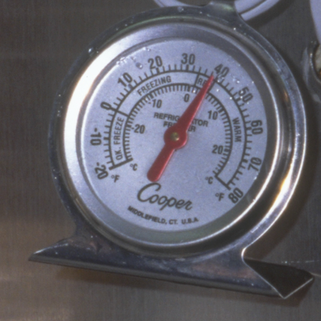
Correct or Incorrect?
  Is this a correct or incorrect storage practice?
A. Correct
B. Incorrect
  Hanging thermometer in the back of a cooler
5-28
Notes:
Instructor Notes
The answer is B. The hanging thermometer should be placed in the warmest part of the cooler. That would be in a location closest to the door rather than in the back of the unit where the temperatures would be coldest.
Storage units must have at least one air temperature measuring device. It must be accurate to +/- 3ºF or +/- 1.5ºC.

Slide 29
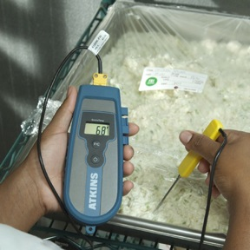
Correct or Incorrect?
  Is this a correct or incorrect storage practice?
A. Correct
B. Incorrect
  Chicken salad
5-29
Notes:
Instructor Notes
The answer is B. The chicken salad is 68ºC (20ºC), which is in the temperature danger zone.
Store cold TCS food at an internal temperature of 41ºF (5ºC) or lower.
Monitor food temperatures regularly. Randomly sample the temperature of stored food to verify that the cooler is working.

Slide 30
Correct or Incorrect?
  Is this a correct or incorrect storage practice?
A. Correct
B. Incorrect
  It is January 25th
5-30
Notes:
Instructor Notes
The answer is A. The potato salad is clearly and accurately labeled. It contains the name of the food as well as a date mark. The date mark indicates that the food must be used within two days. This is a best practice, most likely dictated by company policy.
All items that are not in their original containers must be labeled. Food labels should include the common name of the food or a statement that clearly and accurately identifies it. It is not necessary to label food if it clearly will not be mistaken for another item. The food must be easily identified by sight.
Ready-to-eat TCS food must be date marked if held for longer than 24 hours. It must indicate when the food must be sold, eaten, or thrown out.
Ready-to-eat TCS food can be stored for only seven days if it is held at 41ºF (5ºC) or lower. The count begins on the day that the food was prepared or a commercial container was opened.
Operations have a variety of systems for date marking. Some write the day or date the food was prepped on the label. Others write the use-by day or date on the label.

Slide 31
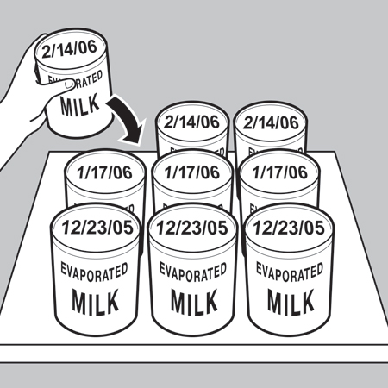
Correct or Incorrect?
  Is this a correct or incorrect storage practice?
A. Correct
B. Incorrect
  The year is 2005
5-31
Notes:
Instructor Notes
The answer is A. The cans are being rotated according to FIFO.
Store items with the earliest use-by or expiration dates in front of items with later dates.

Slide 32
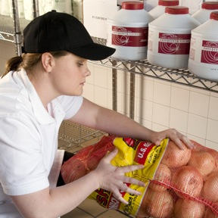
Correct or Incorrect?
  Is this a correct or incorrect storage practice?
A. Correct
B. Incorrect
5-32
Notes:
Instructor Notes
The answer is B. The onions are being stored with chemicals.
Store all items in designated storage areas.

Slide 33
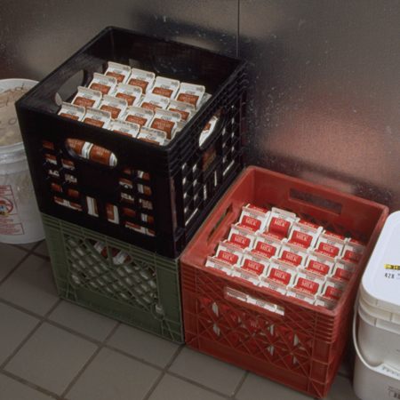
Correct or Incorrect?
  Is this a correct or incorrect storage practice?
A. Correct
B. Incorrect
5-33
Notes:
Instructor Notes
The answer is B. These items are stored on the floor of the walk-in cooler.
Store items away from walls and at least six inches (15 centimeters) off the floor.

Slide 34
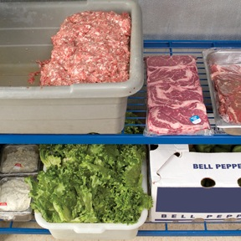
Correct or Incorrect?
  Is this a correct or incorrect storage practice?
A. Correct
B. Incorrect
5-34
Notes:
Instructor Notes
The answer is B. Raw meat is being stored above ready-to-eat food. Some of the meat has also not been covered correctly.
Wrap or cover food. Store raw meat, poultry, and seafood separately from ready-to-eat food. If raw and ready-to-eat food cannot be stored separately, store ready-to-eat food above raw meat, poultry, and seafood. This will prevent juices from raw food from dripping onto ready-to-eat food.

Slide 35
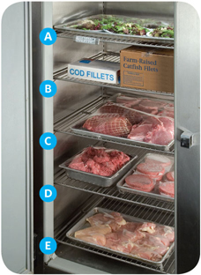
Storage
Preventing cross-contamination:
  Store food items in the following
  top-to-bottom order:
    Ready-to-eat food
    Seafood
    Whole cuts of beef and pork
    Ground meat and ground fish
    Whole and ground poultry
  This storage order is based on the minimum internal cooking temperature of each food
5-35
Notes:
Instructor Notes
Raw meat, poultry, and seafood can be stored with or above ready-to-eat food in a freezer if all of the items have been commercially processed and packaged.
Frozen food that is being thawed in coolers must also be stored below ready-to-eat food.
As an exception, ground meat and ground fish can be stored above whole cuts of beef and pork. To do this, make sure the packaging keeps out pathogens and chemicals. It also must not leak.

Slide 36
Storage
Food should be stored in a clean, dry location away from dust and other contaminants.
  To prevent contamination, NEVER store food in these areas:
    Locker rooms or dressing rooms
    Restrooms or garbage rooms
    Mechanical rooms
    Under unshielded sewer lines or leaking water lines
    Under stairwells
5-36

