Slide 2
DVD
Let’s watch a DVD…
1-2
Notes:
Instructor Notes
Play the Introduction to Food Safety DVD.

Slide 3
Additional Content
Some other things you should know…
1-3
Notes:
Instructor Notes
Teach the additional content not included in the DVD by using the next several slides.

Slide 4
Challenges to Food Safety
A foodborne illness is a disease transmitted to people through food.
An illness is considered an outbreak when:
Two or more people have the same symptoms after eating the same food
An investigation is conducted by state and local regulatory authorities
The outbreak is confirmed by laboratory analysis
1-4

Slide 5
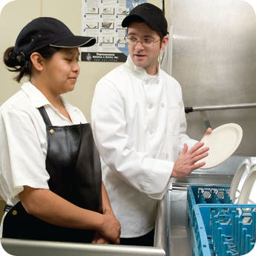
Challenges to Food Safety
Challenges include:
Time and money
Language and culture
Literacy and education
Pathogens
Unapproved suppliers
High-risk customers
Staff turnover
1-5
Notes:
Instructor Notes
Pressure to work quickly can make it hard to take the time to follow food safety practices.
Your staff may speak a different language than you do, which can make it difficult to communicate. Cultural differences can also influence how food handlers view food safety.
Staff often have different levels of education, making it more challenging to teach them food safety.
Illness-causing microorganisms are more frequently found on food that once was considered safe.
Food that is received from suppliers that are not practicing food safety can cause a foodborne-illness outbreak.
The number of customers at high risk for getting a foodborne illness is increasing. An example of this is the growing elderly population.
Training new staff leaves less time for food safety training.
The ServSafe program will provide the tools needed to overcome the challenges in managing a good food safety program.

Slide 6
How Food Becomes Unsafe
Five risk factors for foodborne illness:
Purchasing food from unsafe sources
Failing to cook food correctly
Holding food at incorrect temperatures
Using contaminated equipment
Practicing poor personal hygiene
1-6
Notes:
Instructor Notes
If food is not handled correctly, it can become unsafe. These are the five most common food-handling mistakes, or risk factors, that can cause foodborne illness.

Slide 7
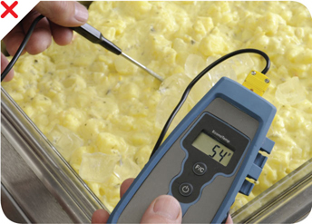
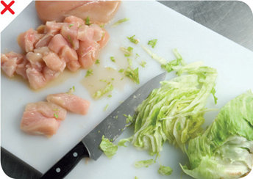
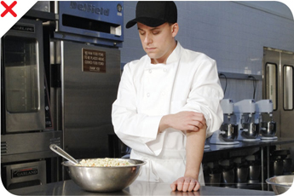
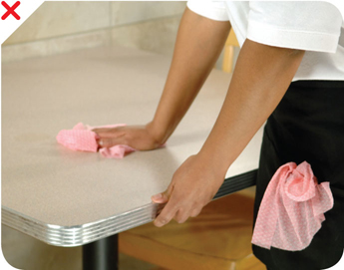
How Food Becomes Unsafe
Time-temperature abuse
Cross-contamination
Poor personal hygiene
Poor cleaning and sanitizing
1-7
Notes:
Instructor Notes
Except for purchasing food from unsafe sources, each risk factor for foodborne illness is related to four main factors: time-temperature abuse, cross-contamination, poor personal hygiene, and poor cleaning and sanitizing.

Slide 8
How Food Becomes Unsafe
Poor cleaning and sanitizing:
Equipment and utensils are not washed, rinsed, and sanitized between uses
Food-contact surfaces are wiped clean instead of being washed, rinsed, and sanitized
Wiping cloths are not stored in a sanitizer solution between uses
Sanitizer solution was not prepared correctly
Pg 1.5 SSF 6e
1-8

Slide 9
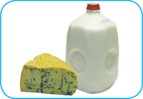
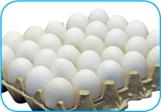
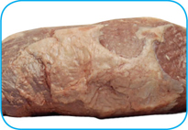
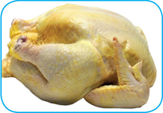
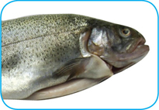
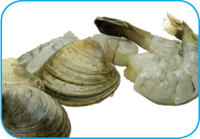
Food Most Likely to Become Unsafe
TCS food:
1-9
Notes:
Instructor Notes
The list of TCS food includes the following:
Milk and dairy products
Shell eggs (except those treated to eliminate nontyphoidal Salmonella)
Meat: beef, pork, and lamb
Poultry
Fish
Shellfish and crustaceans

Slide 10
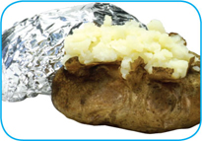
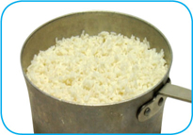
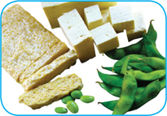
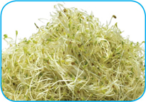
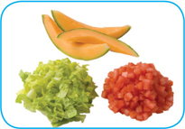
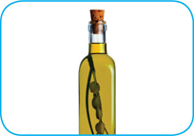
Food Most Likely to Become Unsafe
TCS food:
1-10
Notes:
Instructor Notes
The list of TCS food includes the following:
Baked potatoes
Heat-treated plant food, such as cooked rice, beans, and vegetables
Tofu or other soy protein; synthetic ingredients, such as textured soy protein in meat alternatives
Sprouts and sprout seeds
Sliced melons; cut tomatoes; cut leafy greens
Untreated garlic-and-oil mixtures

Slide 11
Ready-to-Eat Food
Ready-to-eat food is food that can be eaten without further:
Preparation
Washing
Cooking
Ready-to-eat food includes:
Cooked food
Washed fruit and vegetables
Deli meat
Bakery items
Sugar, spices, and seasonings
1-11
Notes:
Instructor Notes
Like TCS food, ready-to-eat food also needs careful handling to prevent contamination.

Slide 12
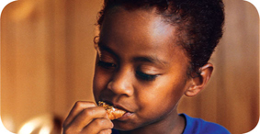
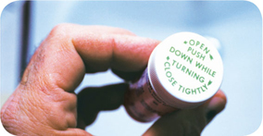
Populations at High Risk for Foodborne Illnesses
These people have a higher risk of getting a foodborne illness:
Elderly people
Preschool-age children
People with compromised immune systems
1-12
Notes:
Instructor Notes
Elderly people are at high risk because their immune systems have weakened with age.
Very young children are at high risk because they have not built up strong immune systems.
People with compromised immune systems include:
People with cancer or on chemotherapy
People with HIV/AIDS
Transplant recipients
People taking certain medications

Slide 13
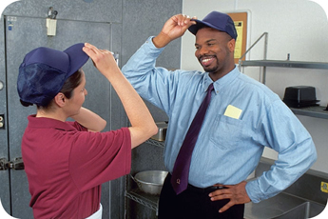
Keeping Food Safe
Focus on these measures:
Controlling time and temperature
Preventing cross-contamination
Practicing personal hygiene
Purchasing from approved, reputable suppliers
Cleaning and sanitizing
1-13
Notes:
Instructor Notes
Set up standard operating procedures that focus on these areas. The ServSafe program will show you how to design these procedures.

Slide 14
Keeping Food Safe
Training and monitoring:
Train staff to follow food safety procedures
Provide initial and ongoing training
Provide all staff with general food safety knowledge
Provide job specific food safety training
Retrain staff regularly
Monitor staff to make sure they are following procedures
Document training
1-14
Notes:
Instructor Notes
Managers must set up standard operating procedures that focus on the measures listed on the slide. Then they must train their staff on these procedures and monitor them to make sure the procedures are followed.

Slide 15
Keeping Food Safe
Government agencies:
The Food and Drug Administration (FDA)
U.S. Department of Agriculture (USDA)
Centers for Disease Control and Prevention (CDC)
U.S. Public Health Service (PHS)
State and local regulatory authorities
1-15
Notes:
Instructor Notes
The Food and Drug Administration (FDA) inspects all food except meat, poultry, and eggs. The agency also regulates food transported across state lines. In addition, the agency issues the FDA Food Code, which provides recommendations for food safety regulations.
The U.S. Department of Agriculture (USDA) regulates and inspects meat, poultry, and eggs. It also regulates food that crosses state boundaries or involves more than one state.
Agencies such as the Centers for Disease Control and Prevention (CDC) and the U. S. Public Health Service (PHS) conduct research into the causes of foodborne-illness outbreaks.
State and local regulatory authorities write or adopt code that regulates retail and foodservice operations.

Slide 16
Review
Let’s review
1-16
Notes:
Instructor Notes
Review the content presented using the next several slides.
To ensure that everyone in class participates, pass out index cards with the letters A, B, C, and D on them. Have each student answer each question by holding up the correct letter.

Slide 17
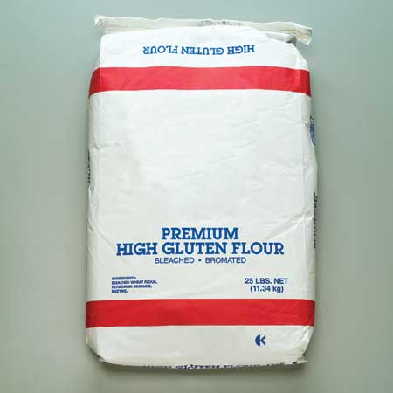
Review
Does it need time and temperature control to keep it safe?
A. Yes
B. No
Flour
1-17
Notes:
Instructor Notes
The answer is B. The flour is not a TCS food.

Slide 18
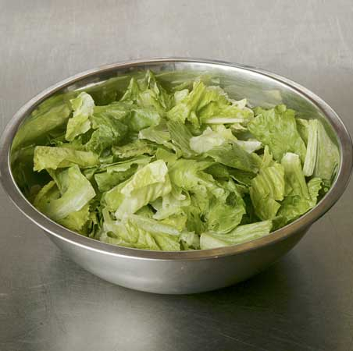
Review
Does it need time and temperature control to keep it safe?
A. Yes
B. No
Cut lettuce
1-18
Notes:
Instructor Notes
The answer is A. The cut lettuce is a TCS food. All cut leafy greens are TCS foods.

Slide 19
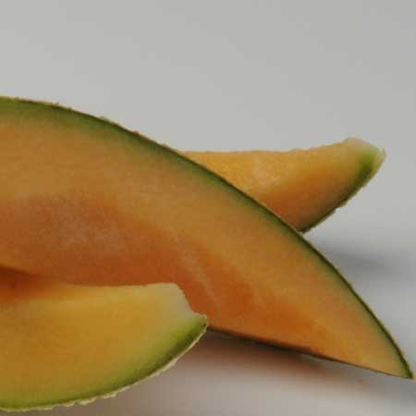
Review
Does it need time and temperature control to keep it safe?
A. Yes
B. No
Sliced melon
1-19
Notes:
Instructor Notes
The answer is A. The sliced melon is a TCS food. All sliced melons are TCS foods.

Slide 20
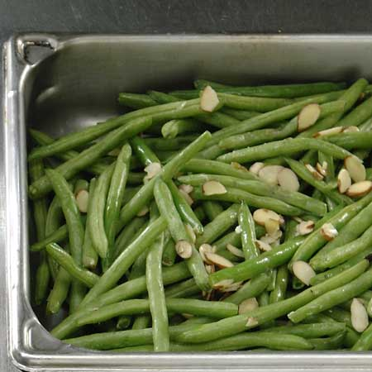
Review
Does it need time and temperature control to keep it safe?
A. Yes
B. No
Cooked beans
1-20
Notes:
Instructor Notes
The answer is A. The cooked beans are a TCS food. All heat-treated plant food, such as cooked rice, beans, and vegetables are TCS foods.

Slide 21
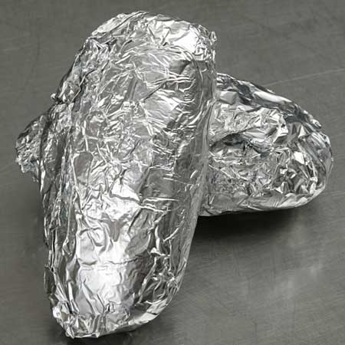
Review
Does it need time and temperature control to keep it safe?
A. Yes
B. No
Baked potatoes
1-21
Notes:
Instructor Notes
The answer is A. The baked potatoes are a TCS food.

Slide 22
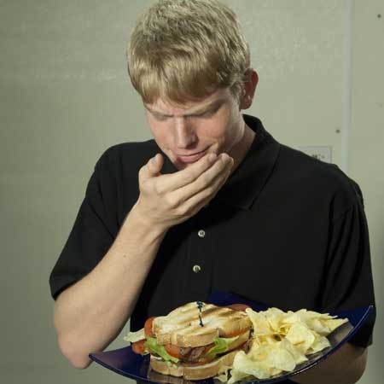
Review
What is the problem?
A. Time-temperature abuse
B. Cross-contamination
C. Poor personal hygiene
D. Poor cleaning and sanitizing
1-22
Notes:
Instructor Notes
The answer is C. Sneezing or coughing on food can contaminate it. These habits are considered poor personal hygiene.

Slide 23
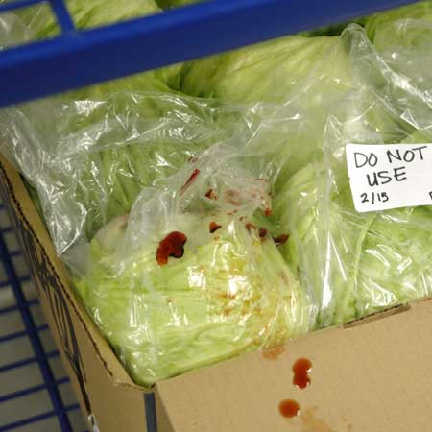
Review
What is the problem?
A. Time-temperature abuse
B. Cross-contamination
C. Poor personal hygiene
D. Poor cleaning and sanitizing
1-23
Notes:
Instructor Notes
The answer is B. Blood from raw meat stored above the lettuce has cross-contaminated it. A foodborne illness can occur anytime contaminated food touches or drips fluids onto cooked or ready-to-eat food. This is cross-contamination.

Slide 24
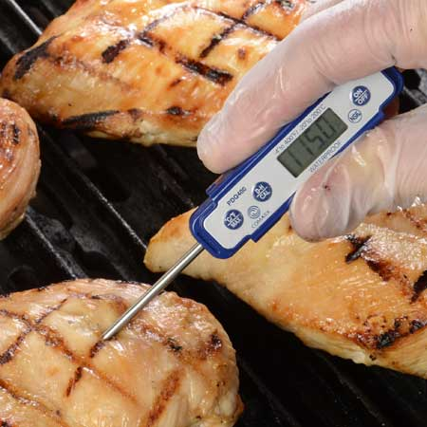
Review
What is the problem?
A. Time-temperature abuse
B. Cross-contamination
C. Poor personal hygiene
D. Poor cleaning and sanitizing
Chicken breasts
1-24
Notes:
Instructor Notes
The answer is A. The chicken has not been cooked to a temperature high enough to kill pathogens. At this point it has been time-temperature abused and could cause a foodborne illness if served.

Slide 25
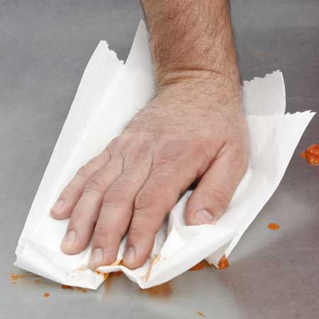
Review
What is the problem?
A. Time-temperature abuse
B. Cross-contamination
C. Poor personal hygiene
D. Poor cleaning and sanitizing
1-25
Notes:
Instructor Notes
The answer is D. The employee appears to only be wiping the prep table clean rather than washing, rinsing, and sanitizing it. This would be considered poor cleaning and sanitizing and could cause a foodborne illness.

Slide 27
DVD
Let’s watch a DVD…
2-2
Notes:
Instructor Notes
Play the Overview of Foodborne Microorganisms and Allergens DVD.

Slide 28
Review
Let’s review
2-3
Notes:
Instructor Notes
Use the next several slides to review the content presented.
To ensure that everyone in class participates, pass out index cards with the letters A and “B” on them. Have each student answer each question by holding up the correct letter.

Slide 29
DVD Review
What are the four types of microorganisms that can cause foodborne illness?
Viruses
Bacteria
Parasites
Fungi
2-4

Slide 30
DVD Review
What six conditions support the growth of bacteria?
F
A
T
T
O
M
ood
cidity
emperature
ime
xygen
oisture
2-5

Slide 31
DVD Review
What two FAT TOM conditions will you be able to control in your operation?
Time
Temperature
2-6

Slide 32
DVD Review
What is the temperature range of the temperature danger zone?
41°F to 135°F (5°C to 57°C)
2-7

Slide 33
DVD Review
What are some basic characteristics of bacteria?
They live in and on our bodies
The cannot be seen, smelled, or tasted
They can grow rapidly if FAT TOM conditions are correct
Controlling time and temperature can prevent them from causing illness
2-8

Slide 34
DVD Review
What are some basic characteristics of viruses?
They are carried by humans and animals
They do not grow in food but they can be transferred through food
People get viruses from food, water, or contaminated surfaces
Foodborne illnesses from viruses typically occur through fecal-oral routes
They are not destroyed by normal cooking temperatures
Practicing good personal hygiene can prevent viruses from causing illness
2-9

Slide 35
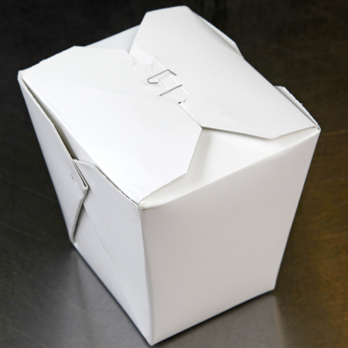
DVD Review
Can this be a physical contaminant?
A. Yes
B. No
2-10
Notes:
Instructor Notes
The answer is A. The container of Chinese food has been stapled shut. The staple can easily end up in the food and become a physical contaminant.

Slide 36
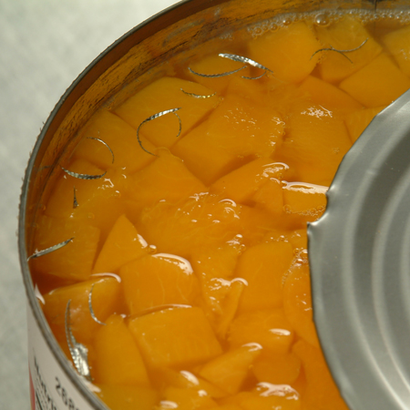
DVD Review
Can this be a physical contaminant?
A. Yes
B. No
2-11
Notes:
Instructor Notes
The answer is A. The can opener has left metal shavings in the canned food which are a physical contaminant.

Slide 37
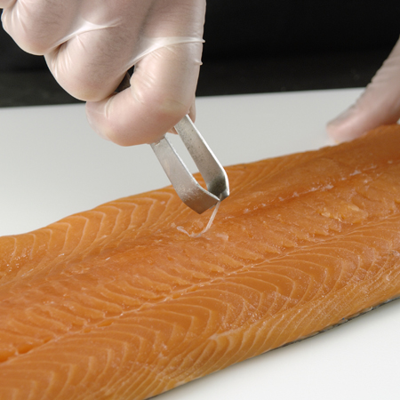
DVD Review
Can this be a physical contaminant?
A. Yes
B. No
2-12
Notes:
Instructor Notes
The answer is A. The bones in a fish filet are a physical contaminant if not removed.

Slide 38
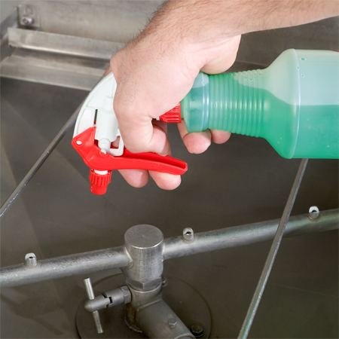
DVD Review
Is this a safe practice when handling chemicals? Why?
A. Yes
B. No
2-13
Notes:
Instructor Notes
The answer is B. The chemical spray bottle does not contain a label with the common name of the chemical.

Slide 39
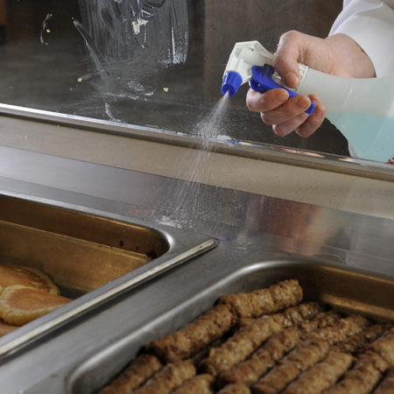
DVD Review
Is this a safe practice when handling chemicals? Why?
A. Yes
B. No
2-14
Notes:
Instructor Notes
The answer is B. The food handler is using the glass cleaner incorrectly by spraying it near food. This can contaminate the food.

Slide 40
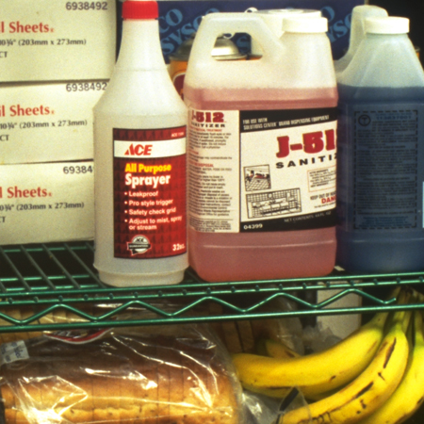
DVD Review
Is this a safe practice when handling chemicals? Why?
A. Yes
B. No
2-15
Notes:
Instructor Notes
The answer is B. Chemicals are being stored above food.

Slide 41
Additional Content
Some other things you should know…
2-16
Notes:
Instructor Notes
Teach the additional content not included in the DVD using the next several slides.

Slide 42
How Contamination Happens
Contaminants come from a variety of places:
Animals we use for food
Air, contaminated water, and dirt
People
Deliberately
Accidentally
2-17
Notes:
Instructor Notes
Contamination comes from a variety of places.
Contaminants can cause foodborne illness or result in physical injury.
Contaminants are found in the animals we use for food, air, water, dirt; and they occur naturally in food, such as bones in fish.
Food can be contaminated on purpose.
Most food is contaminated accidently.
Examples of accidental contamination include: food handlers who don’t wash their hands after using the restroom, and then contaminate food and surfaces with feces from their fingers; and food handlers who pass contaminants through illness.

Slide 43
How Contamination Happens
People can contaminate food when:
They don’t wash their hands after using the restroom
They are in contact with a person who is sick
They sneeze or vomit onto food or food-contact surfaces
They touch dirty food-contact surfaces and equipment and then touch food
2-18
Notes:
Instructor Notes
Food handlers who don’t wash their hands after using the restroom may contaminate food and surfaces with feces from their fingers. Once the food that the food handler touched is eaten, a foodborne illness may result. This is called the fecal-oral route of contamination.

Slide 44
Biological Contamination
Common symptoms of foodborne illness:
Diarrhea
Vomiting
Fever
Nausea
Abdominal cramps
Jaundice (yellowing of skin and eyes)
Onset times:
Depend on the type of foodborne illness
Can range from 30 minutes to six weeks
2-19
Notes:
Instructor Notes
The symptoms of a foodborne illness vary depending on which illness a person has. But most victims of foodborne illness share some common symptoms.
Not every person who is sick from a foodborne illness will have all of these symptoms. Nor are the symptoms of a foodborne illness limited to this list.
How quickly foodborne-illness symptoms appear in a person is known as the onset time of the illness. Onset times depend on the type of foodborne illness a person has. They can range from 30 minutes to as long as six weeks. How severe the illness is can also vary, from mild diarrhea to death.

Slide 45
The “Big Six” Pathogens
Food handlers diagnosed with illnesses from the “Big Six” pathogens cannot work in a foodservice operation while they are sick.
Shigella spp.
Salmonella Typhi
Nontyphoidal Salmonella (NTS)
Shiga toxin-producing Escherichia coli (STEC), also known as E. coli
Hepatitis A
Norovirus
2-20
Notes:
Instructor Notes
According to the Food and Drug Administration (FDA), there are over 40 different kinds of bacteria, viruses, parasites, and molds that can occur in food and cause a foodborne illness. Of these, six have been singled out by the FDA. These have been dubbed the “Big Six” because they are highly contagious and can cause severe illness. They include:
Shigella spp.
Salmonella Typhi
Nontyphoidal Salmonella (NTS)
Shiga toxin-producing Escherichia coli (STEC), also known as E. coli
Hepatitis A
Norovirus
These pathogens are often found in very high numbers in an infected
person’s feces and can be transferred to food easily. A person does not have
to eat much of the pathogen in order to get sick, and that illness is often
severe. For this reason, food handlers diagnosed with illnesses from these
pathogens cannot work in a foodservice operation while they are sick.

Slide 46
Activity
Teach the Bug
2-21
Notes:
Instructor Notes
Do the Teach The Bug Activity. This activity can be downloaded from ServSafe.com. Directions for using the activity are included with it.

Slide 47
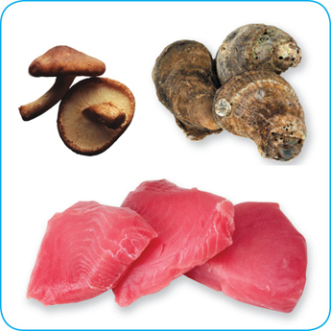
Biological Toxins
Origin:
Naturally occur in certain plants, mushrooms, and seafood
Seafood toxins:
Produced by pathogens found on certain fish
Tuna, bonito, mahimahi
Histamine produced when fish is time-temperature abused
Occur in certain fish that eat smaller fish that have consumed the toxin
Barracuda, snapper, grouper, amberjack
Ciguatera toxin is an example
2-22
Notes:
Instructor Notes
Some toxins are naturally associated with certain plants, mushrooms, and seafood. Toxins are a natural part of some fish.
Other toxins, such as histamine, are made by pathogens on the fish when it is time-temperature abused. This can occur in tuna, bonito, mackerel, and mahimahi.
Some fish become contaminated when they eat smaller fish that have eaten a toxin. One of these toxins is the ciguatera toxin. It can be found in barracuda, snapper, grouper, and amberjack. Shellfish, such as oysters, can be contaminated when they eat marine algae that have a toxin.

Slide 48
Biological Toxins
Illness:
Symptoms and onset times vary with illness
People will experience illness within minutes
General symptoms:
Diarrhea or vomiting
Neurological symptoms
Tingling in extremities
Reversal of hot and cold sensations
Flushing of the face and/or hives
Difficulty breathing
Heart palpitations
2-23
Notes:
Instructor Notes
Toxins cannot be destroyed by cooking or freezing. The most important way to prevent a foodborne illness is to purchase plants, mushrooms, and seafood from approved, reputable suppliers. It is also important to control time and temperature when handling raw fish.

Slide 49
Deliberate Contamination of Food
Groups who may attempt to contaminate food:
Terrorists or activists
Disgruntled current or former staff
Vendors
Competitors
FDA defense tool:
A.L.E.R.T.
2-24
Notes:
Instructor Notes
So far, you have learned about methods to prevent the accidental contamination of food. But you also must take steps to stop people who are actually trying to contaminate it. This may include the groups listed on the slide.
These people may try to tamper with your food using biological, chemical, or physical contaminants. They may even use radioactive materials. Attacks might occur anywhere in the food supply chain. But they are usually focused on a specific food item, process, or business.
The best way to protect food is to make it as difficult as possible for someone to tamper with it. For this reason, a food defense program should deal with the points in your operation where food is at risk.
The FDA has created a tool that can be used to develop a food defense program. It is based on the acronym A.L.E.R.T. It can be used to help you identify the points in your operation where food is at risk.

Slide 50
Deliberate Contamination of Food
Assure Make sure products received are from safe sources
Look Monitor the security of products in the facility
Employees Know who is in your facility
Reports Keep information related to food defense accessible
Threat Develop a plan for responding to suspicious activity or a threat to the operation
2-25
Notes:
Instructor Notes
Assure Make sure that products you receive are from safe sources. Supervise product deliveries. Use approved suppliers who practice food defense. Request that delivery vehicles are locked or sealed.
Look Monitor the security of products in the facility. Limit access to prep and storage areas. Locking storage areas is one way to do this. Create a system for handling damaged products. Store chemicals in a secure location. Train staff to spot food defense threats.
Employees Know who is in your facility. Limit access to prep and storage areas. Identify all visitors, and verify credentials. Conduct background checks on staff.
Reports Keep information related to food defense accessible: receiving logs, office files and documents, staff files, and random food defense self-inspections.
Threat Identify what you will do and who you will contact if there is suspicious activity or a threat at your operation. Hold any product you suspect to be contaminated. Contact your regulatory authority immediately. Maintain an emergency contact list.

Slide 51
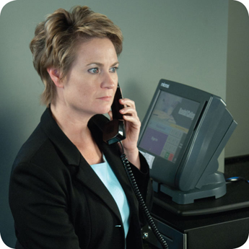
Responding to a Foodborne-Illness Outbreak
Gather information
Ask the person for general contact information
Ask the person to identify the food eaten
Ask for a description of symptoms
Ask when the person first got sick
Notify authorities
Contact the local regulatory authority if an outbreak is suspected
2-26
Notes:
Instructor Notes
Ask the person making the complaint for general contact information and to identify the food that was eaten. Also ask for a description of symptoms and when the person first got sick.
Contact the local regulatory authority if you suspect an outbreak.

Slide 52
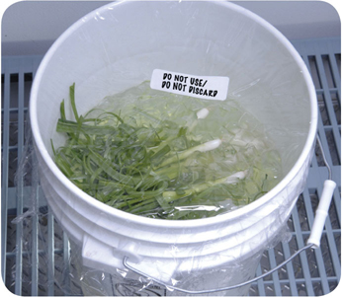
Responding to a Foodborne-Illness Outbreak
Segregate product
Set the suspected product aside if any remains
Include a label with “Do Not Use” and “Do Not Discard” on it
Document the information
Log information about suspected product
Include a product description, product date, lot number, sell-by date, and pack size
2-27
Notes:
Instructor Notes
Set the suspected product aside if any remains. Include a label with Do Not Use and Do Not Discard on it, as shown in the photo on the slide.
Log information about the suspected product. This might include a product description, production date, and lot number. The sell-by date and pack size should also be recorded.

Slide 53
Responding to a Foodborne-Illness Outbreak
Identify staff
Keep a list of food handlers scheduled at time of incident
Interview staff immediately
Cooperate with authorities
Provide appropriate documentation
Review procedures
Determine if standards are being met
Identify if standards are not working
2-28
Notes:
Instructor Notes
Maintain a list of food handlers scheduled at the time of the suspected contamination. These staff members may be subject to an interview and sampling by investigators. They should also be interviewed immediately by management about their health status.
Cooperate with regulatory authorities in the investigation. Provide appropriate documentation. You may be asked to provide temperature logs, HACCP documents, staff files, etc.
Review food-handling procedures to identify if standards are not being met or procedures are not working.

Slide 54
Preventing Allergic Reactions
To help prevent allergic reactions, service staff should:
Describe menu items to guests, and identify any allergens in the item.
Suggest menu items without the allergen.
Clearly identify the guest’s order for kitchen and service staff.
Deliver food separately to prevent cross-contact.
2-29
Notes:
Instructor Notes
Your staff should be able to tell customers about menu items that contain potential allergens. At minimum, have one person available per shift to answer customers’ questions about menu items. When working with a customer to place an allergen special order, staff must be able to do the following.
Describe menu items to guests, and identify any allergens in the item. Identify any “secret” ingredients. For example, your operation may have a house specialty that includes an allergen.
Suggest menu items that do not contain the food that the customer is allergic to.
Identify the allergen special order. Clearly mark or otherwise indicate the order for the guest with the identified food allergy. This is done to inform the kitchen staff of the guest’s food allergy.
Confirm the allergen special order with the kitchen staff when picking up the food. Make sure no garnishes or other items containing the allergen touch the plate. Food should be hand-delivered to guests with allergies. Delivering food separately from the other food delivered to a table will help prevent contact with food allergens.

Slide 55
Avoiding Cross-Contact
When preparing food for a guest with a known allergy, kitchen staff should:
Check recipes and food labels for the allergen
Use cleaned and sanitized utensils
Wash hands and change gloves
Use separate fryers and cooking oils
Label packages correctly
2-30
Notes:
Instructor Notes
When preparing an allergen special order, always check recipes and food labels for the allergen. Manufactured products that contain one or more of the Big Eight allergens are required to clearly identify them on the ingredient label. This makes it easy to see if a product is safe.
Used cleaned an sanitized utensils and equipment, including food-prep surfaces. Some operations use a separate set of cooking utensils just for allergen special orders. Make sure the allergen does not touch anything for customers with food allergies.
Wash hands and change gloves before preparing the order.
Use separate fryers and cooking oils when frying food for customers with food allergies. As an example, cooking shrimp in a fryer will make that oil dangerous for guest with a shellfish allergy. Any other food cooked in that oil could cause an allergic reaction in those guests.
When labeling food packaged on-site for retail sale, make sure the label includes any of the Big Eight allergens contained in the product.

Slide 56
Review
Let’s review
2-31
Notes:
Instructor Notes
Review the content presented using the next several slides.

Slide 57
Review
Who Am I?
1. _____________________
I can be transferred to food or equipment by food handlers with feces on their fingers
People become contagious within a few hours of eating me
I am often linked with ready-to-eat food
Excluding staff who are vomiting or have diarrhea from an illness caused by me can stop me from spreading
Norovirus
2-32

Slide 58
Review
Who Am I?
2. ________________________
I live in a person’s bloodstream and intestines
I am commonly linked with ready-to-eat food and beverages
I am in a person’s feces for weeks after symptoms have ended
Washing hands and cooking food to minimum internal temperatures can prevent me
Salmonella Typhi
2-33

Slide 59
Review
Who Am I?
3. _____________________
I am found in the feces of people I have infected
Flies can transfer me
I am linked with food easily contaminated by hands
Excluding food handlers who have diarrhea from an illness caused by me can stop me from spreading
Shigella spp.
2-34

Slide 60
Review
Who Am I?
4. _____________________
I am often linked with ready-to-eat food
I’m often transferred to food by food handlers who have feces on their fingers
Excluding staff with jaundice can prevent me from causing illness
Normal cooking temperatures do not destroy me
Hepatitis A
2-35

Slide 61
Review
Who Am I?
5. ___________________________________________________
I can be found in the intestines of cattle
I produce toxins in a person’s intestines which cause illness
I am found in ground beef and contaminated produce
Excluding food handlers who have diarrhea from an illness caused by me can stop me from spreading
Shiga toxin-producing E. coli
2-36

Slide 63
DVD
Let’s watch a DVD…
3-2
Notes:
Instructor Notes
Play the Personal Hygiene DVD.

Slide 64
Additional Content
Some other things you should know…
3-3
Notes:
Instructor Notes
The slides in this section should be used to teach the additional content not included in the DVD.

Slide 65
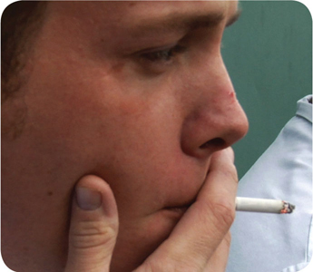
How Food Handlers Can Contaminate Food
Food handlers can contaminate food when they:
Have a foodborne illness
Have wounds that contain a pathogen
Sneeze or cough
Have contact with a person who is sick
Touch anything that may contaminate their hands and don’t wash them
Have symptoms such as diarrhea, vomiting, or jaundice—a yellowing of the eyes or skin
3-4
Notes:
Instructor Notes
With some illnesses, a person may infect others before showing any symptoms. For example, a person could spread hepatitis A for weeks before having any symptoms.
With other illnesses, a person may infect others for days or even months after symptoms are gone. Norovirus can be spread for days after symptoms have ended.
Some people carry pathogens and infect others without ever getting sick themselves. These people are called carriers. The bacteria Staphylococcus aureus is carried in the nose of 30 to 50 percent of healthy adults. About 20 to 35 percent of healthy adults carry it on their skin. Food handlers transfer this type of bacteria to food when they touch the infected areas of their bodies and then touch food without washing their hands.

Slide 66
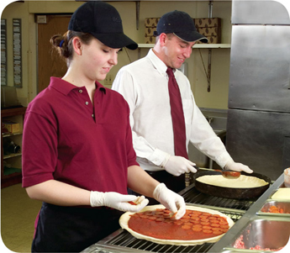
Managing a Personal Hygiene Program
Managers must focus on the following:
Creating personal hygiene policies
Training food handlers on personal hygiene policies and retraining them regularly
Modeling correct behavior at all times
Supervising food safety practices
Revising personal hygiene policies when laws or science change
3-5
Notes:
Instructor Notes
Don’t underestimate your role in a personal hygiene program. You have many responsibilities to help make the program work. Some of these are highlighted in the slide.

Slide 67
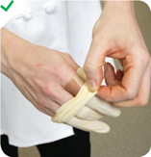
Infected Wounds or Cuts
Infected wounds or cuts:
Contain pus
Must be covered to prevent pathogens from contaminating food and food-contact surfaces
How a wound is covered depends on where it is located:
Cover wounds on the hand or wrist with an impermeable cover, (i.e. bandage or finger cot) and then a single-use glove
Cover wounds on the arm with an impermeable cover, such as a bandage
Cover wounds on other parts of the body with a dry, tight-fitting bandage
3-6

Slide 68
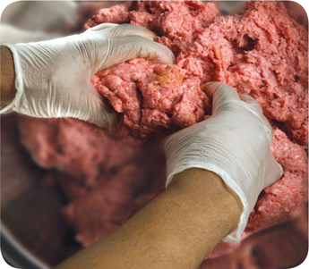
Single-Use Gloves
Single-use gloves:
Should be used when handling ready-to-eat food
Except when washing produce
Except when handling ready-to-eat ingredients for a dish that will be cooked
Must NEVER be used in place of handwashing
Must NEVER be washed and reused
Must fit correctly
3-7
Notes:
Instructor Notes
Single-use gloves can help keep food safe by creating a barrier between hands and food. Gloves should be worn when handling ready-to-eat food. The exceptions include when washing produce, or when handling ready-to-eat ingredients for a dish that will be cooked to the correct internal temperature.
Make sure you provide different glove sizes. Gloves that are too big will not stay on. Those that are too small will tear or rip easily.
Some food handlers and customers may be sensitive to latex. Consider providing gloves made from other materials.

Slide 69
Single-Use Gloves
How to use gloves:
Wash and dry hands before putting gloves on when starting a new task
Select the correct glove size
Hold gloves by the edge when putting them on
Once gloves are on, check for rips or tears
NEVER blow into gloves
NEVER roll gloves to make them easier to put on
3-8
Notes:
Instructor Notes
Wash your hands before putting on gloves when starting a new task. You do not need to rewash your hands each time you change gloves as long as you are performing the same task, and your hands have not become contaminated.
Avoid contaminating gloves when putting them on.

Slide 70
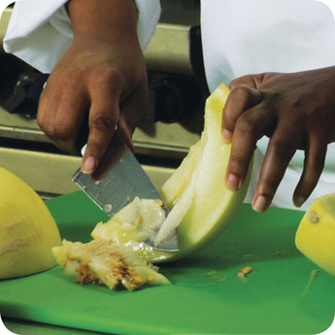
Bare-Hand Contact with Ready-to-Eat Food
Bare-hand contact with ready-to-eat food must be avoided:
The food is an ingredient in a dish that does not contain raw meat, seafood, or poultry
The dish will be cooked to at least 145ºF (63ºC)
The food is an ingredient in a dish containing raw meat, seafood, or poultry
The dish will be cooked to the required minimum internal temperature of the raw items(s)
NEVER handle ready-to-eat food with bare hands when you primarily serve a high-risk population
3-9
Notes:
Instructor Notes
Food can become contaminated when it has been handled with bare hands. This is especially true when hands have not been washed correctly or have infected cuts or wounds. For this reason, do not handle ready-to-eat food with bare hands.
There are times when it may be acceptable to handle ready-to-eat food with bare hands. This is true in the situations identified in the slide.
Never handle ready-to-eat food with bare hands if you primarily serve a high-risk population.
Some regulatory authorities allow bare-hand contact with ready-to- eat food. If your jurisdiction allows this, you must have specific policies in place about staff health. You must also train staff in handwashing and personal hygiene practices.

Slide 71
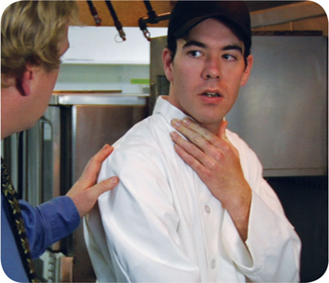
Handling Staff Illnesses
If:
The food handler has a sore throat with a fever
Then:
Restrict the food handler from working with or around food
Exclude the food handler from the operation if you primarily serve a high-risk population
A written release from a medical practitioner is required before returning to work
3-10
Notes:
Instructor Notes
You must encourage your staff to report any health problems before they come to work. This includes newly hired staff who haven’t started working yet.
Staff should also let you know immediately if they get sick while working. Your regulatory authority may ask you to prove you have made staff aware of this policy.
When food handlers are sick, you may need to restrict them from working with or around food. Sometimes, you may need to exclude them from working in the operation.

Slide 72
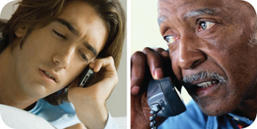
Handling Staff Illnesses
If:
The food handler has at least one of these symptoms
Vomiting
Diarrhea
Then:
Exclude the food handler from the operation
Before returning to work, food handlers who vomited or had diarrhea must meet one of these requirements
Have had no symptoms for at least 24 hours
Have a written release from a medical practitioner
3-11

Slide 73
Handling Staff Illnesses
If:
The food handler has jaundice
Then:
Report the food handler to the regulatory authority
Exclude food handlers from the operation if they have had jaundice for 7 days or less
Food handlers must have a written release from a medical practitioner and approval from the regulatory authority before returning to work
3-12

Slide 74
Handling Staff Illnesses
If:
The food handler is vomiting or has diarrhea and has been diagnosed with an illness caused by one of these pathogens.
Norovirus
Shigella spp.
Nontyphoidal Salmonella
Shiga toxin-producing E. coli
Then:
Exclude the food handler from the operation
Work with the food handler’s medical practitioner and/or the local regulatory authority to decide when the person can go back to work
3-13
Notes:
Instructor Notes
Some food handlers diagnosed with these foodborne illnesses may not experience the usual signs or their symptoms may be over. Work with the local regulatory authority to determine whether the food handler must be excluded from the operation or restricted from working with or around food, and when the exclusion or restriction can be removed.
Remember these are only guidelines, working with your regulatory authority will help you determine the best course of action.

Slide 75
Handling Staff Illnesses
If:
The food handler has been diagnosed with an illness caused by one of these pathogens.
Hepatitis A
Salmonella Typhi
Then:
Exclude the food handler from the operation
Work with the food handler’s medical practitioner and/or the local regulatory authority to decide when the person can go back to work
3-14
Notes:
Instructor Notes
Whether or not a food handler has symptoms, those diagnosed with a disease caused by these pathogens must be excluded from the operation. Work with the local regulatory authority to determine when the exclusion can be removed.
Remember these are only guidelines, working with your regulatory authority will help you determine the best course of action.

Slide 76
Review
Let’s review
3-15
Notes:
Instructor Notes
Use the next several slides to review the content presented.
To ensure that everyone in class participates, pass out index cards with the letters A and B on them. Have each student answer each question by holding up the correct letter.

Slide 77
Review
How long should you scrub your hands with soap?
10 to 15 seconds
3-16
Notes:
Instructor Notes:
The whole handwashing process should take at least 20 seconds. Hands must be scrubbed with soap for 10 to 15 seconds.

Slide 78
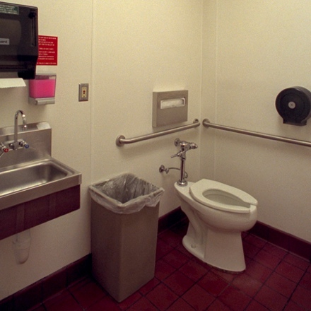
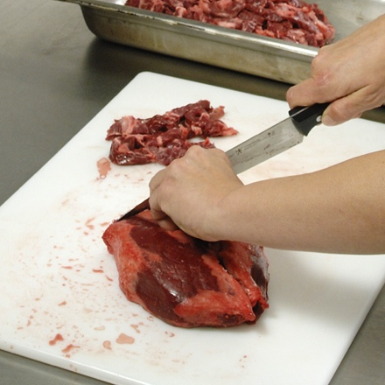
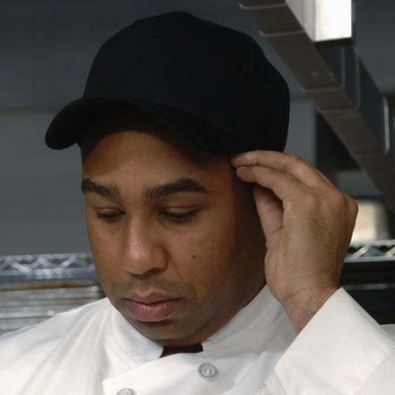
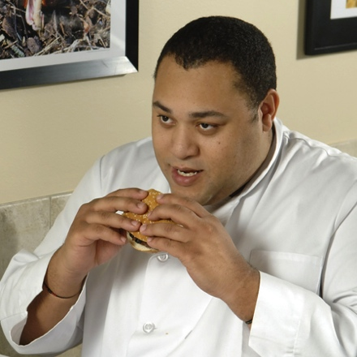
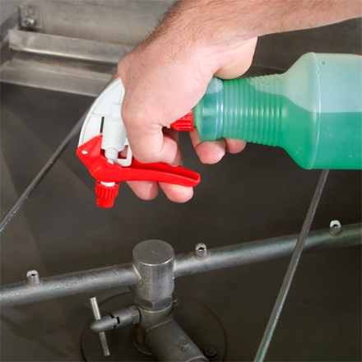
Review
When do food handlers have to wash their hands?
3-17
Notes:
Instructor Notes:
Hands must be washed after the following activities:
Using the restroom
Handling raw meat, poultry, and seafood (before and after)
Touching the hair, face, or body
Sneezing, coughing, or using a tissue
Eating, drinking, smoking, or chewing gum or tobacco
Handling chemicals that might affect food safety
Taking out garbage

Slide 79
Review
When do food handlers have to wash their hands?
3-18
Notes:
Instructor Notes:
Hands must be washed after the following activities:
Clearing tables or busing dirty dishes
Touching clothing or aprons
Handling money
Leaving and returning to kitchen/prep area
Handling service animals or aquatic animals
Touching anything else that may contaminate hands, such as dirty equipment, work surfaces, or cloths

Slide 80
Review
What’s wrong with this picture?
3-19
Notes:
Instructor Notes:
The food handler is wearing false nails and nail polish. She also is not wearing gloves, which she must do when handling ready-to-eat food.

Slide 81
Review
What’s wrong with this picture?
3-20
Notes:
Instructor Notes:
The bandage on the finger must be covered with a finger cot or glove. The food handler should not be resting his thumb on top of the bowl either.

Slide 82
Review
What’s wrong with this picture?
3-21
Notes:
Instructor Notes:
The food handler should not be wearing jewelry on her hands or arms. The only exception would be a plain metal band ring. The food handler should also not be wearing nail polish.

Slide 83
Review
A grill operator places a raw hamburger patty on the grill. Next she assembles a hamburger. Is a glove change required between tasks?
A. Yes
B. No
3-22
Notes:
Instructor Notes
Yes. A glove change is required after handling raw meat and before handling the ready-to-eat hamburger. A glove change is always required before beginning a different task.

Slide 84
Review
A cook preps raw chicken. Next he preps onions for the salad bar. Is a glove change required between tasks?
A. Yes
B. No
3-23
Notes:
Instructor Notes
Yes. A glove change is required after handling raw chicken and before handling the ready-to-eat onions. A glove change is always required before beginning a different task.

Slide 85
Review
Mary works in a restaurant and has a sore throat and fever. Should she be excluded from the operation or restricted from working with or around food?
A. Excluded
B. Restricted
3-24
Notes:
Instructor Notes
Restricted. Food handlers who have a sore throat and/or fever should be restricted from working with or around food.

Slide 86
Review
Martha is a cook who is vomiting. Should she be excluded from the operation or restricted from working with or around food?
A. Excluded
B. Restricted
3-25
Notes:
Instructor Notes
Excluded. Any food handler that is vomiting, has diarrhea, or has had jaundice for less than seven days must be excluded from the operation.

Slide 87
Review
4.
3.
2.
1.
5.
6.
3-26
Notes:
Instructor Notes
Food handlers 1, 2, 3, 5, and 6 should all be wearing single-use gloves since they are handling ready-to-eat food.
Food handler#1 is drinking from an open can of soda. He also has an unrestrained beard, and is scratching a sore on his arm.
Food handler#2 is sneezing directly onto the food he is prepping.
Food handler#3 is eating while prepping food
Food handler#4 is wiping his gloved hands onto his apron. He also appears to be going to help food handler#1. If he does not wash his hands and change his gloves first, he may contaminate the ready-to-eat produce.
Food handler#5 appears to be working while sick. He clearly has a stomachache and may have diarrhea. If so, he should not be working in the operation.
Food handler#6 is wearing false finger nails, nail polish, and jewelry on her hands and arms. Her hair is not correctly restrained and she is smoking in the operation.

Slide 89
The Flow of Food
To keep food safe throughout the flow of food:
Prevent cross-contamination
Prevent time-temperature abuse
4-2
Notes:
Instructor Notes
You are responsible for the safety of the food at every point in this flow. For example, a frozen food might be safe when it leaves the processor’s plant. However, on the way to the supplier’s warehouse, the food might thaw. Once in your operation, the food might not be stored correctly, or it might not be cooked to the correct internal temperature. These mistakes can add up and cause a foodborne illness.

Slide 90
Preventing Cross-Contamination
Separate equipment:
Use separate equipment for each type of food
Clean and sanitize:
Clean and sanitize all work surfaces, equipment, and utensils after each task
4-3
Notes:
Instructor Notes
Each type of food should have separate equipment. For example, use one set of cutting boards, utensils, and containers for raw poultry. Use another set for raw meat. Use a third set for produce. Colored cutting boards and utensil handles can help keep equipment separate. The color tells food handlers which equipment to use with each food item. You might use yellow for raw chicken, red for raw meat, and green for produce, as the prep chef is doing in the photo.
Clean and sanitize all work surfaces, equipment, and utensils after each task. When you cut up raw chicken, for example, you cannot get by with just rinsing the equipment. Pathogens such as nontyphoidal Salmonella can contaminate food through cross-contamination. To prevent this, you must wash, rinse, and sanitize equipment.

Slide 91
Preventing Cross-Contamination
Prep food at different times:
Prepare raw meat, fish, and poultry at different times than ready-to-eat food (when using the same prep table)
Buy prepared food:
Buy food items that do not require much prepping or handling
4-4
Notes:
Instructor Notes
If you need to use the same table to prep different types of food, prep raw meat, fish, and poultry at a different time from when prepping ready-to-eat food. You must clean and sanitize work surfaces and utensils between each type of food. For example, by prepping ready-to-eat food before raw food, you can minimize the chance for cross-contamination.
Buy food that doesn’t require much prepping or handling. For example, you could buy precooked chicken breasts or chopped lettuce, as shown in the photo.

Slide 92
Preventing Time-Temperature Abuse
Time-temperature control:
Food held in the range of 41ºF to 135ºF (5ºC to 57ºC) has been time-temperature abused
Food has been time-temperature abused whenever it is handled in the following ways:
Cooked to the wrong internal temperature
Held at the wrong temperature
Cooked or reheated incorrectly
4-5
Notes:
Instructor Notes
Most foodborne illnesses happen because TCS food has been time-temperature abused. Remember: TCS food has been time-temperature abused any time it remains between 41ºF and 135ºF (5ºC and 57ºC). This is called the temperature danger zone because pathogens grow in this range. But most pathogens grow much faster between 70ºF and 125ºF (21ºC and 52ºC).
Food is being temperature abused whenever it is handled in the following ways: cooked to the wrong internal temperature, held at the wrong temperature, or cooled or reheated incorrectly.
The longer food stays in the temperature danger zone, the more time pathogens have to grow. To keep food safe, you must reduce the time it spends in this temperature range. If food is held in this range for four or more hours, you must throw it out.

Slide 93
Preventing Time-Temperature Abuse
Avoid time-temperature abuse:
Monitor time and temperature
Make sure the correct kinds of thermometers are available
Regularly record temperatures and the times they are taken
Minimize the time that food spends in the temperature danger zone
Take corrective actions if time-temperature standards are not met
4-6
Notes:
Instructor Notes
Learn which food items should be checked, how often, and by whom.
Use timers in prep areas to check how long food is in the temperature danger zone.
A policy limiting the amount of food that can be removed from a cooler when prepping it can limit the time food spends in the temperature danger zone.
Reheating soup that was being held below 135ºF (57ºC) is an example of a corrective action.

Slide 94
Monitoring Time and Temperature
Bimetallic stemmed thermometers
4-7
Notes:
Instructor Notes
A bimetallic stemmed thermometer can check temperatures from 0˚F to 220˚F (–18˚C to 104˚C).
This thermometer measures temperature through its metal stem. When checking temperatures, insert the stem into the food up to the dimple. You must do this because the sensing area of the thermometer goes from the tip of the stem to the dimple. This trait makes this thermometer useful for checking the temperature of large or thick food. It is usually not practical for thin food, such as hamburger patties.
The calibration nut is used to adjust the thermometer to make it accurate.

Slide 95
Monitoring Time and Temperature
Thermocouples and thermistors:
Measure temperature through a metal probe
Display temperatures digitally
Come with interchangeable probes
Immersion probe
Surface probe
Penetration probe
Air probe
Have a sensing area on the tip of their probes
4-8
Notes:
Instructor Notes
The sensing area on thermocouples and thermistors is on the tip of their probes. This means you don’t have to insert them into the food as far as bimetallic stemmed thermometers to get a correct reading. Thermocouples and thermistors are good for checking the temperature of both thick and thin food.
Thermocouples and thermistors come in several styles and sizes. Many come with different types of probes.
Immersion probes are used to check the temperature of liquids such as soups, sauces, and frying oil.
Surface probes are used to check the temperature of flat cooking equipment such as griddles.
Penetration probes are used to check the internal temperature of food. Small-diameter probes should be used to check the internal temperature of thin food such as meat patties and fish fillets.
Air probes are used to check the temperature inside coolers and ovens.
.

Slide 96
Monitoring Time and Temperature
Infrared (laser) thermometers:
Use them to measure the surface temperature of food and equipment
Hold them as close to the food or equipment as possible
Remove anything between the thermometer and the food, food package, or equipment
Follow the manufacturer’s guidelines
4-9
Notes:
Instructor Notes
These thermometers cannot measure air temperature or the internal temperature of food.
Hold the thermometer as close as possible to the food, food package, or equipment without touching it. Do NOT take readings through glass or metal, such as stainless steel or aluminum.
Always follow the manufacturer’s guidelines for the thermometer that you are using. This should give you the most accurate readings.

Slide 97
Monitoring Time and Temperature
Time-temperature indicators (TTI):
Monitor both time and temperature
Are attached to packages by the supplier
A color change appears on the device when time-temperature abuse has occurred
Maximum registering tape:
Indicates the highest temperature reached during use
Used where temperature readings cannot be continuously observed
4-10
Notes:
Instructor Notes
Some devices monitor both time and temperature. The time-temperature indicator (TTI) is an example. These tags are attached to packaging by the supplier. A color change appears in the window if the food has been time-temperature abused during shipment or storage. This color change is not reversible, so you know if the food has been abused.
Some suppliers place temperature-recording devices inside their delivery trucks. These devices constantly check and record temperatures. You can check the device during receiving to make sure food was at safe temperatures while it was being shipped.
Other tools are available that can help you monitor temperature. A maximum registering thermometer is one type. This thermometer indicates the highest temperature reached during use and is used where temperature readings cannot be continuously observed. It works well for checking final rinse temperatures of dishwashing machines.

Slide 98
General Thermometer Guidelines
When using thermometers:
Wash, rinse, sanitize, and air-dry thermometers before and after using them
Calibrate them before each shift to ensure accuracy
Make sure thermometers used to measure the temperature of food are accurate to +/- 2ºF or +/- 1ºC
Only use glass thermometers if they are enclosed in a shatterproof casing
4-11
Notes:
Instructor Notes
Thermometers should be washed, rinsed, sanitized, and air-dried before and after each use to prevent cross-contamination. Be sure the sanitizing solution you use is for food-contact surfaces.
Thermometers can lose their accuracy when they are bumped or dropped. It can also happen when they go through severe temperature change. When this happens, the thermometer must be calibrated, or adjusted, to give a correct reading. Make sure your thermometers are accurate by calibrating them regularly. You should do this before each shift. You should also do this before the first delivery arrives. Some thermometers cannot be calibrated and must be replaced. Others will need to be sent back to the manufacturer for calibration. Follow the manufacturer’s directions regarding calibration.
Glass thermometers, such as candy thermometers, can be a physical contaminant if they break. They can only be used when enclosed in a shatterproof casing.

Slide 99
General Thermometer Guidelines
When using thermometers:
Insert the thermometer stem or probe into the thickest part of the product (usually the center)
Take more than one reading in different spots
Wait for the thermometer reading to steady before recording the temperature
4-12
Notes:
Instructor Notes
When checking the temperature of food, insert the probe into the thickest part of the food, as shown in the photo. This is usually in the center. Also take another reading in a different spot. The temperature may vary in different areas. Before recording a temperature, wait for the thermometer reading to steady. Wait at least 15 seconds after you insert the stem or the probe into the food.

Slide 100
Review
Let’s review
4-13
Notes:
Instructor Notes
Use the next several slides to review the content presented.
To ensure that everyone in class participates, pass out index cards with the letters A, B, C, and D on them. Have each student answer each question by holding up the correct letter.

Slide 101
Review
Can this prevent cross-contamination? Why?
A. Yes
B. No
Prepping meat on a red cutting board
4-14
Notes:
Instructor Notes
The answer is A. Using separate equipment can help prevent cross-contamination. Colored cutting boards and utensil handles can help keep equipment separate. The color tells food handlers which equipment to use with each type of food.

Slide 102
Review
Can this prevent cross-contamination? Why?
A. Yes
B. No
Buying precut lettuce for salads
4-15
Notes:
Instructor Notes
The answer is A. Buying food that doesn’t require much prepping or handling, such as precut lettuce, can help prevent cross-contamination.

Slide 103
Review
Which thermometer(s) is best for measuring the temperature of this?
A. Bimetallic stemmed
B. Thermocouple
C. Infrared
Hamburger patty
4-16
Notes:
Instructor Notes
The answer is B. Thermocouples and thermistors are good for checking the temperatures of thin food since they do not need to be inserted very far into the food to get an accurate reading. Bimetallic stemmed thermometers are not practical for checking the temperature of thin food, such as hamburger patties. That’s because they have to be inserted into the food from the tip of the stem to the sensing area.

Slide 104
Review
Which thermometer(s) is best for measuring the temperature of this?
A. Bimetallic stemmed
B. Thermocouple
C. Infrared
Roast
4-17
Notes:
Instructor Notes
The answers are A and B. Bimetallic stemmed thermometers are good for checking the temperature of large or thick food, like this roast. Thermocouples and thermistors are good for checking the temperature of thick and thin food. An infrared thermometer is not a good choice because it can only check the surface temperature of the product.

Slide 105
Review
Which thermocouple probe should be used when measuring temperature in this situation?
A. Immersion probe
B. Surface probe
C. Penetration probe
D. Air probe
Cooler temperature
4-18
Notes:
Instructor Notes
The answer is D. An air probe is good for checking the temperature inside coolers and ovens.

Slide 106
Review
Which thermocouple probe should be used when measuring temperature in this situation?
A. Immersion probe
B. Surface probe
C. Penetration probe
D. Air probe
Fryer oil
4-19
Notes:
Instructor Notes
The answer is A. Immersion probes are used to check the temperature of liquids such as soups, sauces, and frying oil.

Slide 107
Review
Which thermocouple probe should be used when measuring temperature in this situation?
A. Immersion probe
B. Surface probe
C. Penetration probe
D. Air probe
Steak
4-20
Notes:
Instructor Notes
The answer is C. Penetration probes are used to check the internal temperature of food, such as this steak.

Slide 108
Apply Your Knowledge
Where should you stick the thermometer?
C
B
A
4-21
Notes:
Instructor Notes:
The answer is C. When checking the temperature of food, insert the probe into the thickest part of the food. This is usually the center. Also, take another reading in a different spot. The temperature may vary in different areas.

Slide 110
Purchasing
and
Receiving
5-2

Slide 111
General Purchasing and Receiving Principles
Purchase food from approved, reputable suppliers:
Have been inspected
Meet all applicable local, state, and federal laws
Arrange deliveries so they arrive:
When staff has enough time to do inspections
When they can be correctly received
5-3
Notes:
Instructor Notes
Food must be purchased from approved, reputable suppliers. These suppliers have been inspected and can show you an inspection report. They also meet all applicable local, state, and federal laws. This applies to all suppliers in the supply chain. Your operation’s chain can include growers, shippers, packers, manufacturers, distributors (trucking fleets and warehouses), and local markets.
Develop a relationship with your suppliers, and get to know their food safety practices. Consider reviewing their most recent inspection reports. These reports can be from the U.S. Department of Agriculture (USDA), the Food and Drug Administration (FDA), or a third-party inspector. They should be based on Good Manufacturing Practices (GMP) or Good Agricultural Practices (GAP).

Slide 112
Receiving and Inspecting
Key drop deliveries:
Supplier is given after-hour access to the operation to make deliveries
Deliveries must meet the following criteria:
Be inspected upon arrival at the operation
Be from an approved source
Have been placed in the correct storage location to maintain the required temperature
Have been protected from contamination in storage
Are NOT contaminated
Are honestly presented
5-4
Notes:
Instructor Notes
Some foodservice operations receive food after hours when they are closed for business. This is often referred to as a key drop delivery.
The supplier is given a key or other access to the operation to make the delivery. Products are then placed in coolers, freezers, and dry-storage areas. The delivery must be inspected once you arrive at the operation and meet the criteria identified in the slide.

Slide 113
Receiving and Inspecting
Recalls:
Identify the recalled food items
Remove the item from inventory, and place it in a secure and appropriate location
Store the item separately from food, utensils, equipment, linens, and single-use items
Label the item in a way that will prevent it from being placed back in inventory
Inform staff not to use the product
Refer to the vendor’s notification or recall notice to determine what to do with the item
5-5
Notes:
Instructor Notes
Food items you have received may sometimes be recalled by the manufacturer. This may happen when food contamination is confirmed or suspected. It can also occur when items have been mislabeled or misbranded. Often food is recalled when food allergens have not been identified on the label. Most vendors will notify you of the recall. However, you should also monitor recall notifications made by the FDA and the USDA. Follow the guidelines in the slide when notified of a recall.
Identify the recalled food items by matching information from the recall notice to the item. This may include the manufacturer’s ID, the time the item was manufactured, and the item’s use-by date.
Remove the item from inventory, and place it in a secure and appropriate location. That may be a cooler or dry-storage area.
The recalled item must be stored separately from food, utensils, equipment, linens, and single-use items.
Label the item in a way that will prevent it from being placed back in inventory. Some operations do this by including a Do Not Use and Do Not Discard label on recalled food items. Inform staff not to use the product.
Refer to the vendor’s notification or recall notice for what to do with the item. For example, you might be instructed to throw it out or return it to the vendor.

Slide 114
Would you accept it or reject It?
5-6
Notes:
Instructor Notes
Use the next several slides to discuss accept/reject criteria for receiving food and foodservice supplies. Ask your students to look at the product and description and decide whether to accept or reject it. Use the talking points for each slide to ensure that the necessary principles are discussed afterwards.
To ensure that everyone in class participates, pass out index cards with the letters A and B on them. Have each student answer each question by holding up the letter A or B.

Slide 115
Accept / Reject Criteria
Would you accept or reject it?
A. Accept
B. Reject
Meat received at 40ºF (4ºC)
5-7
Notes:
Instructor Notes
The answer is A. Cold TCS food, such as meat, must be received at 41ºF (5ºC) or lower, unless otherwise specified.

Slide 116
Accept / Reject Criteria
Would you accept or reject it?
A. Accept
B. Reject
Live oysters received at an internal temperature of 50ºF (10ºC)
5-8
Notes:
Instructor Notes
The answer is A. Live oysters, mussels, clams, and scallops must be received at an air temperature of 45ºF (7ºC) and an internal temperature no greater than 50ºF (10ºC). Once received, the shellfish must be cooled to 41ºF (5ºC) or lower in four hours.
Shucked shellfish must be received at 45ºF (7ºC) or lower. The shellfish must then be cooled to 41ºF (5ºC) or lower in four hours.

Slide 117
Accept / Reject Criteria
Would you accept or reject it?
A. Accept
B. Reject
Milk received at 45ºF (7ºC)
5-9
Notes:
Instructor Notes
The answer is A. Milk must be received at 45ºF (7ºC) or lower. Cool the milk to 41ºF (5ºC) or lower in four hours.

Slide 118
Accept / Reject Criteria
Would you accept or reject it?
A. Accept
B. Reject
Eggs received at an air temperature of 50ºF (10ºC)
5-10
Notes:
Instructor Notes
The answer is B. Shell eggs must be received at an air temperature of 45ºF (7ºC) or lower.

Slide 119
Accept / Reject Criteria
Would you accept or reject it?
A. Accept
B. Reject
Hot TCS food received at 120ºF (49ºC)
5-11
Notes:
Instructor Notes
The answer is B. Hot TCS food must be received at 135ºF (57ºC) or higher.

Slide 120
Accept / Reject Criteria
Would you accept or reject it?
A. Accept
B. Reject
Frozen shrimp
5-12
Notes:
Instructor Notes
The answer is B. The shrimp shows evidence of thawing and refreezing. There are ice crystals and frozen liquids on the food and the packaging. This may be evidence of thawing and refreezing, which shows the food has been time-temperature abused.

Slide 121
Accept / Reject Criteria
Would you accept or reject it?
A. Accept
B. Reject
Flour
5-13
Notes:
Instructor Notes
The answer is B. The water stain on the flour bag shows that the flour had become wet at some point.
Reject items with leaks, dampness, or water stains (which means the item was wet at some point).

Slide 122
Accept / Reject Criteria
Would you accept or reject it?
A. Accept
B. Reject
Flour
5-14
Notes:
Instructor Notes
The answer is B. The flour bag has a tear or puncture, which may have been made by pests. These pests may have contaminated the product.
Reject items with tears, holes, or punctures in their packaging.
Likewise, reject cans with labels that are not intact or have bulging or swollen ends, rust, or dents.

Slide 123
Accept / Reject Criteria
Would you accept or reject it?
A. Accept
B. Reject
Danish
5-15
Notes:
Instructor Notes
The answer is B. The box of Danish has been damaged by rodents, and droppings can be seen inside the box.
Reject items with signs of pests or pest damage.

Slide 124
Accept / Reject Criteria
Would you accept or reject it?
A. Accept
B. Reject
ROP meat
5-16
Notes:
Instructor Notes
The answer is B. All food packaged in a reduced-oxygen environment, such as vacuum-packed meat, must be rejected if the packaging is bloated or leaking.
Items with broken cartons or seals, or items with dirty and discolored packaging should also be rejected.
Do not accept cases or packages that appear to have been tampered with.

Slide 125
Accept / Reject Criteria
Would you accept or reject it?
A. Accept
B. Reject
Fresh tuna with a seaweed smell
5-17
Notes:
Instructor Notes
The answer is A. Fish often has a fresh ocean or seaweed smell.
Reject food with an abnormal or unpleasant odor.

Slide 126
Accept / Reject Criteria
Would you accept or reject it?
A. Accept
B. Reject
Fresh pork chops that are sticky
5-18
Notes:
Instructor Notes
The answer is B. Reject meat, fish, or poultry that is slimy, sticky, or dry. Also reject it if it has soft flesh that leaves an imprint when you touch it.

Slide 127
Receiving and Inspecting
Required documents:
Shellfish must be received with shellstock identification tags
Tags indicate when and where the shellfish were harvested
Must be kept on file for 90 days from the date the last shellfish was used from its delivery container
5-19

Slide 128
Receiving and Inspecting
Required documents:
Fish that will be eaten raw or partially cooked:
Documentation must show the fish was correctly frozen before being received
Keep documents for 90 days from the sale of the fish
Farm-raised fish:
Must have documentation stating the fish was raised to FDA standards
Keep documents for 90 days from the sale of the fish
5-20

Slide 129
Storage
5-21

Slide 130
Storage
Labeling food for use on-site:
All items not in their original containers must be labeled
Food labels should include the common name of the food or a statement that clearly and accurately identifies it
It is not necessary to label food if it clearly will not be mistaken for another item
5-22
Notes:
Instructor Notes
Labeling food is important for many reasons. Illnesses have occurred when unlabeled chemicals were mistaken for food such as flour, sugar, and baking powder. Customers have also suffered allergic reactions when food was unknowingly prepped with a food allergen that was not labeled.
It is not necessary to label food if it will clearly not be mistaken for another item. The food must be easily identified by sight.

Slide 131
Storage
Labeling food packaged on-site for retail sale:
Common name of the food or a statement clearly identifying it
Quantity of the food
If the item contains two or more ingredients, list the ingredients and sub ingredients in descending order by weight
List of artificial colors and flavors in the food, including chemical preservatives
Name and place of business of the manufacturer, packer, or distributor
Source of each major food allergen contained in the food
5-23
Notes:
Instructor Notes
Food packaged in the operation that is being sold to customers for use at home must be labeled. The label must include the information on the slide.
Naming the source of each major food allergen contained in the food is not necessary if the source is already part of the common name of the ingredient.
These labeling requirements do not apply to customers’ leftover food items placed in carry-out containers.

Slide 132
Storage
Date marking:
Ready-to-eat TCS food can be stored for only seven days if it is held at 41ºF (5ºC) or lower
The count begins on the day that the food was prepared or a commercial container was opened
For example, potato salad prepared and stored on October 1 would have a discard date of October 7 on the label
Some operations write the day or date the food was prepared on the label; others write the use-by day or date on the label
5-24
Notes:
Instructor Notes
Ready-to-eat TCS food must be date marked if held for longer than 24 hours. It must indicate when the food must be sold, eaten, or thrown out.

Slide 133
Storage
Date marking:
If:
A commercially processed food has a use-by date that is less than seven days from the date the container was opened
Then:
The container should be marked with this use-by date as long as the date is based on food safety
5-25
Notes:
Instructor Notes
Operations have a variety of systems for date marking. Some write the day or date the food was prepped on the label. Others write the use-by day or date on the label.

Slide 134
Storage
Date marking:
When combining food in a dish with different use-by dates, the discard date of the dish should be based on the earliest prepared food
Consider a shrimp and sausage jambalaya prepared on December 4
The shrimp has a use-by date of December 8
The sausage has a use-by date of December 10
The use-by date of the jambalaya is December 8
5-26

Slide 135
Correct or Incorrect?
5-27
Notes:
Instructor Notes
Use the next several slides to discuss correct storage practices for food and foodservice supplies. Ask your students to look at the situation and determine if the practice in question is correct or incorrect. Use the talking points for each slide to ensure that the necessary principles are discussed afterwards.
To ensure that everyone in class participates, pass out index cards with the letters A and B on them. Have each student answer each question by holding up the letter A or B.

Slide 136
Correct or Incorrect?
Is this a correct or incorrect storage practice?
A. Correct
B. Incorrect
Hanging thermometer in the back of a cooler
5-28
Notes:
Instructor Notes
The answer is B. The hanging thermometer should be placed in the warmest part of the cooler. That would be in a location closest to the door rather than in the back of the unit where the temperatures would be coldest.
Storage units must have at least one air temperature measuring device. It must be accurate to +/- 3ºF or +/- 1.5ºC.

Slide 137
Correct or Incorrect?
Is this a correct or incorrect storage practice?
A. Correct
B. Incorrect
Chicken salad
5-29
Notes:
Instructor Notes
The answer is B. The chicken salad is 68ºC (20ºC), which is in the temperature danger zone.
Store cold TCS food at an internal temperature of 41ºF (5ºC) or lower.
Monitor food temperatures regularly. Randomly sample the temperature of stored food to verify that the cooler is working.

Slide 138
Correct or Incorrect?
Is this a correct or incorrect storage practice?
A. Correct
B. Incorrect
It is January 25th
5-30
Notes:
Instructor Notes
The answer is A. The potato salad is clearly and accurately labeled. It contains the name of the food as well as a date mark. The date mark indicates that the food must be used within two days. This is a best practice, most likely dictated by company policy.
All items that are not in their original containers must be labeled. Food labels should include the common name of the food or a statement that clearly and accurately identifies it. It is not necessary to label food if it clearly will not be mistaken for another item. The food must be easily identified by sight.
Ready-to-eat TCS food must be date marked if held for longer than 24 hours. It must indicate when the food must be sold, eaten, or thrown out.
Ready-to-eat TCS food can be stored for only seven days if it is held at 41ºF (5ºC) or lower. The count begins on the day that the food was prepared or a commercial container was opened.
Operations have a variety of systems for date marking. Some write the day or date the food was prepped on the label. Others write the use-by day or date on the label.

Slide 139
Correct or Incorrect?
Is this a correct or incorrect storage practice?
A. Correct
B. Incorrect
The year is 2006
5-31
Notes:
Instructor Notes
The answer is A. The cans are being rotated according to FIFO.
Store items with the earliest use-by or expiration dates in front of items with later dates.

Slide 140
Correct or Incorrect?
Is this a correct or incorrect storage practice?
A. Correct
B. Incorrect
5-32
Notes:
Instructor Notes
The answer is B. The onions are being stored with chemicals.
Store all items in designated storage areas.

Slide 141
Correct or Incorrect?
Is this a correct or incorrect storage practice?
A. Correct
B. Incorrect
5-33
Notes:
Instructor Notes
The answer is B. These items are stored on the floor of the walk-in cooler.
Store items away from walls and at least six inches (15 centimeters) off the floor.

Slide 142
Correct or Incorrect?
Is this a correct or incorrect storage practice?
A. Correct
B. Incorrect
5-34
Notes:
Instructor Notes
The answer is B. Raw meat is being stored above ready-to-eat food. Some of the meat has also not been covered properly.
Wrap or cover food. Store raw meat, poultry, and seafood separately from ready-to-eat food. If raw and ready-to-eat food cannot be stored separately, store ready-to-eat food above raw meat, poultry, and seafood. This will prevent juices from raw food from dripping onto ready-to-eat food.

Slide 143
Storage
Preventing cross-contamination:
Store food items in the following top-to-bottom order:
Ready-to-eat food
Seafood
Whole cuts of beef and pork
Ground meat and ground fish
Whole and ground poultry
This storage order is based on the minimum internal cooking temperature of each food
5-35
Notes:
Instructor Notes
Raw meat, poultry, and seafood can be stored with or above ready-to-eat food in a freezer if all of the items have been commercially processed and packaged.
Frozen food that is being thawed in coolers must also be stored below ready-to-eat food.
As an exception, ground meat and ground fish can be stored above whole cuts of beef and pork. To do this, make sure the packaging keeps out pathogens and chemicals. It also must not leak.

Slide 144
Storage
Food should be stored in a clean, dry location away from dust and other contaminants.
To prevent contamination, NEVER store food in these areas:
Locker rooms or dressing rooms
Restrooms or garbage rooms
Mechanical rooms
Under unshielded sewer lines or leaking water lines
Under stairwells
5-36

Slide 146
DVD
Let’s watch a DVD…
6-2
Notes:
Instructor Notes
Play the Preparation, Cooking, and Serving DVD. Stop the DVD after the “Produce” section has finished playing.

Slide 147
Additional Content
Some other things you should know…
6-3
Notes:
Instructor Notes
Teach the additional content not included in the section of the DVD just watched by using the next several PowerPoint slides.

Slide 148
Using Additives
Food and color additives:
Only use additives approved by your local regulatory authority
NEVER use more additives than are allowed by law
NEVER use additives to alter the appearance of food
Do NOT sell produce treated with sulfites before it was received in the operation
NEVER add sulfites to produce that will be eaten raw
6-4

Slide 149
Presenting Food Honestly
Do NOT use the following to misrepresent the appearance of food:
Food additives or color additives
Colored overwraps
Lights
Food that was not presented honestly must be thrown out.
6-5
Notes:
Instructor Notes
Food must be offered to customers in a way that does not mislead or misinform them. Customers must be able to judge the true appearance, color, and quality of food.

Slide 150
Corrective Actions
Food must be thrown out in the following situations:
When it is handled by staff who have been restricted or excluded from the operation due to illness
When it is contaminated by hands or bodily fluids from the nose or mouth
When it has exceeded the time and temperature requirements designed to keep food safe
6-6
Notes:
Instructor Notes
• Food that has become unsafe must be thrown out unless it can be safely reconditioned. All food—especially ready-to-eat food—must be thrown out in the situations highlighted in the slide.
• Sometimes food can be restored to a safe condition. This is called reconditioning. For example, a hot food that has not been held at the correct temperature may be reheated if it has not been in the temperature danger zone for more than two hours.

Slide 151
Thawing ROP Fish
Frozen fish received in ROP packaging must be thawed carefully.
If the label states that the product must remain frozen until use, then remove fish from packaging:
Before thawing under refrigeration.
Before or immediately after thawing under running water.
6-7
Notes:
Instructor Notes
Because of concerns about the potential for Botulism, frozen fish in ROP packaging has special handling practices.

Slide 152
Prepping Produce
Produce can be washed in water containing ozone to sanitize it
Check with your local regulatory authority
When soaking or storing produce in standing water or an ice-water slurry, do NOT mix:
Different items
Multiple batches of the same item
6-8
Notes:
Instructor Notes
Certain chemicals may be used to wash fruits and vegetables. Also, produce can be treated by washing it in water containing ozone. This treatment helps control pathogens. Check your local regulatory requirements.

Slide 153
Prepping Ice
NEVER use ice as an ingredient if it was used to keep food cold
Transfer ice using clean and sanitized containers and scoops
NEVER hold ice in containers that held chemicals or raw meat, seafood, or poultry
6-9
Notes:
Instructor Notes
Make ice from water that is safe to drink.
Never use ice as an ingredient if it was used to keep food cold. For example, if ice is used to cool food on a salad bar, it cannot then be used in drinks.

Slide 154
Prepping Ice
Store ice scoops outside ice machines in a clean, protected location
NEVER use a glass to scoop ice or touch ice with hands
6-10

Slide 155
Preparation Practices That Have Special Requirements
You need a variance if prepping food in these ways:
Packaging fresh juice on-site for sale at a later time, unless the juice has a warning label
Smoking food to preserve it but not to enhance flavor
Using food additives or components to preserve or alter food so it no longer needs time and temperature control for safety
Curing food
6-11
Notes:
Instructor Notes
You will need a variance when prepping food in certain ways. A variance is a document issued by your regulatory authority that allows a regulatory requirement to be waived or changed.
When applying for a variance, your regulatory authority may require you to submit a HACCP plan. The plan must account for any food safety risks related to the way you plan to prep the food item.

Slide 156
Preparation Practices That Have Special Requirements
You need a variance if prepping food in these ways:
Packaging food using a reduced-oxygen packaging (ROP) method
Sprouting seeds or beans
Offering live shellfish from a display tank
Custom-processing animals for personal use (i.e., dressing a deer)
6-12
Notes:
Instructor Notes
Clostridium botulinum and Listeria monocytogenes are risks to food packaged using a reduced-oxygen packaging method. This includes MAP, vacuum-packed and sous vide food.

Slide 157
Review
Let’s review
6-13
Notes:
Instructor Notes
Review the content presented using the next several PowerPoint slides.

Slide 158
Review
What’s wrong with this picture?
6-14
Notes:
Instructor Notes
The chef has taken out too much tuna salad for the number of sandwiches she is going to make. This exposes more tuna salad to the temperature danger zone than is necessary.
Only remove as much food from the cooler as you can prep in a short period of time. This keeps ingredients from sitting out for long periods of time.

Slide 159
Review
What’s wrong with this picture?
6-15
Notes:
Instructor Notes
The food handler appears to be prepping the carrots on a cutting board used to prep another product, possibly raw meat. This can lead to cross-contamination and illness.
Make sure workstations, cutting boards, and utensils are clean and sanitized.

Slide 160
Review
What’s wrong with this picture?
6-16
Notes:
Instructor Notes
This frozen chicken is being thawed incorrectly. It is simply being submerged in water.
If the chicken is going to be thawed in this manner, it must meet these requirements.
Submerge it under running, drinkable water at 70ºF (21ºC) or lower. The flow of the water must be strong enough to wash loose food bits into the drain.
Always use a clean and sanitized food-prep sink when thawing food this way.
Never let the temperature of the food go above 41ºF (5ºC) for longer than four hours. This includes the time it takes to thaw the food plus the time it takes to prep or cool it.

Slide 161
Review
What’s wrong with this picture?
6-17
Notes:
Instructor Notes
The lettuce, a ready-to-eat food, is being prepped on the same board as the raw chicken. This is can lead to cross-contamination.
Make sure that fruit and vegetables do not touch surfaces exposed to raw meat, seafood, or poultry.

Slide 162
Review
What’s wrong with this picture?
6-18
Notes:
Instructor Notes
The food handler is using a glass to scoop ice. This could result in the physical contamination of the ice if the glass were to break.
Never use a glass to scoop ice or touch ice with bare hands.

Slide 163
DVD
Let’s watch a DVD…
6-19
Notes:
Instructor Notes
Play the “Cooking”, “Cooling”, and “Reheating” sections of the Preparation, Cooking, and Serving DVD. Stop the DVD after the “Reheating” section has finished playing.

Slide 164
Additional Content
Some other things you should know…
6-20
Notes:
Instructor Notes
Teach the additional content not included in the section of the DVD just watched using the next several PowerPoint slides.

Slide 165
Cooking Requirements for Specific Food
Minimum internal cooking temperature:
165ºF (74ºC) for 15 seconds
Poultry—whole or ground chicken, turkey, or duck
Stuffing made with fish, meat, or poultry
Stuffed meat, seafood, poultry, or pasta
Dishes that include previously cooked, TCS ingredients
6-21

Slide 166
Cooking Requirements for Specific Food
Minimum internal cooking temperature:
155ºF (68ºC) for 15 seconds
Ground meat—beef, pork, and other meat
Injected meat—including brined ham and flavor-injected roasts
Mechanically tenderized meat
Ratites, including ostrich and emu
Ground seafood—including chopped or minced seafood
Shell eggs that will be hot-held for service
6-22

Slide 167
Cooking Requirements for Specific Food
Minimum internal cooking temperature:
145ºF (63ºC) for 15 seconds
Seafood—including fish, shellfish, and crustaceans
Steaks/chops of pork, beef, veal, and lamb
Commercially raised game
Shell eggs that will be served immediately
6-23

Slide 168
Cooking Requirements for Specific Food
Minimum internal cooking temperature:
145ºF (63ºC) for 4 minutes
Roasts of pork, beef, veal, and lamb
Alternate cooking times/temperatures
130ºF (54ºC) 112 minutes
131ºF (55ºC) 89 minutes
133ºF (56ºC) 56 minutes
135ºF (57ºC) 36 minutes
136ºF (58ºC) 28 minutes
138ºF (59ºC) 18 minutes
140ºF (60ºC) 12 minutes
142ºF (61ºC) 8 minutes
144ºF (62ºC) 5 minutes
6-24

Slide 169
Cooking Requirements for Specific Food
Minimum internal cooking temperature:
135ºF (57ºC)
Fruit, vegetables, grains (rice, pasta), and legumes (beans, refried beans) that will be hot-held for service
6-25

Slide 170
Partial Cooking During Preparation
If partially cooking meat, seafood, poultry, or eggs or dishes containing these items:
NEVER cook the food longer than 60 minutes during initial cooking
Cool the food immediately after initial cooking
Freeze or refrigerate the food after cooling it
Heat the food to its required minimum internal temperature before selling or serving it
Cool the food if it will not be served immediately or held for service
6-26
Notes:
Instructor Notes
Some operations partially cook food during prep and then finish cooking it just before service. You must follow the steps in the slide if you plan to partially cook meat, seafood, poultry, or eggs; or dishes containing these items.
Your local regulatory authority may require you to have written procedures that explain how the food cooked by this process will be prepped and stored. These procedures must be approved by the regulatory authority and describe the following:
How the requirements will be monitored and documented
Which corrective actions will be taken if requirements are not met
How these food items will be marked after initial cooking to indicate that they need further cooking
How these food items will be separated from ready-to-eat food during storage, once initial cooking is complete

Slide 171
Consumer Advisories
If your menu includes raw or undercooked TCS items, you must:
Note it on the menu next to the items
Asterisk the item
Place a footnote at the menu bottom indicating the item is raw, undercooked, or contains raw or undercooked ingredients
Advise customers who order this food of the increased risk of foodborne illness
Post a notice in the menu
Provide this information using brochures, table tents, or signs
6-27
Notes:
Instructor Notes
If your menu includes TCS items that are raw or undercooked, you must note it on the menu next to these items. This can be done by placing an asterisk next to the item that points customers to a footnote at the bottom of the menu. The footnote must include a statement that indicates the item is raw or undercooked, or contains raw or undercooked ingredients.
You must advise customers who order food that is raw or undercooked of the increased risk of foodborne illness. You can do this by posting a notice in your menu. You can also provide this information using brochures, table tents, signs, or other written methods.

Slide 172
Consumer Advisories
The FDA advises against offering these items on a children’s menu if they are raw or undercooked:
Meat
Poultry
Seafood
Eggs
6-28
Notes:
Instructor Notes
The Food and Drug Administration (FDA) advises against offering raw or undercooked meat, poultry, seafood, or eggs on a children’s menu. This is especially true for undercooked ground beef, which may be contaminated with Shiga toxin-producing E. coli O157:H7.

Slide 173
Operations That Mainly Serve High-Risk Populations
NEVER serve:
Raw seed sprouts
Raw or undercooked eggs, meat, or seafood
Over-easy eggs
Raw oysters on the half shell
Rare hamburgers
6-29

Slide 174
Storing Food for Further Cooling
When storing food for further cooling:
Loosely cover food containers before storing them
Food can be left uncovered if protected from contamination
Storing uncovered containers above other food, especially raw seafood, meat, and poultry, will help prevent cross-contamination
6-30
Notes:
Instructor Notes
Loosely cover food containers before storing them. Food can be left uncovered if stored in a way that prevents contaminants from getting into it. Storing uncovered containers above other food, especially raw seafood, meat, and poultry, will help prevent cross-contamination.

Slide 175
Reheating Food
Food reheated for immediate service:
Can be reheated to any temperature if it was cooked and cooled correctly
Food reheated for hot-holding:
Must be reheated to an internal temperature of 165ºF (74ºC) for 15 seconds within two hours
Reheat commercially processed and packaged ready-to-eat food to an internal temperature of at least 135ºF (57ºC)
6-31
Notes:
Instructor Notes
These guidelines apply to all heating methods, including ovens and microwave ovens.

Slide 176
Review
Let’s review
6-32
Notes:
Instructor Notes
Review the content just presented using the next several PowerPoint slides.
To ensure that everyone in class participates, pass out index cards with the letters A, B, C, and D on them. Have each student answer each question by holding up the correct letter.

Slide 177
Review
What is the minimum internal cooking temperature?
A. 165ºF (74ºC) for 15 seconds
B. 155ºF (68ºC) for 15 seconds
C. 145ºF (63ºC) for 15 seconds
D. 135ºF (57ºC) for 15 seconds
Ground meat
6-33
Notes:
Instructor Notes
The answer is B. Ground meat, including beef, pork, and other meat, must be cooked to 155ºF (68ºC) for 15 seconds.

Slide 178
Review
What is the minimum internal cooking temperature?
A. 165ºF (74ºC) for 15 seconds
B. 155ºF (68ºC) for 15 seconds
C. 145ºF (63ºC) for 15 seconds
D. 135ºF (57ºC) for 15 seconds
Beef steak
6-34
Notes:
Instructor Notes
The answer is C. Steak/chops of pork, beef, veal, and lamb must be cooked to 145ºF (63ºC) for 15 seconds.

Slide 179
Review
What is the minimum internal cooking temperature?
A. 165ºF (74ºC) for 15 seconds
B. 155ºF (68ºC) for 15 seconds
C. 145ºF (63ºC) for 15 seconds
D. 135ºF (57ºC) for 15 seconds
Poultry
6-35
Notes:
Instructor Notes
The answer is A. Poultry, including whole or ground chicken, must be cooked to a minimum internal temperature of 165ºF (74ºC) for 15 seconds.

Slide 180
Review
What is the minimum internal cooking temperature?
A. 165ºF (74ºC) for 15 seconds
B. 155ºF (68ºC) for 15 seconds
C. 145ºF (63ºC) for 15 seconds
D. 135ºF (57ºC) for 15 seconds
Shell eggs for hot-holding
6-36
Notes:
Instructor Notes
The answer is B. Shell eggs that will be hot-held for service must be cooked to a minimum internal temperature of 155ºF (68ºC) for 15 seconds.

Slide 181
Review
What is the minimum internal cooking temperature?
A. 165ºF (74ºC) for 15 seconds
B. 155ºF (68ºC) for 15 seconds
C. 145ºF (63ºC) for 15 seconds
D. 135ºF (57ºC) for 15 seconds
Swordfish
6-37
Notes:
Instructor Notes
The answer is C. Seafood, including fish, shellfish, and crustaceans must be cooked to a minimum internal temperature of 145ºF (63ºC) for 15 seconds.

Slide 182
Review
What is the minimum internal cooking temperature?
A. 165ºF (74ºC)
B. 155ºF (68ºC)
C. 145ºF (63ºC)
D. 135ºF (57ºC)
Cooked rice
6-38
Notes:
Instructor Notes
The answer is D. Fruit, vegetables, grains (rice, pasta), and legumes (beans, refried beans) that will be hot-held for service must be cooked to a minimum internal temperature of 135ºF (57ºC).

Slide 183
Review
Meat sauce was cooled from 135ºF to 70ºF (57ºC to 21ºC) in 1 hour and then from 70ºF to 41ºF (21ºC to 5ºC) in 4 hours. Was it cooled correctly?
A. Yes
B. No
6-39
Notes:
Instructor Notes
The answer is A. Food must be cooled from 135ºF to 70ºF (57ºC to 21ºC) within two hours and then from 70ºF to 41ºF (21ºC to 5ºC) or lower in the next four hours.

Slide 184
Review
Chili was cooled from 135ºF to 70ºF (57ºC to 21ºC) in 2 hours and then from 70ºF to 41ºF (21ºC TO 5ºC) in 4 hours. Was it cooled correctly?
A. Yes
B. No
6-40
Notes:
Instructor Notes
The answer is A. Food must be cooled from 135ºF to 70ºF (57ºC to 21ºC) within two hours and then from 70ºF to 41ºF (21ºC to 5ºC) or lower in the next four hours.

Slide 185
Review
Soup was reheated to 165ºF (74ºC) for 15 seconds within 4 hours. Was it reheated correctly?
A. Yes
B. No
6-41
Notes:
Instructor Notes
The answer is B. TCS food that will be reheated for hot-holding must be reheated to an internal temperature of 165ºF (74ºC) for 15 seconds within two hours.

Slide 187
DVD
Let’s Watch A DVD…
7-2
Notes:
Instructor Notes
Play the “Serving Food” section from the Preparation, Cooking, and Serving DVD.

Slide 188
Additional Content
Some other things you should know…
7-3
Notes:
Instructor Notes
Teach the additional content not included in the section of the DVD just watched by using the next several PowerPoint slides.

Slide 189
Holding Food Without Temperature Control
Cold food can be held without temperature control for up to six hours if:
It was held at 41ºF (5ºC) or lower before removing it from refrigeration
It does not exceed 70ºF (21ºC) during service
Throw out food that exceeds this temperature
It has a label specifying:
Time it was removed from refrigeration
Time it must be thrown out
It is sold, served, or thrown out within six hours
7-4
Notes:
Instructor Notes
If your operation displays or holds TCS food without temperature control, it must do so under certain conditions. The conditions for holding cold food are different from those for holding hot food. Before using time as a method of control, check with your local regulatory authority for specific requirements.
For cold food, label the food with the time you removed it from refrigeration and the time you must throw it out. The discard time on the label must be six hours from the time you removed the food from refrigeration.
For example, if you remove potato salad from refrigeration at 3:00 p.m. to serve at a picnic, the discard time on the label should be 9:00 p.m. This equals six hours from the time you removed it from refrigeration.

Slide 190
Holding Food Without Temperature Control
Hot food can be held without temperature control for up to four hours if:
It was held at 135ºF (57ºC) or higher before removing it from temperature control
It has a label specifying when the item must be thrown out
It is sold, served, or thrown out within four hours
7-5
Notes:
Instructor Notes
Before using time as a method of control, check with your local regulatory authority for specific requirements.
For hot food, the discard time on the label must be four hours from the time you removed the food from temperature control.

Slide 191
Preset Tableware
If you preset tableware:
Prevent it from being contaminated; for example, you can wrap or cover the items
Table settings do not need to be wrapped or covered if extra settings:
Are removed when guests are seated
Are cleaned and sanitized after guests have left
7-6
Notes:
Instructor Notes
Table settings do not need to be wrapped or covered if extra settings meet these requirements:
They are removed when guests are seated
If they remain on the table, they are cleaned and sanitized after guests have left

Slide 192
Refilling Returnable Take-Home Containers for Food
Some jurisdictions allow the refilling of take-home food containers.
Take-home food containers must be:
Designed to be reused
Provided to the customer by the operation
Cleaned and sanitized correctly
7-7
Notes:
Instructor Notes
Some jurisdictions allow food handlers to refill take-home containers brought back by a customer with food and beverages. Take-home containers can be refilled if they meet these conditions.
They were designed to be reused
They were provided to the customer by the operation
They are cleaned and sanitized correctly

Slide 193
Refilling Returnable Take-Home Containers for Beverages
Some jurisdictions allow the refilling of take-home beverage containers.
These can be refilled for the same customer with non-TCS food. The container must be:
Able to be effectively cleaned at home and at the operation
Rinsed with fresh, pressurized hot water before refilling
Refilled using a process prevents contamination
7-8
Notes:
Instructor notes
Take-home beverage containers can be refilled as long as the beverage is not a TCS food and the container will be refilled for the same customer. The container must also meet these conditions.
It can be effectively cleaned at home and in the operation
It will be rinsed before refilling with fresh, hot water under pressure
It will be refilled by staff in the operation or by the customer using a process that prevents contamination

Slide 194
Re-serving Food
NEVER re-serve:
Food returned by one customer to another customer
Uncovered condiments
Uneaten bread
Plate garnishes
Generally, only unopened, prepackaged food in good condition can be re-served:
Condiment packets
Wrapped crackers or breadsticks
7-9
Notes:
Instructor Notes
You must protect condiments from contamination. Serve them in their original containers or in containers designed to prevent contamination. Offering condiments in individual packets or portions can also help keep them safe. Never re-serve uncovered condiments. Do not combine leftover condiments with fresh ones. Throw away opened portions or dishes of condiments after serving them to customers. Salsa, butter, mayonnaise, and ketchup are examples.
Change linens used in bread baskets after each customer.
In general, only unopened prepackaged food can be re-served. That includes condiment packets, wrapped crackers or breadsticks, and bottles of ketchup and mustard.

Slide 195
Labeling Bulk Food in Self-Service Areas
Make sure the label is in plain view of the customer
Include the manufacturer or processor label provided with the food
As an alternative, provide the information using a card, sign, or other labeling method
7-10

Slide 196
Labeling Bulk Food in Self-Service Areas
A label is not needed for bulk unpackaged food, such as bakery products, if:
The product makes no claim regarding health or nutrient content
No laws requiring labeling exist
The food is manufactured or prepared on the premises
The food is manufactured or prepared at another regulated food operation or processing plant owned by the same person
7-11
Notes:
Instructor Notes
Bulk unpackaged food, such as bakery products and unpackaged food portioned for customers, does not need to be labeled if it meets the conditions identified in the slide.

Slide 197
Off-Site Service
When delivering food off-site:
Use insulated, food-grade containers designed to stop food from mixing, leaking, or spilling
Clean the inside of delivery vehicles regularly
Check internal food temperatures
Label food with a use-by date and time, and reheating and service instructions
7-12
Notes:
Instructor Notes
Delays from the point of preparation to the point of service increase the risk that food will be exposed to contamination or time-temperature abuse.
At the service site, use appropriate containers or equipment to hold food at the correct temperature.
Check internal food temperatures. If containers or delivery vehicles are not holding food at the correct temperature, reevaluate the length of the delivery route or the efficiency of the equipment being used.

Slide 198
Off-Site Service
When delivering food off-site:
Make sure the service site has the correct utilities
Safe water for cooking, dishwashing, and handwashing
Garbage containers stored away from food-prep, storage, and serving areas
Store raw meat, poultry, and seafood, and ready-to-eat items separately
7-13

Slide 199
Vending Machines
To keep vended food safe:
Check product shelf life daily
Refrigerated food prepped on-site and not sold in seven days must be thrown out
Keep TCS food at the correct temperature
Dispense TCS food in its original container
Wash and wrap fresh fruit with edible peels before putting it in the machine
7-14
Notes:
Instructor Notes
Handle food prepped and packaged for vending machines with the same care as any other food served to customers. Vending operators should protect food from contamination and time-temperature abuse during transport, delivery, and service.
Check product shelf life daily. Products often have a code date, such as an expiration or a use-by date. If the date has expired, throw out the food immediately. Throw out refrigerated food prepped on-site if not sold within seven days of preparation.
Keep TCS food at the correct temperature. It should be held at 41°F (5°C) or lower, or at 135°F (57°C) or higher. These machines must have controls that prevent TCS food from being dispensed if the temperature stays in the danger zone for a specified amount of time. This food must be thrown out.

Slide 200
Review
Let’s review
7-15
Notes:
Instructor Notes
Review the content presented using the next several PowerPoint slides.
To ensure that everyone in class participates, pass out index cards with the letters A and B on them. Have each student answer each question by holding up the correct letter.

Slide 201
Activity
Is this food being held safely?
A. Yes
B. No
Green bean casserole hot-held at 120ºF (49ºC)
7-16
Notes:
Instructor Notes
The answer is B. Hot TCS food must be held at an internal temperature of 135°F (57°C) or higher. Cooked beans are a TCS food.

Slide 202
Activity
Is this food being held safely?
A. Yes
B. No
Potato salad held in cold-holding at 41ºF (5ºC)
7-17
Notes:
Instructor Notes
The answer is A. Cold TCS food must be held at an internal temperature of 41°F (5°C) or lower. Potato salad is a TCS food.

Slide 203
Activity
Is this food being held safely?
A. Yes
B. No
Soup is placed in a hot-holding unit at 40ºF (4ºC)
7-18
Notes:
Instructor Notes
The answer is B. The soup is being reheated in a hot-holding unit. Never use hot-holding equipment to reheat food unless it is built to do so. Most hot-holding equipment does not pass food through the temperature danger zone quickly enough. Reheat food correctly. Then move it to the holding unit.

Slide 204
Activity
Is this food being held safely?
A. Yes
B. No
Pasta salad held without temperature control at 75ºF (24ºC)
7-19
Notes:
Instructor Notes
The answer is B. Cold TCS food that is being held without temperature control must be thrown out if its temperature exceeds 70°F (21°C).

Slide 205
Activity
What Did I Do Wrong?
7-20
Notes:
Instructor Notes
This activity can be downloaded from ServSafe.com. Directions for using the activity are included with it.

Slide 207
Food Safety Management Systems
Food safety management system:
Group of practices and procedures intended to prevent foodborne illness
Actively controls risks and hazards throughout the flow of food
8-2

Slide 208
Food Safety Programs
These are the foundation of a food safety management system:
Personal hygiene program
Food safety training program
Supplier selection and specification program
Quality control and assurance program
8-3
Notes:
Instructor Notes
Having food safety programs already in place gives you the foundation for your system. The principles presented in the ServSafe program are the basis of these programs.

Slide 209
Food Safety Programs
These are the foundation of a food safety management system:
Cleaning and sanitation program
Standard operating procedures (SOPs)
Facility design and equipment maintenance program
Pest control program
8-4
Notes:
Instructor Notes
Having food safety programs already in place gives you the foundation for your system. The principles presented in the ServSafe program are the basis of these programs.

Slide 210
Active Managerial Control
Focuses on controlling the five most common risk factors for foodborne illness:
Purchasing food from unsafe sources
Failing to cook food adequately
Holding food at incorrect temperatures
Using contaminated equipment
Practicing poor personal hygiene
8-5
Notes:
Instructor Notes
It is the manager’s responsibility to actively control these and other risk factors for foodborne illness. This is called active managerial control. It is important to note that active managerial control is proactive rather than reactive. You must anticipate these risks and plan for them.

Slide 211
Active Managerial Control
There are many ways to achieve active managerial control in the operation:
Training programs
Manager supervision
Incorporation of standard operating procedures (SOPs)
HACCP
These are critical to the success of active managerial control:
Monitoring critical activities in the operation
Taking the necessary corrective action when required
Verifying that the actions taken control the risks factors
8-6
Notes:
Instructor Notes
There are many ways to achieve active managerial control in the operation. According to the Food and Drug Administration (FDA), you can use simple tools such as training programs, manager supervision, and the incorporation of SOPs. Active Managerial Control can also be achieved through more complex solutions such as a HACCP Program.
Monitoring is critical to the success of active managerial control. Food will be safe if managers monitor critical activities in the operation.
Managers must also take the necessary corrective action when required. They must also verify that the actions taken to control the risk factors for foodborne illness are actually working.

Slide 212
Active Managerial Control
The FDA provides recommendations for controlling the common risk factors for foodborne illness:
Demonstration of knowledge
Staff health controls
Controlling hands as a vehicle of contamination
Time and temperature parameters for controlling pathogens
Consumer advisories
8-7
Notes:
Instructor Notes
Demonstration of knowledge: As a manager, you must be able to show that you know what to do to keep food safe. Becoming certified in food safety is one way to show this.
Staff health controls: Procedures must be put in place to make sure staff are practicing personal hygiene. For example, staff must know that they must report illnesses and illness symptoms to management.
Controlling hands as a vehicle of contamination: Controls must be put in place to prevent bare-hand contact with ready-to-eat food. This might include requiring the use of tongs to handle ready-to-eat food.
Time and temperature parameters for controlling pathogens: Procedures must be put in place to limit the time food spends in the temperature danger zone. Requiring food handlers to check the temperature of food being hot-held every two hours is an example.
Consumer advisories: Notices must be provided to customers if you serve raw or undercooked menu items. These notices must include a statement about the risks of eating these foods.

Slide 213
HACCP
The HACCP approach:
HACCP is based on identifying significant biological, chemical, or physical hazards at specific points within a product’s flow through an operation
Once identified, hazards can be prevented, eliminated, or reduced to safe levels
8-8
Notes:
Instructor Notes
There are many systems you can implement to achieve active managerial control of foodborne illness risk factors. Hazard Analysis Critical Control Point (HACCP) is one such system. HACCP (pronounced HASS-ip) is based on identifying significant biological, chemical, or physical hazards at specific points within a product’s flow. Once identified, the hazards can be prevented, eliminated, or reduced to safe levels.

Slide 214
HACCP
To be effective, a HACCP system must be based on a written plan:
It must be specific to each facility’s menu, customers, equipment, processes, and operations
A plan that works for one operation may not work for another
8-9
Notes:
Instructor Notes
Each HACCP plan is unique, a plan that works for one operation may not work for another.

Slide 215
The 7 HACCP Principles
The seven HACCP principles:
Conduct a hazard analysis
Determine critical control points (CCPs)
Establish critical limits
Establish monitoring procedures
Identify corrective actions
Verify that the system works
Establish procedures for record keeping and documentation
8-10
Notes:
Instructor Notes
In general terms, the HACCP principles can be broken into three groups:
Principles 1 and 2 help you identify and evaluate your hazards.
Principles 3, 4, and 5 help you establish ways for controlling those hazards.
Principles 6 and 7 help you maintain the HACCP plan and system and verify its effectiveness.

Slide 216
Activity
Time for a HACCP Story
8-11
Notes:
Instructor Notes
You are about to illustrate the seven HACCP principles using an analogy. This analogy helps students understand the HACCP principles by relating HACCP to a traffic accident story. As you present the next seven slides, read the instructor notes on the bottom of each slide to the class. The eighth slide will tie the whole analogy together. This is a proven technique for helping students understand the seven HACCP principles.

Slide 217
HACCP Principles Analogy
The Situation
8-12
Notes:
Instructor Notes
Read the following scenario to the class:
“A town has been experiencing several car accidents. Multiple people have been killed. Town residents are in an uproar and demand that town officials do something. Town officials vow to look into the problem and reduce the accidents.”

Slide 218
HACCP Principles Analogy
1. Conduct a hazard analysis
8-13
Notes:
Instructor Notes
Read the following scenario to the class:
“Town officials start by analyzing police reports from the accidents to try to figure out the hazard that is causing them.”

Slide 219
HACCP Principles Analogy
2. Determine critical control points
8-14
Notes:
Instructor Notes
Read the following scenario to the class:
“They realize that cars are driving too fast, which is causing accidents. They determine that if they can control the speed of the cars on their roads, accidents will be reduced and lives will be saved.”

Slide 220
HACCP Principles Analogy
3. Establish critical limits
8-15
Notes:
Instructor Notes
Read the following scenario to the class:
“Town officials impose a speed limit to reduce accidents. The new speed limit is 50 mph.”

Slide 221
HACCP Principles Analogy
4. Establish monitoring procedures
8-16
Notes:
Instructor Notes
Read the following scenario to the class:
“To make sure people don’t drive faster than the new speed limit, police use radar to monitor the speed limit.”

Slide 222
HACCP Principles Analogy
5. Identify corrective actions
8-17
Notes:
Instructor Notes
Read the following scenario to the class:
“When people are caught driving above the speed limit, they are given a speeding ticket by the police. Because they don’t want to get another ticket, people slow down when driving through town.”

Slide 223
HACCP Principles Analogy
6. Verify the system works
8-18
Notes:
Instructor Notes
Read the following scenario to the class:
“Town officials want to see if the new speed limit is reducing accidents in town. They review accident reports and see a decline in the number of accidents, proving that speeding is the cause of the previous accidents. This verifies that imposing a speed limit was the right thing to do.”

Slide 224
HACCP Principles Analogy
7. Establish record keeping and documentation procedures
8-19
Notes:
Instructor Notes
Read the following scenario to the class:
“Town officials want to stay on top of the situation, so they require the police department to keep accident records and speeding tickets on file for the next five years.”

Slide 225
HACCP: The 7 HACCP Principles Analogy
The Seven HACCP Principles
What hazard were town officials trying to control?
What did they decide was critical to control the hazard?
What limit did they establish to slow cars down?
How did the town monitor the new speed limit?
What action was taken by drivers who received tickets?
How did town officials verify that the new speed limit was reducing accidents?
What did town officials do to stay on top of the situation?
8-20
Notes:
Instructor Notes
Answers:
Accidents (conduct a hazard analysis)
Lowering the speed limit (determine critical control points)
A speed limit of 50 mph (establish critical limits)
Police monitored the speed of cars using radar (establish monitoring procedures)
Drivers were given tickets when caught speeding (identify corrective actions)
Reviewed accident reports (verify the system works)
Required police to keep accident records and speeding tickets on file for five years (establish record keeping and documentation procedures)

Slide 226
The 7 HACCP Principles
Principle 1: Conduct a hazard analysis
Identify potential hazards in the food served by looking at how it is processed
Identify TCS food items and determine where hazards are likely to occur for each one; look for biological, chemical, and physical contaminants
8-21

Slide 227
The 7 HACCP Principles
Principle 2: Determine critical control points (CCPs)
Find points in the process where identified hazards can be prevented, eliminated, or reduced to safe levels—these are the CCPs
Depending on the process, there may be more than one CCP
8-22

Slide 228
The 7 HACCP Principles
Principle 3: Establish critical limits
For each CCP, establish minimum or maximum limits
These limits must be met to
Prevent or eliminate the hazard
Reduce it to a safe level
Critical
Limit
8-23

Slide 229
The 7 HACCP Principles
Principle 4: Establish monitoring procedures
Determine the best way to check critical limits
Make sure they are consistently met
Identify who will monitor them and how often
8-24

Slide 230
The 7 HACCP Principles
Principle 5: Identify corrective actions
Identify steps that must be taken when a critical limit is not met
Determine these steps in advance
8-25

Slide 231
The 7 HACCP Principles
Principle 6: Verify that the system works
Determine if the plan is working as intended
Evaluate the plan on a regular basis using
Monitoring charts
Records
Hazard analysis
Determine if your plan prevents, reduces, or eliminates identified hazards
8-26

Slide 232
The 7 HACCP Principles
Principle 7: Establish procedures for record keeping and documentation
Keep records for these actions:
Monitoring activities
Corrective actions
Validating equipment (checking for good working condition)
Working with suppliers (invoices, specifications, etc.)
8-27

Slide 233
HACCP
These specialized processing methods require a variance and may require a HACCP plan:
Smoking food as a method to preserve it (but not to enhance flavor)
Using food additives or components, such as vinegar, to preserve or alter food so it no longer requires time and temperature control for safety
Curing food
Custom-processing animals
8-28
Notes:
Instructor Notes
Some food processes are highly specialized and can be a serious health risk if specific procedures are not followed. Typically these processes are carried out at processing plants.
A variance from the regulatory authority will be required before processing food this way. A variance is a document that allows a requirement to be waived or changed.
A HACCP plan may also be required if the processing method carries a higher risk of causing a foodborne illness. There may also be dangers unique to these processes that are best addressed by HACCP.

Slide 234
HACCP
These specialized processing methods require a variance and may require a HACCP plan:
Packaging food using ROP methods including
MAP
Vacuum-packed
Sous vide
Treating (e.g. pasteurizing) juice on-site and packaging it for later sale
Sprouting seeds or beans
8-29
Notes:
Instructor Notes
Always check with your local regulatory authority to see if a variance is also required when prepping food in these ways.
A HACCP plan is required when packaging food using reduced-oxygen packaging (ROP) methods. This includes MAP, vacuum-packed, and sous vide food. Clostridium botulinum and Listeria monocytogenes are risks to food packaged in these ways.

Slide 235
Review
Let’s Review
8-30
Notes:
Instructor Notes
Review the content presented using the next several PowerPoint slides.
To ensure that everyone in class participates, pass out index cards with the letters A, B, C, D, E, F, and G on them. Have each student answer each question by holding up the correct letter.

Slide 236
Review
Checking to see if critical limits are met
A. Hazard analysis
B. Critical control points
C. Critical limits
D. Monitoring
E. Corrective action
F. Verification
G. Record keeping and documentation
8-31
Notes:
Instructor Notes
The answer is D. Once critical limits have been created, determine the best way for your operation to check them. Make sure the limits are consistently met. Identify who will monitor them and how often.

Slide 237
Review
Keeping HACCP plan documents
A. Hazard analysis
B. Critical control points
C. Critical limits
D. Monitoring
E. Corrective action
F. Verification
G. Record keeping and documentation
8-32
Notes:
Instructor Notes
The answer is G. Maintain your HACCP plan and keep all documentation created when developing it. Keep records for the following actions:
• Monitoring activities
• Taking corrective action
• Validating equipment (checking for good working condition)
• Working with suppliers (i.e., shelf-life studies, invoices, specifications, challenge studies, etc.)

Slide 238
Review
Assessing risks within the flow of food
A. Hazard analysis
B. Critical control points
C. Critical limits
D. Monitoring
E. Corrective action
F. Verification
G. Record keeping and documentation
8-33
Notes:
Instructor Notes
The answer is A. First, identify and assess potential hazards in the food you serve. Start by looking at how food is processed in your operation. Many types of food are processed in similar ways.

Slide 239
Review
Specific places within the flow of food where hazards can be prevented, eliminated, or reduced to a safe level
A. Hazard analysis
B. Critical control points
C. Critical limits
D. Monitoring
E. Corrective action
F. Verification
G. Record keeping and documentation
8-34
Notes:
Instructor Notes
The answer is B. Find the points in the process where the identified hazard(s) can be prevented, eliminated, or reduced to safe levels. These are the critical control points (CCPs). Depending on the process, there may be more than one CCP.

Slide 240
Review
Predetermined step taken when a critical limit is not met
A. Hazard analysis
B. Critical control points
C. Critical limits
D. Monitoring
E. Corrective action
F. Verification
G. Record keeping and documentation
8-35
Notes:
Instructor Notes
The answer is E. Identify steps that must be taken when a critical limit is not met. These steps should be determined in advance.

Slide 241
Review
Minimum or maximum boundaries that must be met to prevent a hazard
A. Hazard analysis
B. Critical control points
C. Critical limits
D. Monitoring
E. Corrective action
F. Verification
G. Record keeping and documentation
8-36
Notes:
Instructor Notes
The answer is C. For each CCP, establish minimum or maximum limits. These limits must be met to prevent or eliminate the hazard, or to reduce it to a safe level.

Slide 242
Review
Determining if the HACCP plan is working as intended
A. Hazard analysis
B. Critical control points
C. Critical limits
D. Monitoring
E. Corrective action
F. Verification
G. Record keeping and documentation
8-37
Notes:
Instructor Notes
The answer is F. Determine if the plan is working as intended. Evaluate it on a regular basis. Use your monitoring charts, records, hazard analysis, etc.; and determine if your plan prevents, reduces, or eliminates identified hazards.

Slide 244
DVD
Let’s watch a DVD…
9-2
Notes:
Instructor Notes
Play the “Sanitary Facilities and Equipment” section from the Facilities, Cleaning and Sanitizing, and Pest Management DVD.

Slide 245
Additional Content
Some other things you should know…
9-3
Notes:
Instructor Notes
Teach the additional content not included in the section of the DVD just watched by using the next several PowerPoint slides.

Slide 246
Interior Requirements for a Safe Operation
Floors, walls, and ceilings:
Materials must be smooth and durable for easier cleaning
Must be regularly maintained
9-4
Notes:
Instructor Notes
Once installed, flooring, walls, and ceilings must be regularly maintained. Replace missing or broken ceiling tiles. Do the same for flooring. Repair all holes in walls.

Slide 247
Equipment Selection
Foodservice equipment must meet these standards if it will come in contact with food:
Nonabsorbent, smooth, and corrosion resistant
Easy to clean
Durable
Resistant to damage
9-5
Notes:
Instructor Notes
Foodservice equipment must meet certain standards if it will come in contact with food.
NSF is an organization that creates these national standards. NSF is accredited by the American National Standards Institute (ANSI).
NSF/ANSI standards for food equipment require that it be nonabsorbent, smooth, and corrosion resistant. Food equipment must also be easy to clean, durable, and resistant to damage.

Slide 248
Installing and Maintaining Equipment
Once equipment has been installed:
It must be maintained regularly
Only qualified people should maintain it
Set up a maintenance schedule with your supplier or manufacturer
Check equipment regularly to make sure it is working correctly
9-6

Slide 249
Dishwashing Machines
Dishwashers must be installed:
So they are reachable and conveniently located
In a way that keeps utensils, equipment, and other food-contact services from becoming contaminated
Following manufacturer’s instructions
9-7
Notes:
Instructor Notes
Always follow the manufacturer’s instructions when installing, operating, and maintaining dishwashers.

Slide 250
Dishwashing Machines
When selecting dishwashers make sure:
The detergents and sanitizers used are approved by the local regulatory authority
They have the ability to measure water temperature, water pressure, and cleaning and sanitizing chemical concentration
Information about the correct settings is posted on the machine
9-8

Slide 251
Three-Compartment Sinks
Purchase sinks large enough to accommodate large equipment and utensils.
9-9
Notes:
Instructor Notes
You should also have other methods for cleaning these items.

Slide 252
Handwashing Stations
Handwashing stations must be conveniently located and are required in:
Restrooms or directly next to them
Food-prep areas
Service areas
Dishwashing areas
Handwashing sinks must be used only for handwashing.
9-10
Notes:
Instructor Notes
Handwashing stations should be put in areas that make it easy for staff to wash their hands often. Make sure these stations work correctly and are well stocked and maintained. They must also be available at all times.
Handwashing stations cannot be blocked by portable equipment or stacked full of dirty kitchenware.

Slide 253
Water and Plumbing
Backflow:
Reverse flow of contaminants through a cross-connection into the drinkable water supply
Backsiphonage:
A vacuum created in the plumbing system that sucks contaminants back into the water supply
Can occur when high water use in one area of the operation creates a vacuum
A running hose in a mop bucket can lead to backsiphonage
9-11
Notes:
Instructor Notes
Backflow can be the result of pressure pushing contaminants back into the water supply. It can also happen when high water use in one area of an operation creates a vacuum in the plumbing system that sucks contaminants back into the water supply. This is called backsiphonage.
A running faucet below the flood rim of a sink is an example of a cross-connection that can lead to backsiphonage. A running hose in a mop bucket is another example.

Slide 254
Water and Plumbing
Backflow prevention methods:
Vacuum breaker
Air gap
9-12
Notes:
Instructor Notes
The best way to prevent backflow is to avoid creating a cross-connection. Do not attach a hose to a faucet unless a backflow prevention device, such as a vacuum breaker, is attached. A vacuum breaker is a mechanical device that prevents backsiphonage. It does this by closing a check valve and sealing the water supply line shut when water flow is stopped.
Other mechanical devices are used to prevent backflow. These include double check valve and reduced pressure zone backflow preventers. These devices include more than one check valve for sealing off the water supply. They also provide a way to determine if the check valves are operational.
Backflow prevention devices must be checked periodically to make sure they are working correctly. This work must be done and documented by a trained and certified technician. Always follow local requirements and manufacturer’s recommendations.
The only sure way to prevent backflow is to create an air gap. An air gap is an air space that separates a water supply outlet from a potentially contaminated source. A sink that is correctly designed and installed usually has two air gaps, as shown in the graphic on the slide. One is between the faucet and the flood rim of the sink. The other is between the drainpipe of the sink and the floor drain of the operation.

Slide 255
Lighting
Consider the following when installing and maintaining lighting:
Different areas of the facility have different lighting intensity requirements
Local jurisdictions usually require prep areas to be brighter than other areas
All lights should have shatter-resistant lightbulbs or protective covers
Replace burned out bulbs with correct size bulbs
9-13
Notes:
Instructor Notes
Good lighting makes it easier to clean things in your operation. It also provides a safer environment.
Lighting intensity—how bright the lights are in the operation—is usually measured in units called foot-candles or lux. Local jurisdictions usually require prep areas to be brighter than other areas. This allows staff to recognize the condition of food. It also allows staff to identify items that need cleaning.
Once the appropriate level of lighting has been installed in each area of the facility, you must monitor it. Replace any bulbs that have burned out. And make sure they are the correct size. All lights should have shatter-resistant lightbulbs or protective covers. These products prevent broken glass from contaminating food or food-contact surfaces.

Slide 256
Garbage
Designated storage areas:
Store waste and recyclables separately from food and food-contact surfaces
Storage must not create a nuisance or a public health hazard
9-14
Notes:
Instructor Notes
Waste and recyclables must be stored separately from food and food-contact surfaces. The storage of these items must not create a nuisance or a public health hazard.

Slide 257
Emergencies That Affect the Facility
Imminent health hazard:
A significant threat or danger to health
Requires immediate correction or closure to prevent injury
Possible imminent health hazards:
Electrical power outages
Fire
Flood
Sewage backups
9-15
Notes:
Instructor Notes
Certain crises can affect the safety of the food you serve. Common crisis’ include electrical power outages, fire, flooding, and sewage backups. Local regulatory authorities consider these to be imminent health hazards. An imminent health hazard is a significant threat or danger to health that requires immediate correction or closure to prevent injury.
Temperature control: Power failures and refrigeration breakdowns can threaten your ability to control the temperature of TCS food, which can result in the growth of pathogens.
Physical security: Unauthorized people inside a facility are a risk to food safety. This is especially true when they can access storage and processing areas. Also, acts of nature can weaken a facility’s security.
Drinkable water supply: Threats to the drinkable water supply must also be considered. Broken water mains and breakdowns at water treatment facilities are a risk to the safety of food. Terrorist contamination of the water supply could also be a threat.

Slide 258
Emergencies That Affect the Facility
How to respond to a crisis affecting the facility:
Determine if there is a significant risk to the safety or security of your food
If the risk is significant
Stop service
Notify the local regulatory authority
Decide how to correct the problem
Establish time-temperature control
Clean and sanitize surfaces
Verify water is drinkable
Reestablish physical security of the facility
9-16

Slide 259
Review
Let’s review
9-17
Notes:
Instructor Notes
Review the content presented using the next several PowerPoint slides.
To ensure that everyone in class participates, pass out index cards with the letters A, B, C, and D on them. Have each student answer each question by holding up the correct letter.

Slide 260
Review
What are the most important things to look for when choosing materials for floors, walls, and ceiling?
The smoothness of the materials
The durability of the materials
9-18
Notes:
Instructor Notes
Cleaning will be easier if you choose materials that are smooth and durable.

Slide 261
Review
What standards must equipment food-contact surfaces meet in order to keep food safe?
Nonabsorbent
Smooth
Corrosion resistant
Clean
Durable
Resistant to damage
9-19
Notes:
Instructor Notes
Foodservice equipment must meet certain standards if it will come in contact with food. NSF is an organization that creates these national standards.
NSF is accredited by the American National Standards Institute (ANSI). NSF/ANSI standards for food equipment require that it be nonabsorbent, smooth, and corrosion resistant. Food equipment must also be easy to clean, durable, and resistant to damage.

Slide 262
Review
How far should floor-mounted equipment be installed from the floor?
A. 0 inches
B. 2 inches
C. 4 inches
D. 6 inches
Standing mixer
9-20
Notes:
Instructor Notes
The answer is D. Put floor-mounted equipment on legs at least six inches (15 centimeters) high. Another option is to seal it to a masonry base.

Slide 263
Review
What factors must dishwashers have the ability to measure?
Water temperature
Water pressure
Cleaning and sanitizing chemical concentration
9-21
Notes:
Instructor Notes
Information about the correct settings should be posted on the machine.

Slide 264
Review
What’s missing from this handwashing station?
9-22
Notes:
Instructor Notes
The handwashing station appears to be missing signage that reminds employees to wash their hands before returning to work. That signage should be in all languages used by the staff in the operation.
It also appears to be missing a garbage container for disposing of paper towels used to dry hands.

Slide 265
Review
How can backflow be prevented?
Avoid creating a cross-connection
Install a backflow prevention device
Create an air gap
9-23
Notes:
Instructor Notes
The best way to prevent backflow is to avoid creating a cross-connection. Do not attach a hose to a faucet unless a backflow prevention device is attached.
A vacuum breaker is a mechanical device that prevents backsiphonage. It does this by closing a check valve and sealing the water supply line shut when water flow is stopped.
Other mechanical devices are used to prevent backflow. These include double check valve and reduced pressure zone backflow preventers. These devices include more than one check valve for sealing off the water supply. They also provide a way to determine if the check valves are operational.
The only sure way to prevent backflow is to create an air gap. An air gap is an air space that separates a water supply outlet from a potentially contaminated source.

Slide 266
Review
What can be done to keep garbage from contaminating food and equipment?
Remove it from prep areas quickly
Clean garbage containers frequently
Purchase leak proof, waterproof, and pest proof containers
Cover containers when not in use
Store waste and recyclables separately from food and food-contact surfaces
Make sure outdoor containers have tight-fitting lids and keep them covered
9-24

Slide 267
Review
What should be done if there is a sewer backup in the facility?
Determine if there is a significant risk to the safety or security of food
Stop service if the risk is significant
Notify the local regulatory authority
9-25
Notes:
Instructor Notes
Certain crises can affect the safety of the food you serve. Some of the most common include electrical power outages, fire, flooding, and sewage backups. These are considered by the local regulatory authority to be imminent health hazards. An imminent health hazard is a significant threat or danger to health that requires immediate correction or closure to prevent injury.
When faced with any of these crises, you must first determine if there is a significant risk to the safety or security of your food. If the risk is significant, service must be stopped. Then the local regulatory authority must be notified.

Slide 268
Activity
Pests vs. PCO’s…
9-26
Notes:
Instructor Notes
This activity can be downloaded from ServSafe.com. Directions for using the activity are included with it.

Slide 270
DVD
Let’s watch a DVD…
10-2
Notes:
Instructor Notes
Play the “Cleaning and Sanitizing” section from the Facilities, Cleaning and Sanitizing, and Pest Management DVD.

Slide 271
Additional Content
Some other things you should know…
10-3
Notes:
Instructor Notes
The slides in this section should be used to teach the additional content not included in the DVD.

Slide 272
Guidelines for the Effective Use of Sanitizers
Chlorine
Water temperature | ≥100°F (38°C) | ≥75°F (24°C)
Water pH | ≤10 | ≤8
Water hardness | As per manufacturer’s recommendations
Sanitizer concentration range | 50–99 ppm | 50–99 ppm
Sanitizer contact time | ≥7 sec | ≥7 sec
10-4

Slide 273
Guidelines for the Effective Use of Sanitizers
 | Iodine | Quats
Water temperature | 68°F (20°C) | 75°F (24°C)
Water pH | ≤5 or as per manufacturer’s recommendations | As per manufacturer’s recommendations
Water hardness | As per manufacturer’s recommendations | ≤500 ppm or as per manufacturer’s recommendations
Sanitizer concentration range | 12.5–25 ppm | As per manufacturer’s recommendations
Sanitizer contact time | ≥30 sec | ≥30 sec
10-5

Slide 274
How and When to Clean and Sanitize
How to clean and sanitize:
Scrape or remove food bits from the surface
Wash the surface
Rinse the surface
Sanitize the surface
Allow the surface to air-dry
10-6
Notes:
Instructor Notes
All surfaces must be cleaned and rinsed. This includes walls, storage shelves, and garbage containers. However, any surface that touches food, such as knives, stockpots, cutting boards, or prep tables, must be cleaned and sanitized.
Scrape or remove food bits from the surface. Use the correct cleaning tool such as a nylon brush or pad, or a cloth towel.
Wash the surface. Prepare the cleaning solution with an approved detergent. Wash the surface with the correct cleaning tool such as a cloth towel.
Rinse the surface. Use clean water. Rinse the surface with the correct cleaning tool such as a cloth towel.
Sanitize the surface. Use the correct sanitizing solution. Prepare the concentration per manufacturer requirements. Use the correct tool, such as a cloth towel, to sanitize the surface. Make sure the entire surface has come in contact with the sanitizing solution.
Allow the surface to air-dry.

Slide 275
How and When to Clean and Sanitize
Cleaning and sanitizing stationary equipment:
Unplug the equipment
Take the removable parts off the equipment
Wash, rinse, and sanitize them by hand or run the parts through a dishwasher if allowed
Scrape or remove food from the equipment surfaces
Wash the equipment surfaces
10-7
Notes:
Instructor Notes
Equipment manufacturers will usually provide instructions for cleaning and sanitizing stationary equipment, such as a slicer.
Unplug the equipment.
Take the removable parts off the equipment. Wash, rinse, and sanitize them by hand. You can also run the parts through a dishwasher if allowed.
Scrape or remove food from the equipment surfaces.
Wash the equipment surfaces. Use a cleaning solution prepared with an approved detergent. Wash the equipment with the correct cleaning tool such as a nylon brush or pad, or a cloth towel.

Slide 276
How and When to Clean and Sanitize
Cleaning and sanitizing stationary equipment:
Rinse the equipment surfaces with clean water
Sanitize the equipment surfaces
Make sure the sanitizer comes in contact with each surface
Allow all surfaces to air-dry
Put the unit back together
10-8
Notes:
Instructor Notes
Rinse the equipment surfaces with clean water. Use a cloth towel or other correct tool.
Sanitize the equipment surfaces. The food handler in the photo is sanitizing the surfaces of a slicer. Make sure the sanitizer comes in contact with each surface. The concentration of the sanitizer must meet requirements.
Allow all surfaces to air-dry.
Put the unit back together.

Slide 277
How and When to Clean and Sanitize
Clean-in-place equipment:
Equipment holding and dispensing TCS food must be cleaned and sanitized every day unless otherwise indicated by the manufacturer
Check local regulatory requirements
10-9
Notes:
Instructor Notes
Some pieces of equipment, such as soft-serve yogurt machines, are designed to have cleaning and sanitizing solutions pumped through them. Since many of them hold and dispense TCS food, they must be cleaned and sanitized every day unless otherwise indicated by the manufacturer. You should also check your local regulatory requirements.

Slide 278
Manual Dishwashing
Setting up a three-compartment sink:
Clean and sanitize each sink and drain board
Fill the first sink with detergent and water at least 110ºF (43ºC)
Fill the second sink with clean water
Fill the third sink with water and sanitizer to the correct concentration
Provide a clock with a second hand to let food handlers know how long items have been in the sanitizer
10-10

Slide 279
Monitoring High Temperature Dishwashing Machines
When using high-temperature dishwashing machines, provide staff with tools to check the temperature of the items being sanitized.
Options include:
Maximum registering thermometers
Temperature sensitive tape
10-11
Notes:
Instructor Notes:
Operations using high-temperature dishwashing machines must provide staff with an easy and quick way to measure the surface temperatures of items being sanitized.
The method used must provide an irreversible record of the highest temperature reached during the sanitizing rinse. This ensures that the dishwasher can reach correct sanitizing temperatures during operation.
Maximum registering thermometers or heat sensitive tape are good tools for checking temperatures.

Slide 280
Cleaning and Sanitizing in the Operation
Cleaning up after people who get sick:
Diarrhea and vomit in the operation must be cleaned up correctly
It can carry Norovirus, which is highly contagious
Correct cleanup can prevent food from becoming contaminated and keep others from getting sick
Check with your local regulatory authority regarding requirements for cleaning up vomit and diarrhea. A written cleanup plan may be required.
1012
Notes:
Instructor Notes
If a person has diarrhea or vomits in the operation, these spills must be cleaned up the correct way. Vomit and diarrhea can carry Norovirus, which is highly contagious. Correct cleanup can prevent food from becoming contaminated. It will also keep others from getting sick. The way you clean up these substances is different from the way you clean other items in the operation. Many jurisdictions require a written cleanup plan.

Slide 281
Cleaning and Sanitizing in the Operation
Consider the following when developing a plan for cleaning up vomit and diarrhea:
How you will contain liquid and airborne substances, and remove them from the operation
How you will clean, sanitize, and disinfect surfaces
When to throw away food that may have been contaminated
What equipment is needed to clean up these substances, and how it will be cleaned and disinfected after use
When a food handler must wear personal protective equipment
10-13
Notes:
Instructor Notes
There are several things to think about when developing a plan for cleaning up vomit and diarrhea:
How you will contain liquid and airborne substances, and remove them from the operation
How you will clean, sanitize, and disinfect surfaces
When to throw away food that may have been contaminated
What equipment is needed to clean up these substances, and how it will be cleaned and disinfected after use
When a food handler must wear personal protective equipment
How staff will be notified of the correct procedures for containing, cleaning, and disinfecting these substances
How to segregate contaminated areas from other areas
When staff must be restricted from working with or around food or excluded from working in the operation
How sick customers will be quickly removed from the operation
How the cleaning plan will be implemented

Slide 282
Cleaning and Sanitizing in the Operation
Consider the following when developing a plan for cleaning up vomit and diarrhea:
How staff will be notified of the correct procedures for containing, cleaning, and disinfecting these substances
How to segregate contaminated areas from other areas
When staff must be restricted from working with or around food or excluded from working in the operation
How sick customers will be quickly removed from the operation
How the cleaning plan will be implemented
10-14
Notes:
Instructor Notes
If a person has diarrhea or vomits in the operation, these spills must be cleaned up the correct way. Vomit and diarrhea can carry Norovirus, which is highly contagious. Correct cleanup can prevent food from becoming contaminated. It will also keep others from getting sick. The way you clean up these substances is different from the way you clean other items in the operation. There are several things to think about when developing a plan for cleaning up vomit and diarrhea:
How you will contain liquid and airborne substances, and remove them from the operation
How you will clean, sanitize, and disinfect surfaces
When to throw away food that may have been contaminated
What equipment is needed to clean up these substances, and how it will be cleaned and disinfected after use
When a food handler must wear personal protective equipment
How staff will be notified of the correct procedures for containing, cleaning, and disinfecting these substances
How to segregate contaminated areas from other areas
When staff must be restricted from working with or around food or excluded from working in the operation
How sick customers will be quickly removed from the operation
How the cleaning plan will be implemented

Slide 283
Cleaning and Sanitizing in the Operation
NEVER:
Dump mop water or other liquid waste into toilets or urinals
Clean tools in sinks used for
Handwashing
Food prep
Dishwashing
10-15
Notes:
Instructor Notes
When storing cleaning tools, consider the following:
Air-dry towels overnight
Hang mops, brooms, and brushes on hooks to air-dry
Clean and rinse buckets; let them air-dry, and store them with other tools

Slide 284
Review
Let’s review
10-16
Notes:
Instructor Notes
Use the next several slides to review the content presented.
To ensure that everyone in class participates, pass out index cards with the letters A and B on them. Have each student answer each question by holding up the correct letter.

Slide 285
Review
Should it be cleaned and sanitized?
A. Yes
B. No
10-17
Notes:
Instructor Notes
The answer is B. All surfaces must be cleaned and rinsed. However, only surfaces that touch food must be cleaned and sanitized.

Slide 286
Review
Should it be cleaned and sanitized?
A. Yes
B. No
10-18
Notes:
Instructor Notes
The answer is A. All surfaces that touch food must be cleaned and sanitized.

Slide 287
Review
What are the steps for cleaning and sanitizing a prep table?
Scrape or remove food from the surface
Wash the surface
Rinse the surface
Sanitize the surface
Allow the surface to air-dry
10-19

Slide 288
Review
Jorge has used the same knife and cutting board to prep tomatoes for over an hour. Should he clean and sanitize them?
A. Yes
B. No
10-20
Notes:
Instructor Notes
The answer is B. These items would not have to be cleaned and sanitized until four hours of constant use.

Slide 289
Review
Bob finished trimming a roast and wants to use the same knife and cutting board to prep fish. Should he clean and sanitize them?
A. Yes
B. No
10-21
Notes:
Instructor Notes
The answer is A. These items would need to be cleaned and sanitized after they are used and before the food handler starts working with a different type of food, such as the fish.

Slide 290
Review
What two methods can be used to sanitize surfaces?
Heat sanitizing
Chemical sanitizing
10-22

Slide 291
Review
What temperature must the water be when using heat sanitizing?
At least 171ºF (77ºC)
10-23
Notes:
Instructor Notes
The items must be soaked for at least 30 seconds.

Slide 292
Review
What factors influence the effectiveness of a sanitizer?
Concentration
Water temperature
Contact time
Water hardness
Water pH
10-24
Notes:
Instructor Notes
Several factors influence the effectiveness of chemical sanitizers. The most critical include concentration, temperature, contact time, water hardness, and pH.

Slide 293
Review
What should the temperature be for the final sanitizing rinse in a dishwashing machine?
At least 180ºF (82ºC)
At least 165ºF (74ºC) for stationary rack single-temperature machines
10-25

Slide 294
Review
Are these stored correctly?
A. Yes
B. No
10-26
Notes:
Instructor Notes
The answer is B. Glasses and cups must be stored upside down on a clean and sanitized shelf or rack.

Slide 295
Review
How should chemicals be stored?
In their original containers
Away from food and prep areas
Separated by spacing or partitioning
10-27

